Slide 1
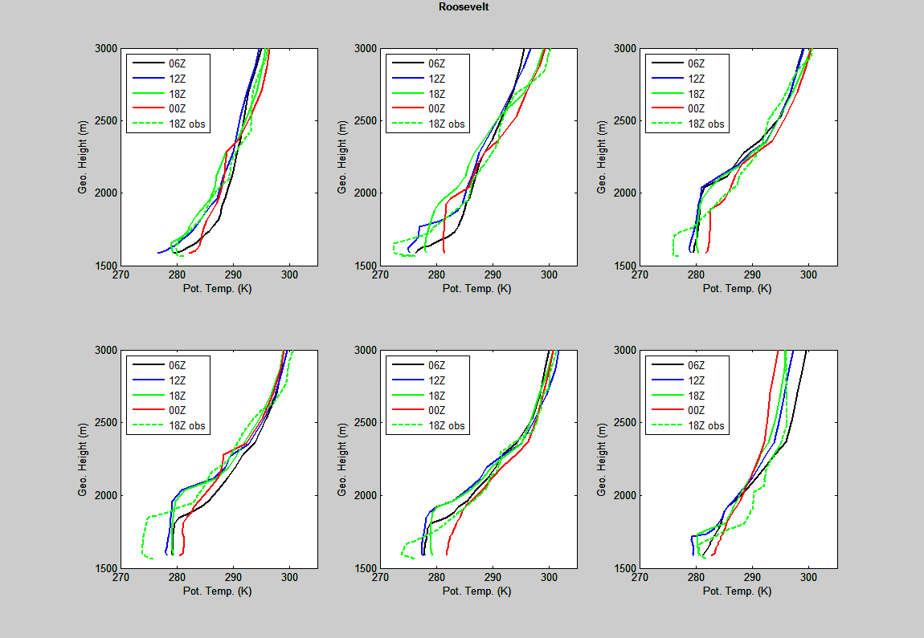
1 Feb 2013
2 Feb 2013
3 Feb 2013
4 Feb 2013
5 Feb 2013
6 Feb 2013

Slide 2
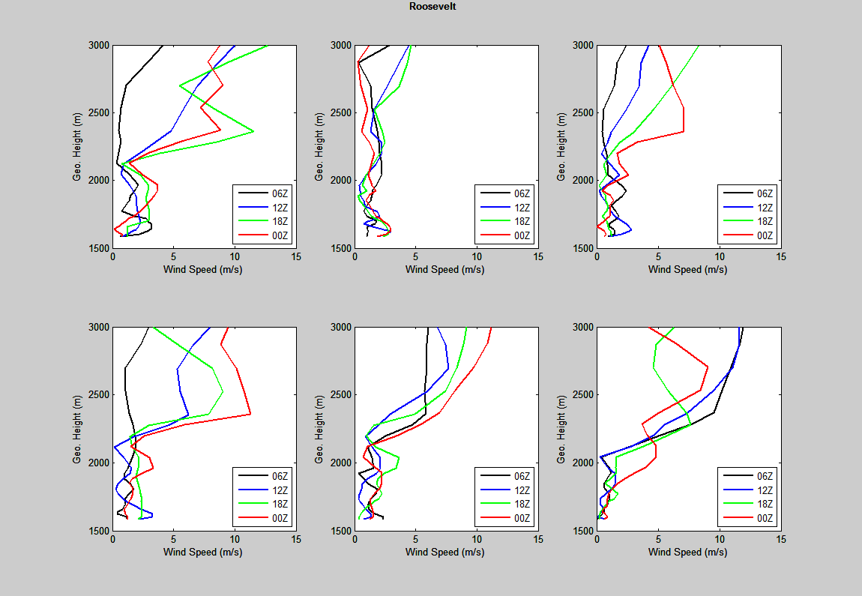
1 Feb 2013
2 Feb 2013
3 Feb 2013
4 Feb 2013
5 Feb 2013
6 Feb 2013

Slide 3
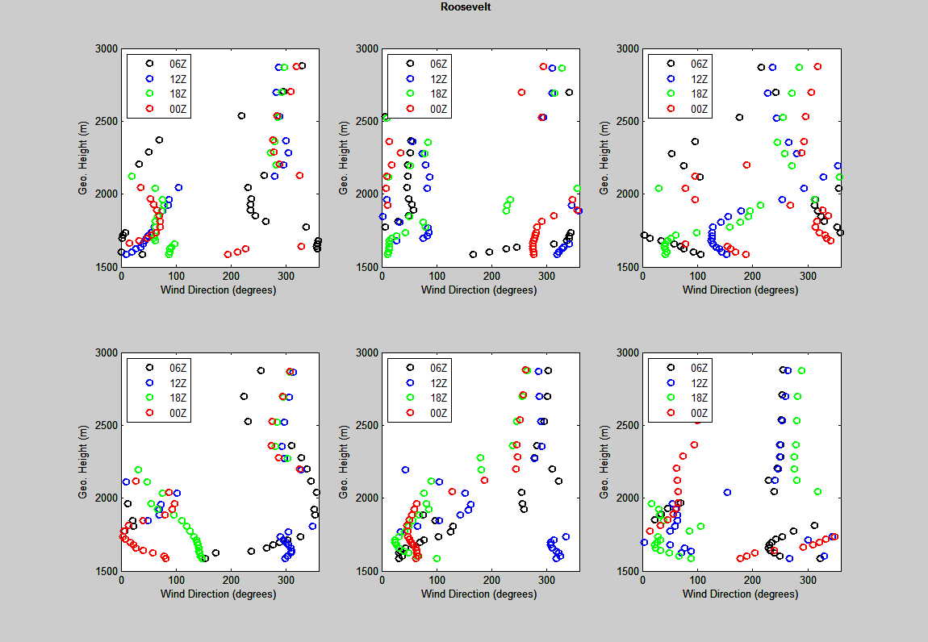
1 Feb 2013
2 Feb 2013
3 Feb 2013
4 Feb 2013
5 Feb 2013
6 Feb 2013

Slide 4
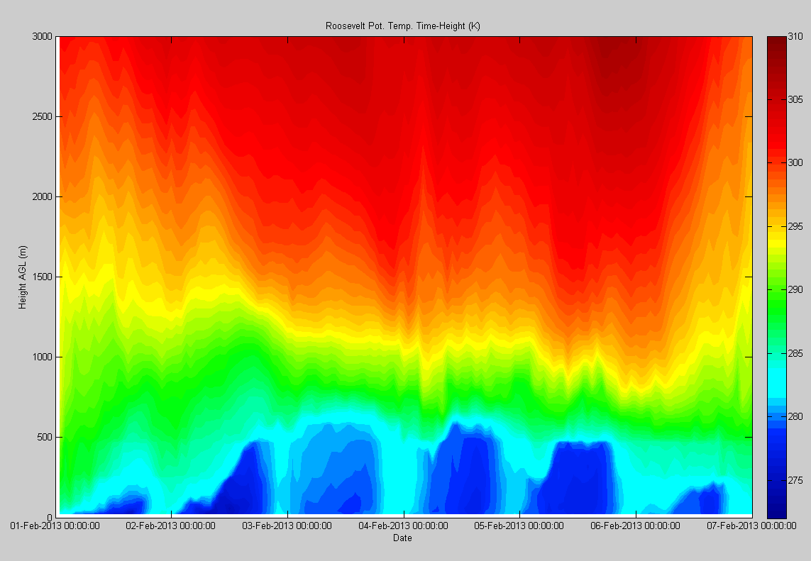

Slide 5
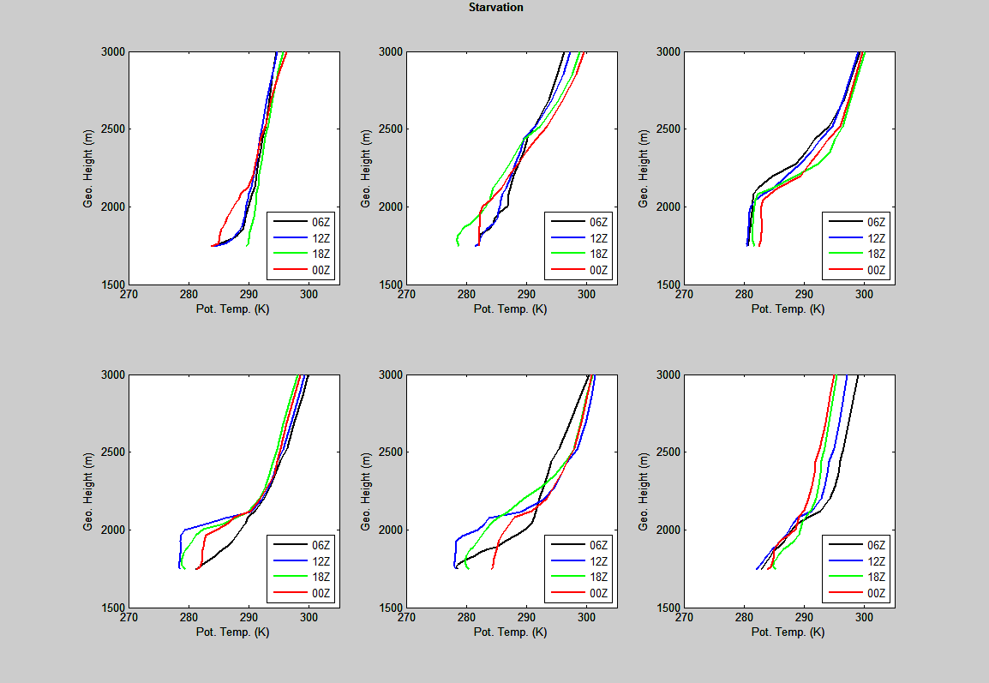
1 Feb 2013
2 Feb 2013
3 Feb 2013
4 Feb 2013
5 Feb 2013
6 Feb 2013

Slide 6
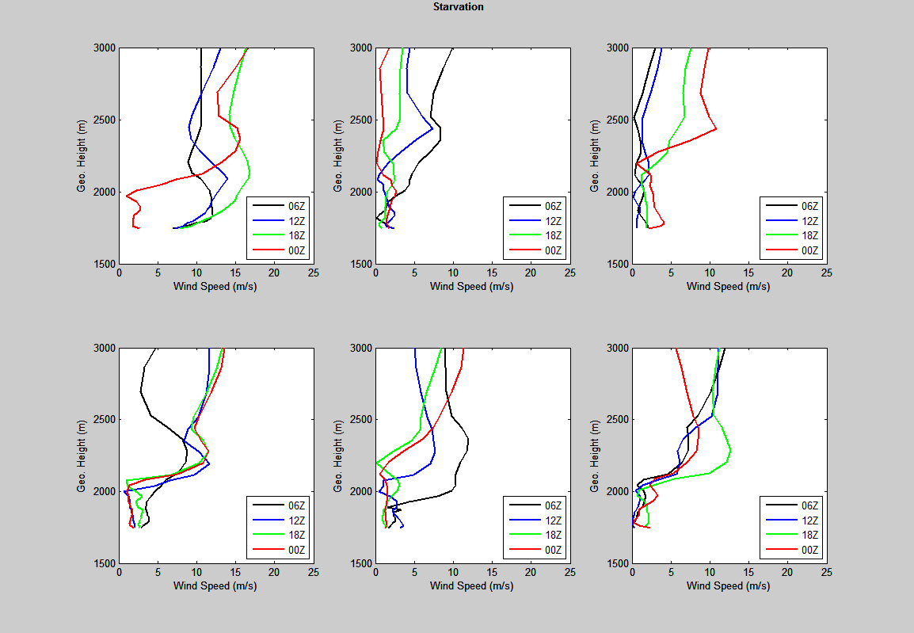
1 Feb 2013
2 Feb 2013
3 Feb 2013
4 Feb 2013
5 Feb 2013
6 Feb 2013

Slide 7
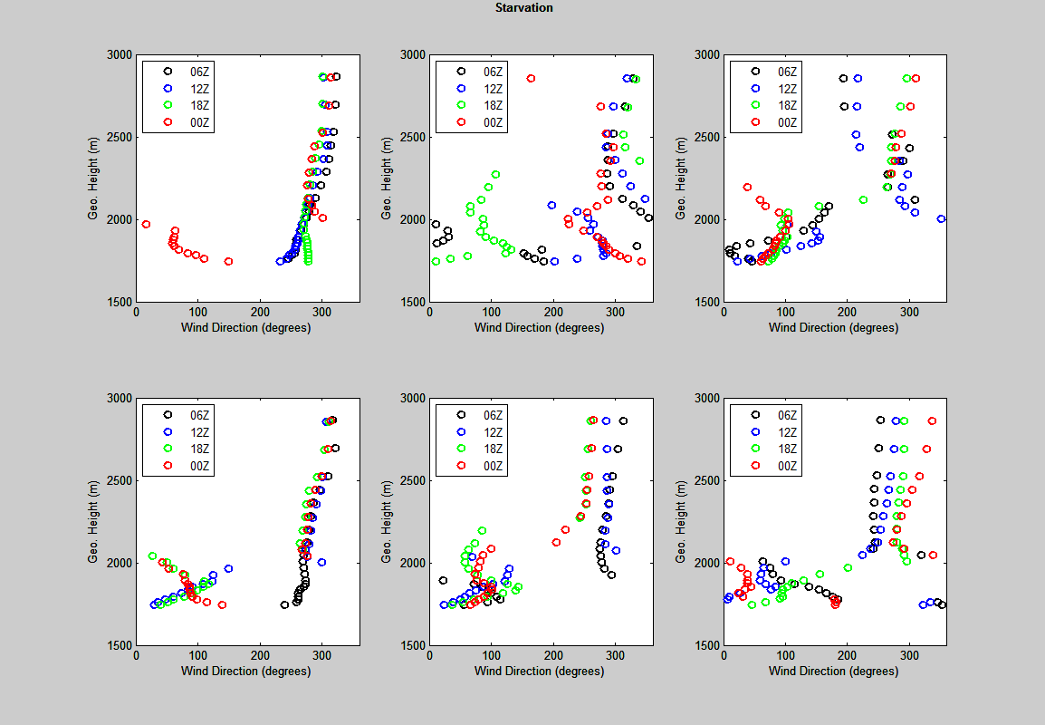
1 Feb 2013
2 Feb 2013
3 Feb 2013
4 Feb 2013
5 Feb 2013
6 Feb 2013

Slide 8
