Slide 1
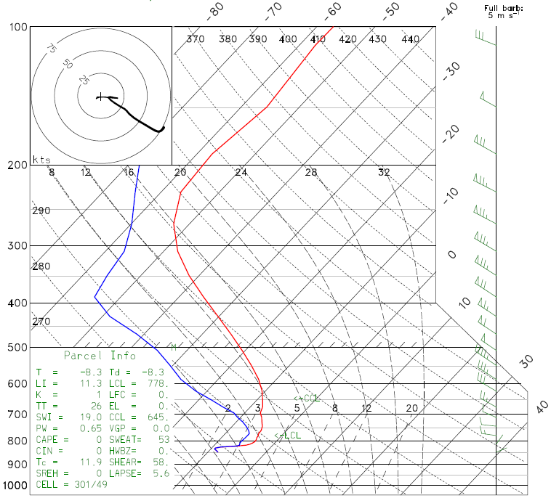
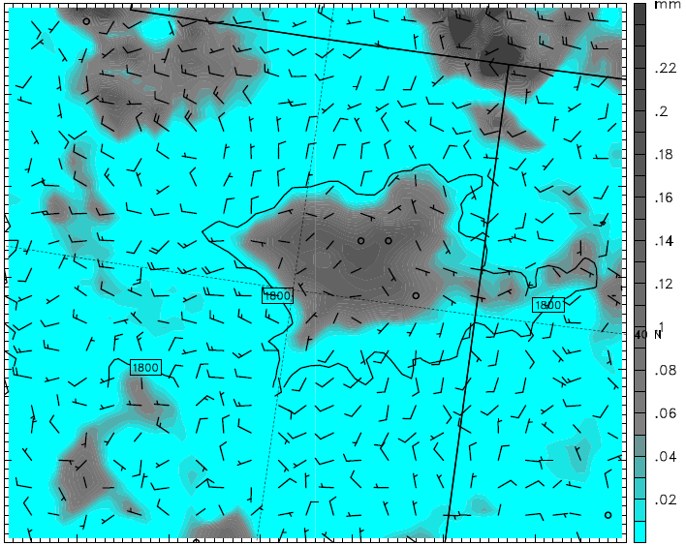
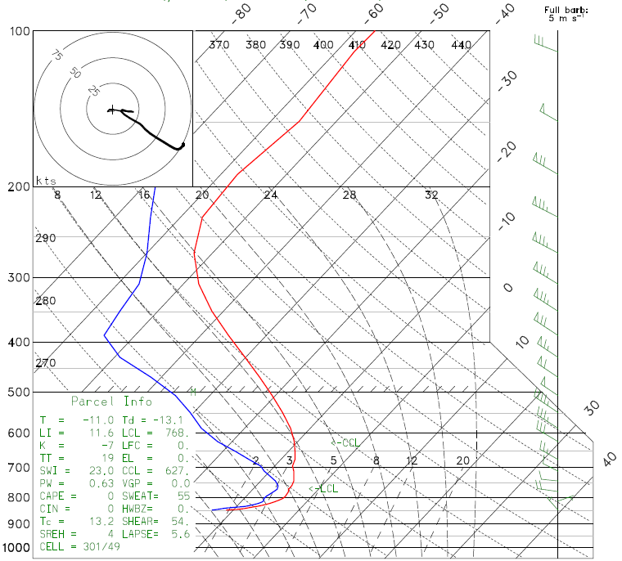
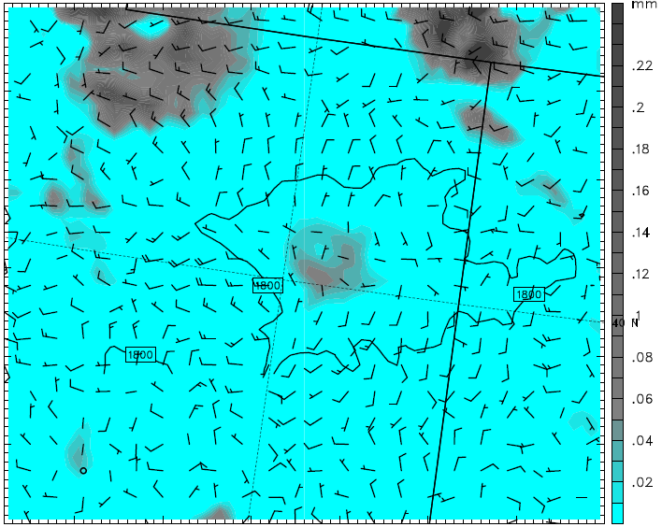
YSU run
1 Feb 2013 12Z
Column-integrated cloud hydrometeors
MYJ run
1 Feb 2013 12Z

Slide 2
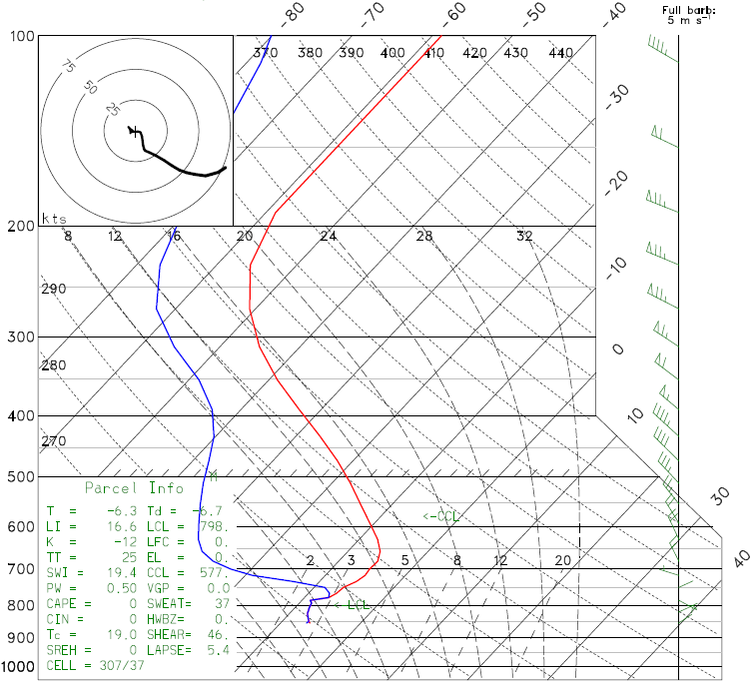
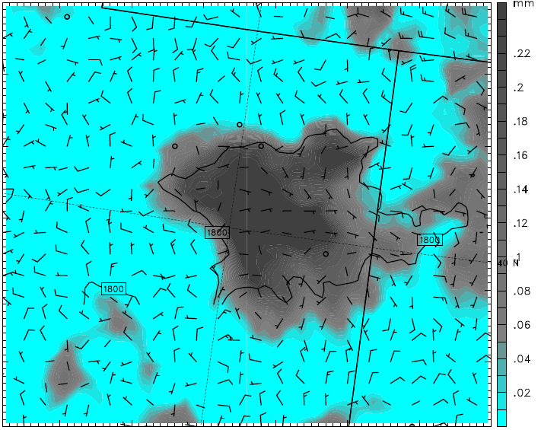
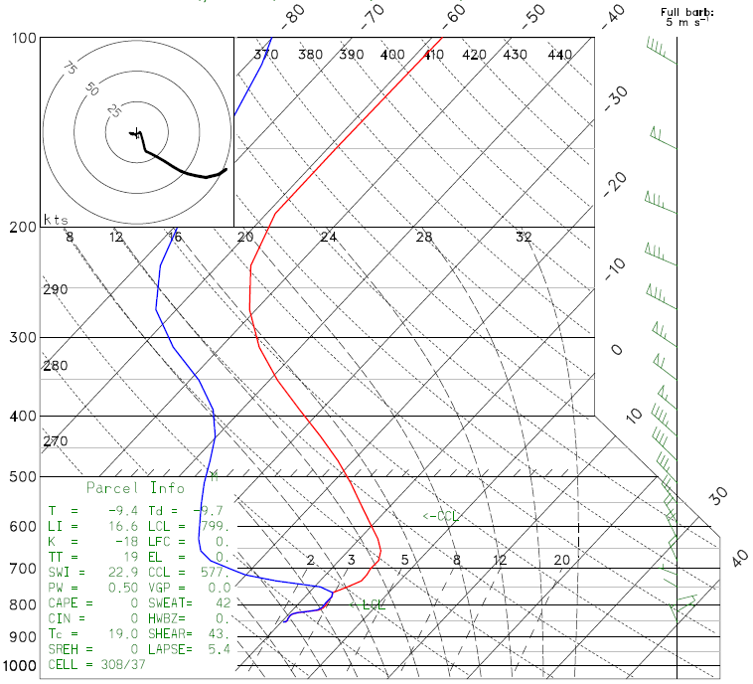
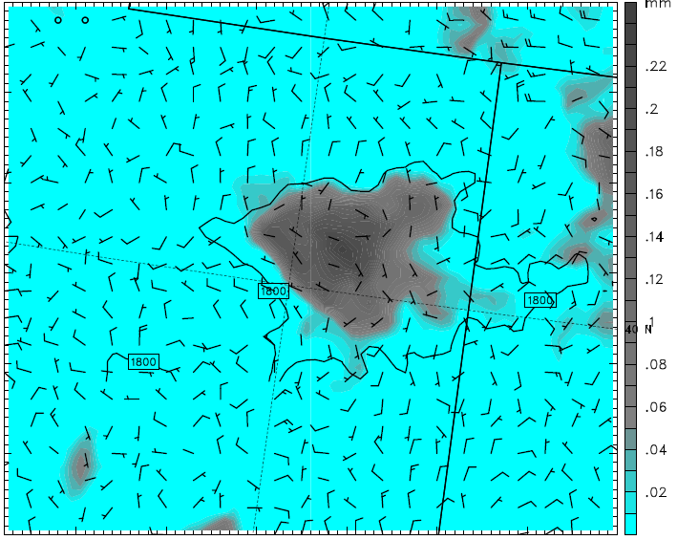
YSU run
2 Feb 2013 12Z
Column-integrated cloud hydrometeors
MYJ run
2 Feb 2013 12Z

Slide 3
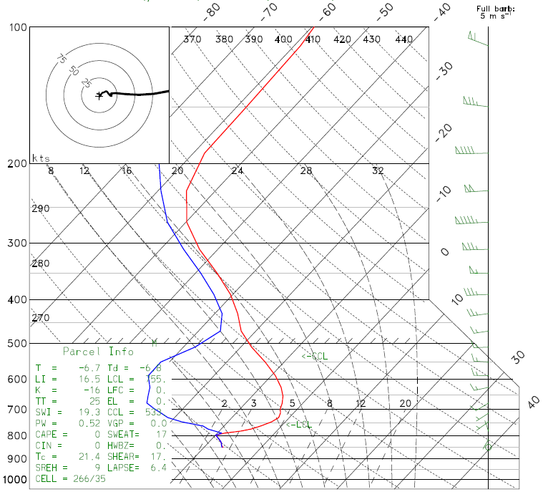
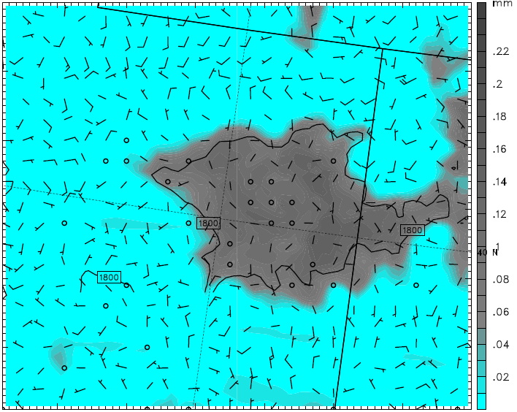
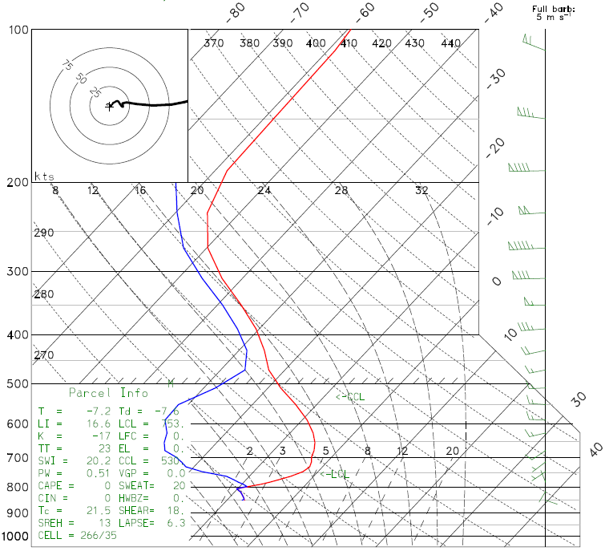
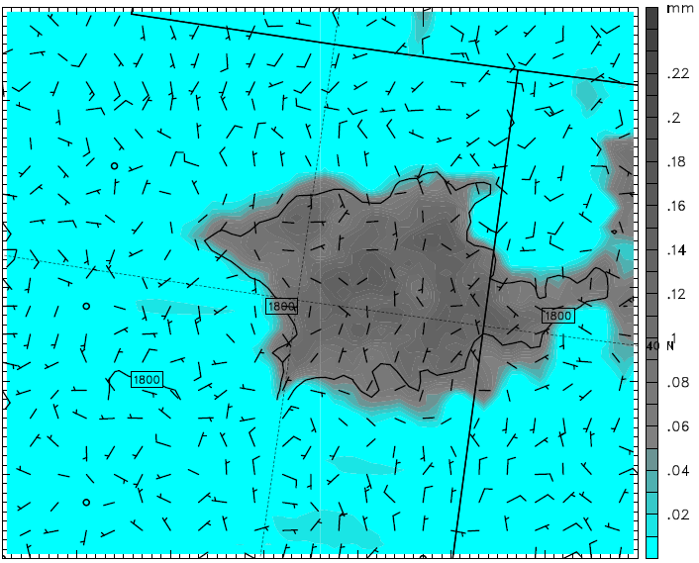
YSU run
3 Feb 2013 12Z
Column-integrated cloud hydrometeors
MYJ run
3 Feb 2013 12Z

Slide 4
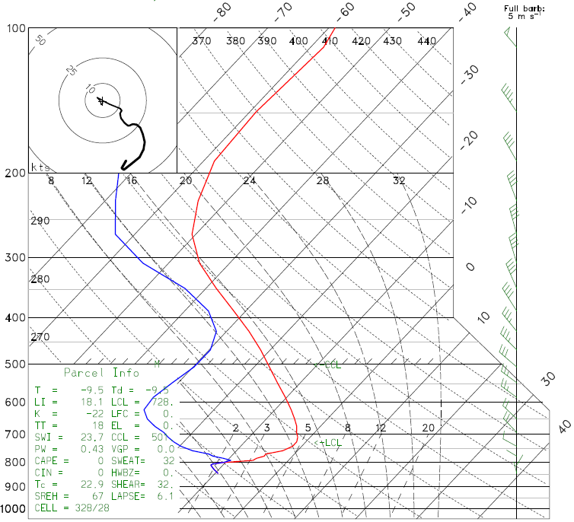
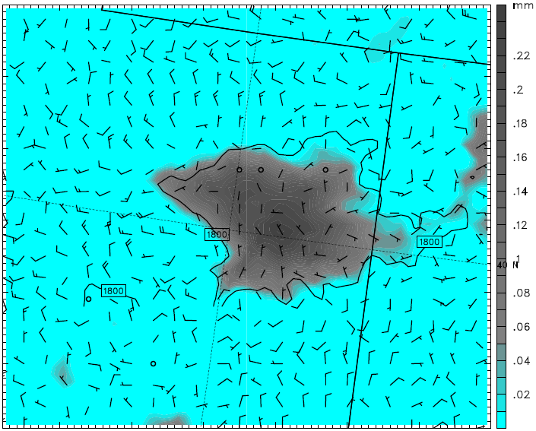
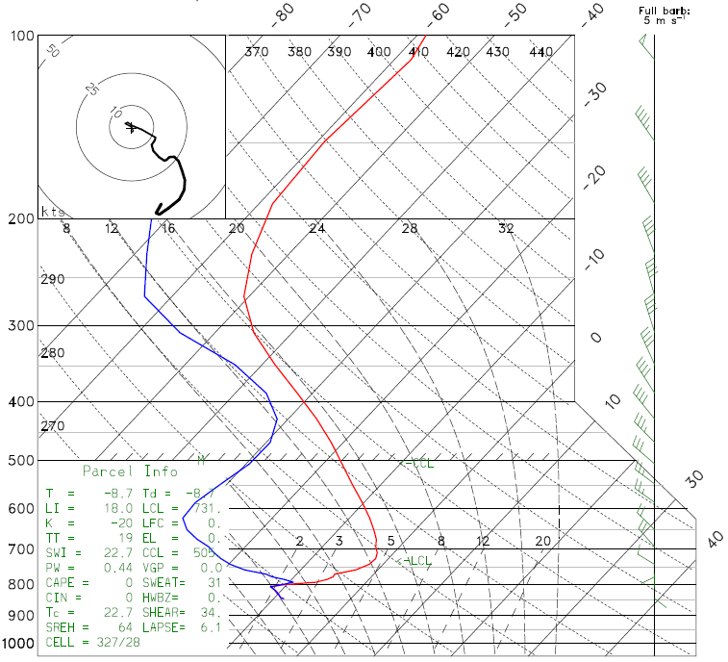
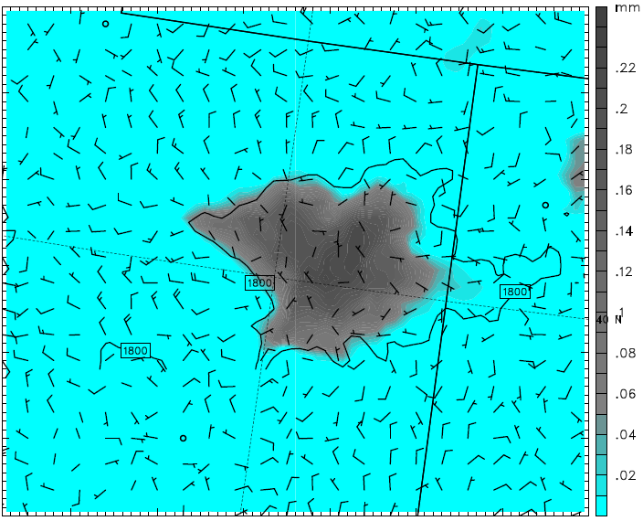
YSU run
4 Feb 2013 12Z
Column-integrated cloud hydrometeors
MYJ run
4 Feb 2013 12Z

Slide 5
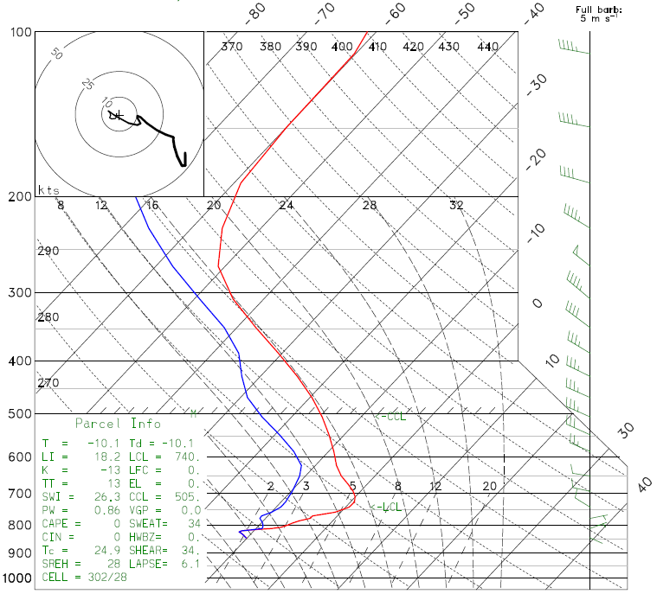
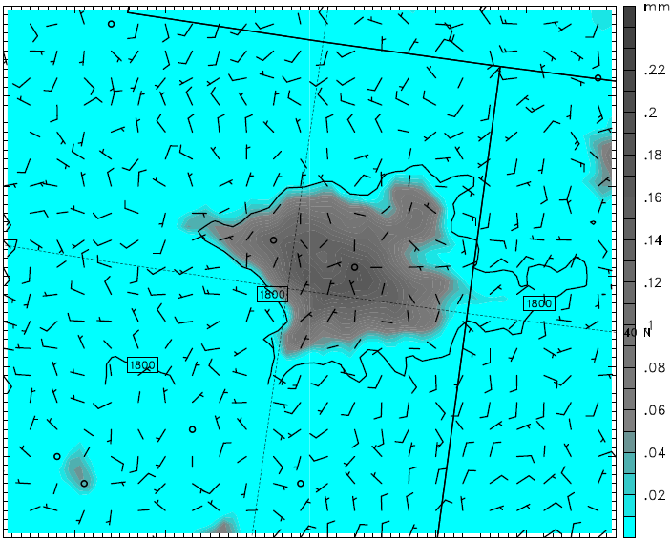
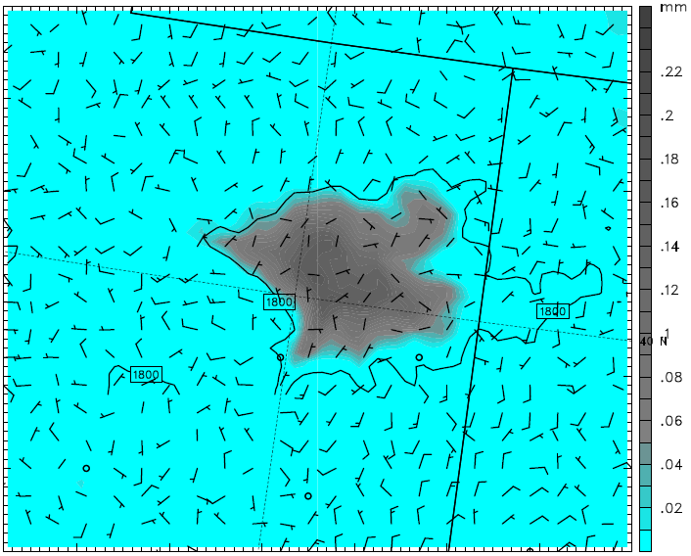
YSU run
5 Feb 2013 12Z
Column-integrated cloud hydrometeors
MYJ run
5 Feb 2013 12Z

Slide 6
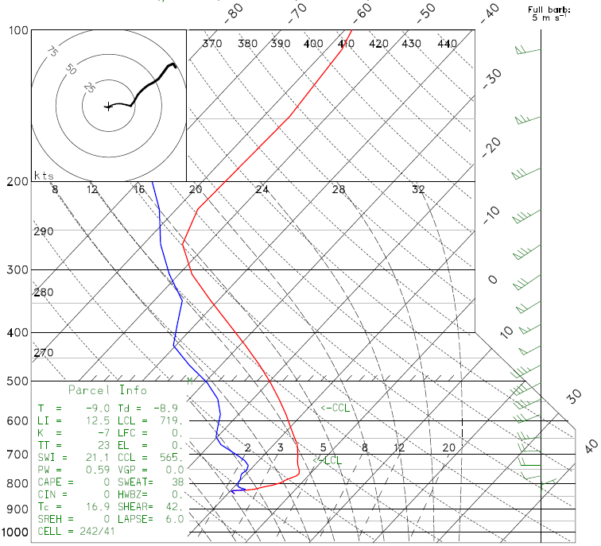
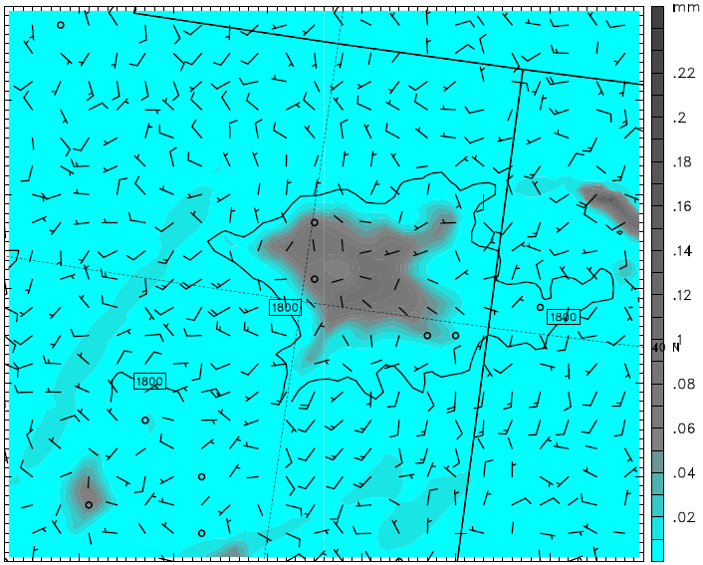
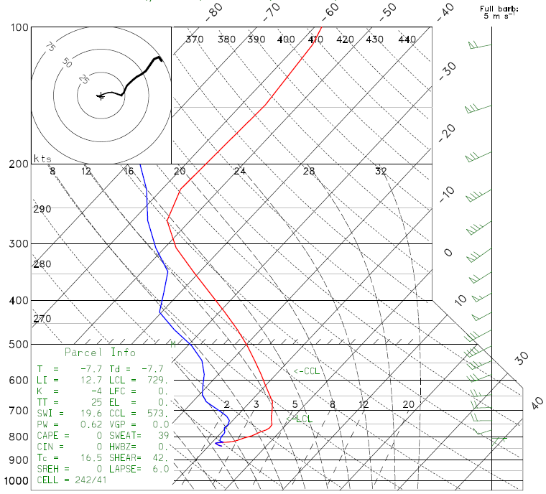
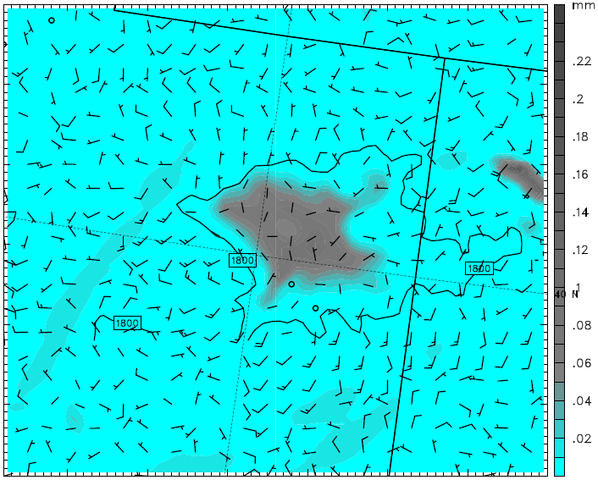
YSU run
6 Feb 2013 12Z
Column-integrated cloud hydrometeors
MYJ run
6 Feb 2013 12Z

