Slide 1
Leg-like Precipitation Feature as seen on
Camera, Radar, IR, and IMERG

Slide 2
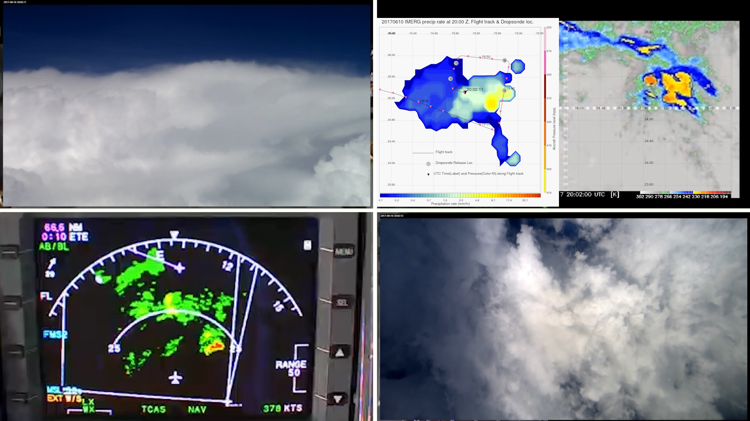
Time : 20:00:00 UTC - What makes up this Leg-like feature.

Slide 3
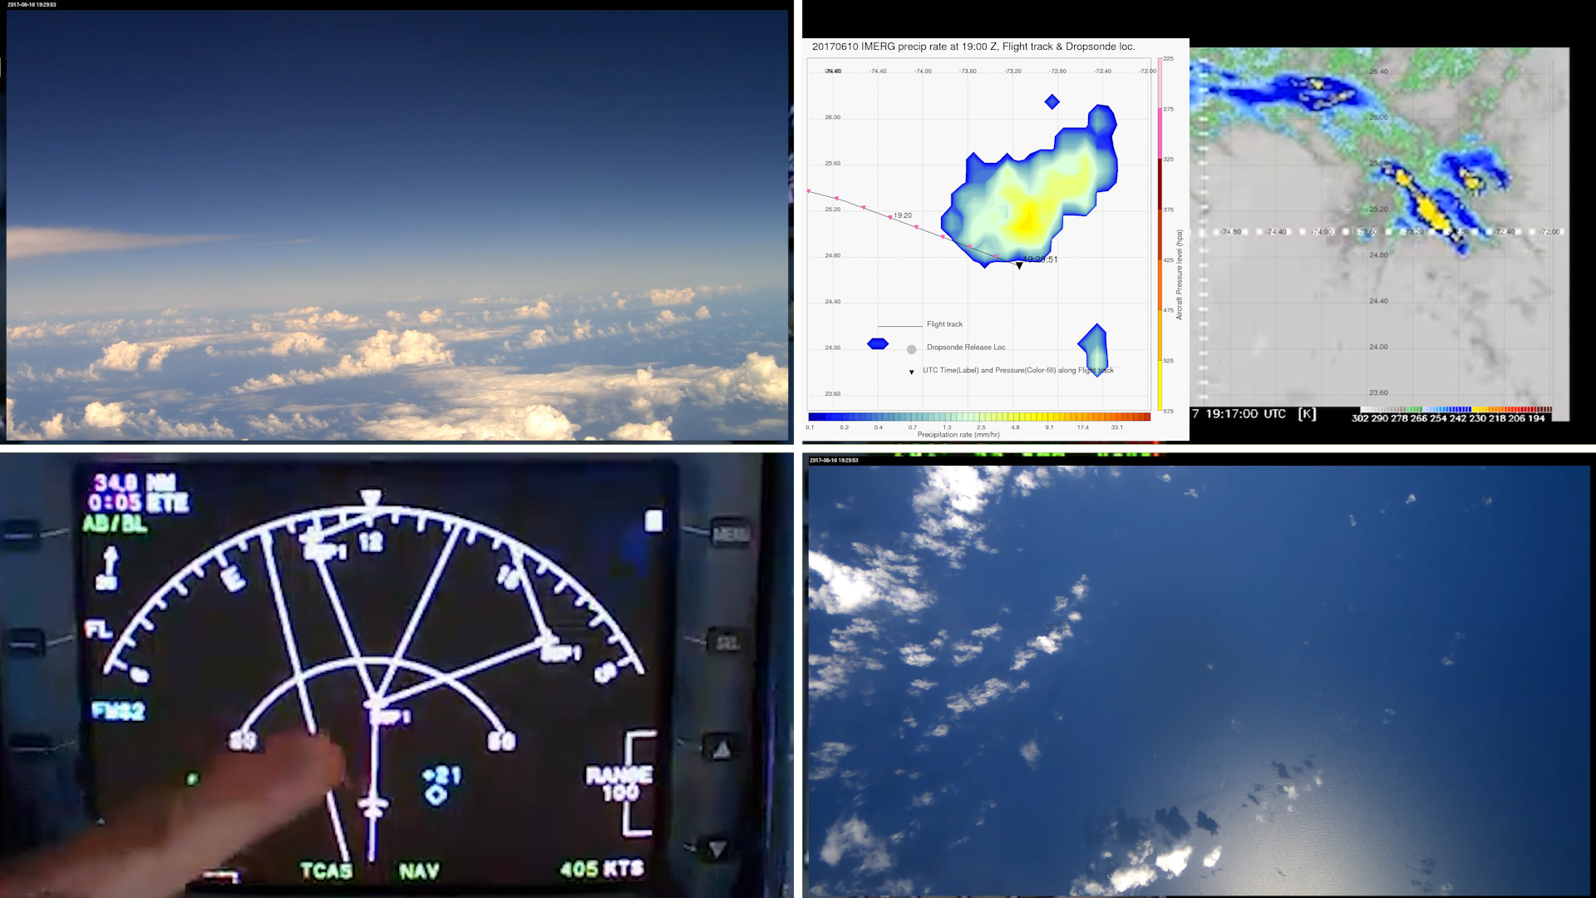
Time : 19:28:51 UTC - Looking into east - shallow scattered cumulus.

Slide 4
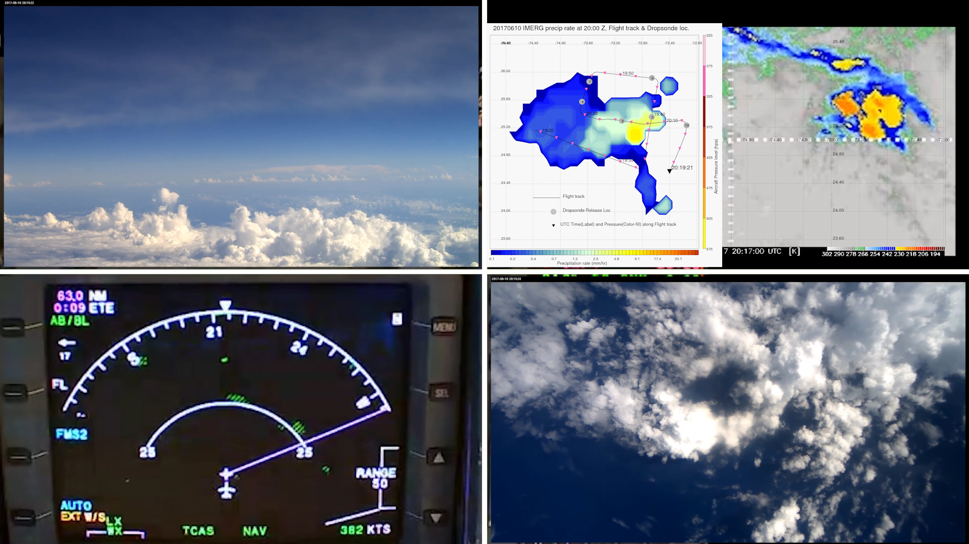
Time : 20:19:21 UTC - Looking at 210 degrees - Line of moderately deep cumulus, seen on forward camera, radar and IR.

Slide 5
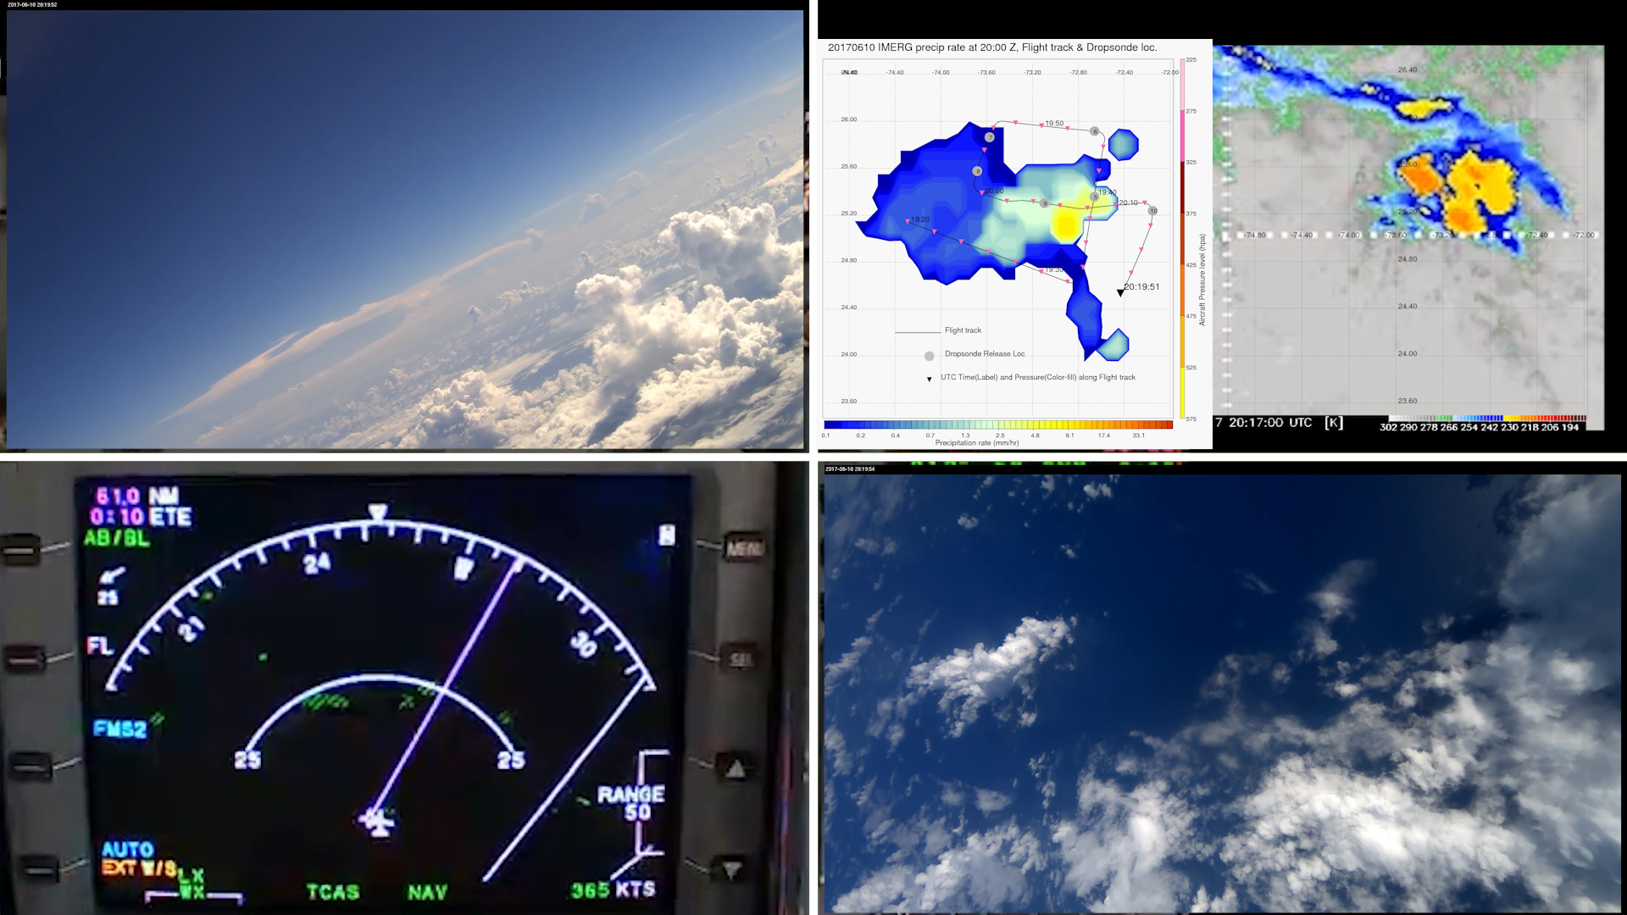
Time : 20:19:51 UTC - Looking at 250 degrees - Line of moderately deep cumulus, seen on forward camera, radar, and IR.

Slide 6
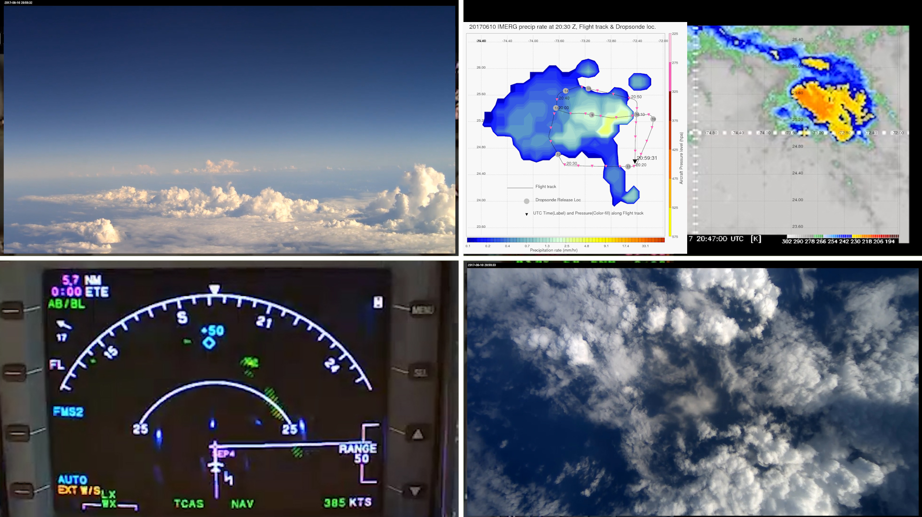
Time : 20:59:31 UTC - Looking at 190 degrees - Line of moderately deep cumulus, seen on forward camera, radar and IR.

Slide 7
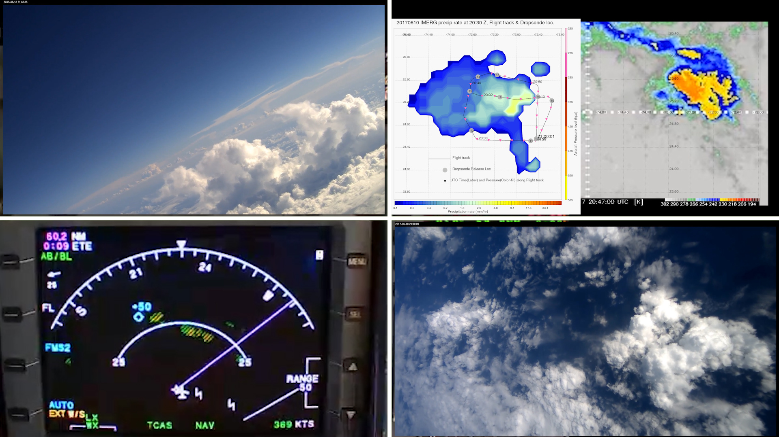
Time : 21:00:01 UTC - Looking at 230 degrees - Line of moderately deep cumulus, seen on forward camera, radar, and IR.

Slide 8
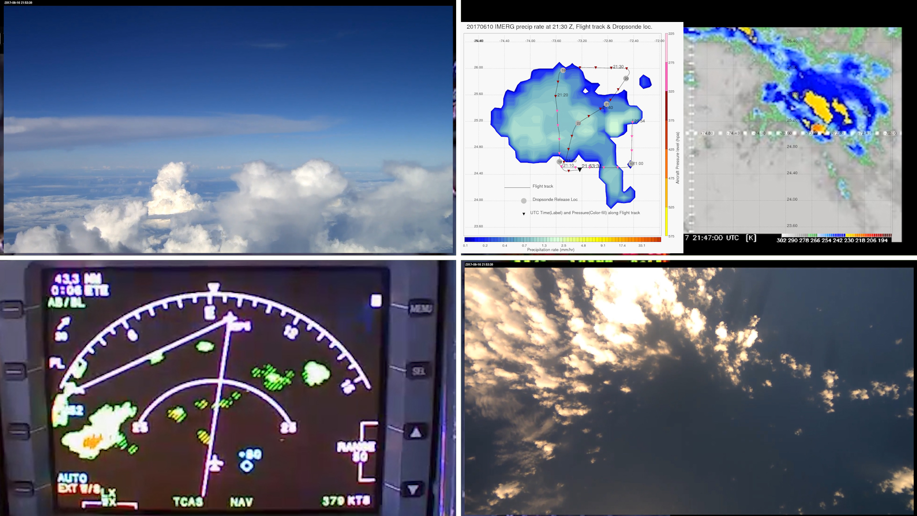
Time : 21:53:31 UTC - Looking at 90 degrees from west - Line of moderately deep cumulus, seen on forward camera, radar, and IR.

