Slide 1
Convection as seen on
Camera, Radar, IR, and IMERG

Slide 2
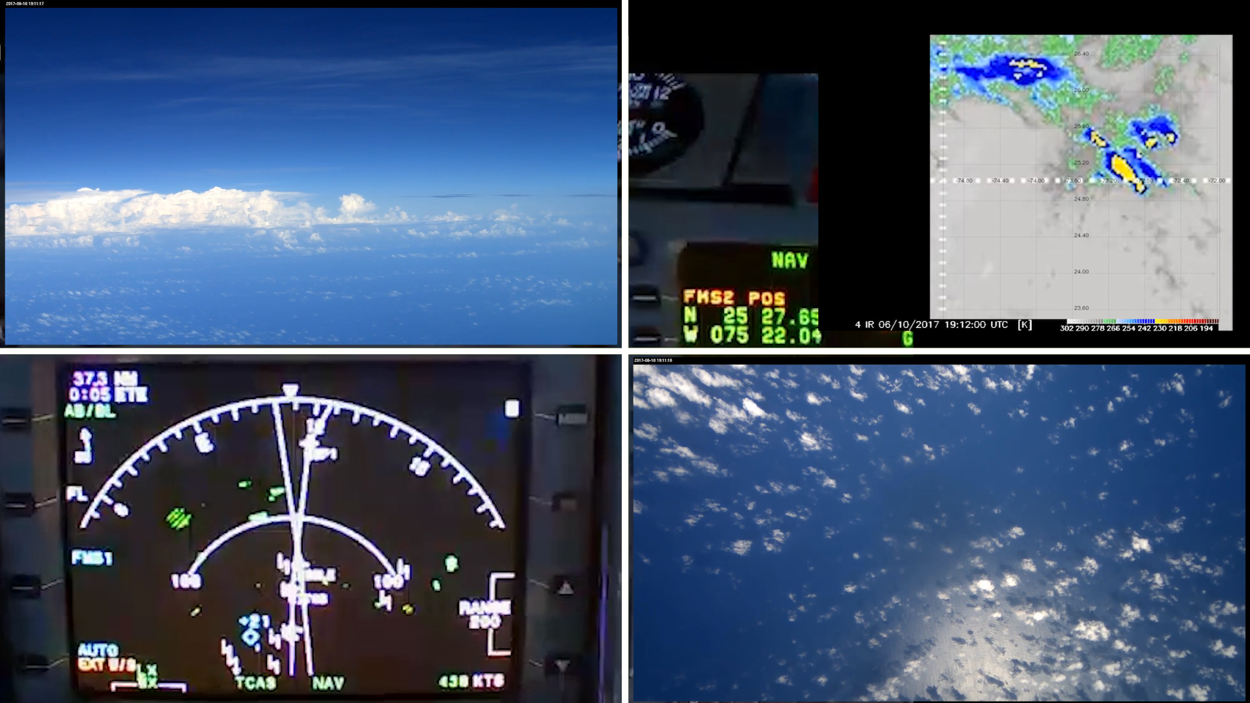
Time : 19:11:16 UTC - Approaching the system

Slide 3
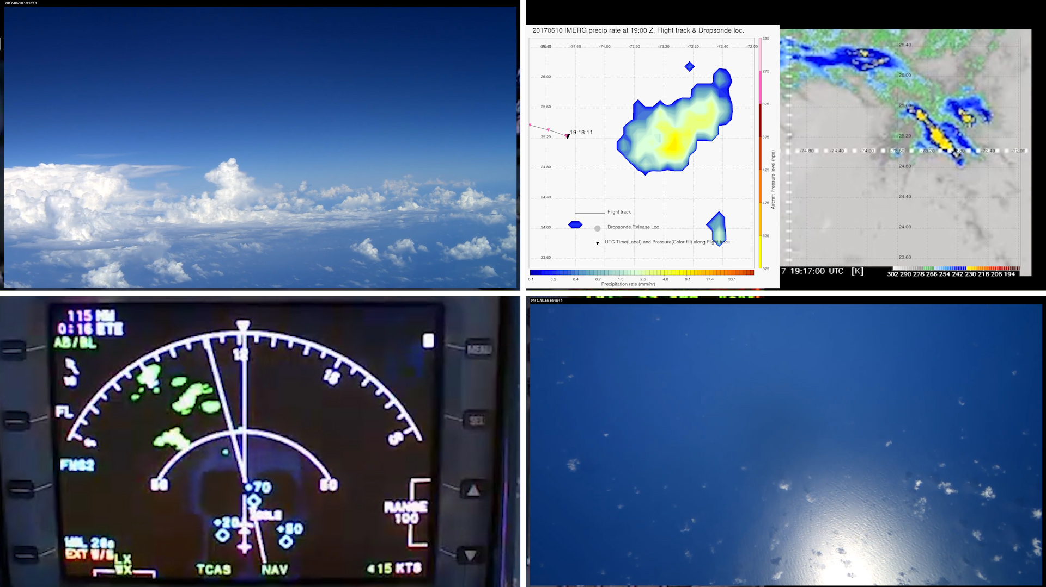
Time : 19:18:11 UTC - Convection seen on Radar vs IR vs IMERG
The radar reflectivity matches the deep clouds in IR image very well. IMERG too captures this deep convection.

Slide 4
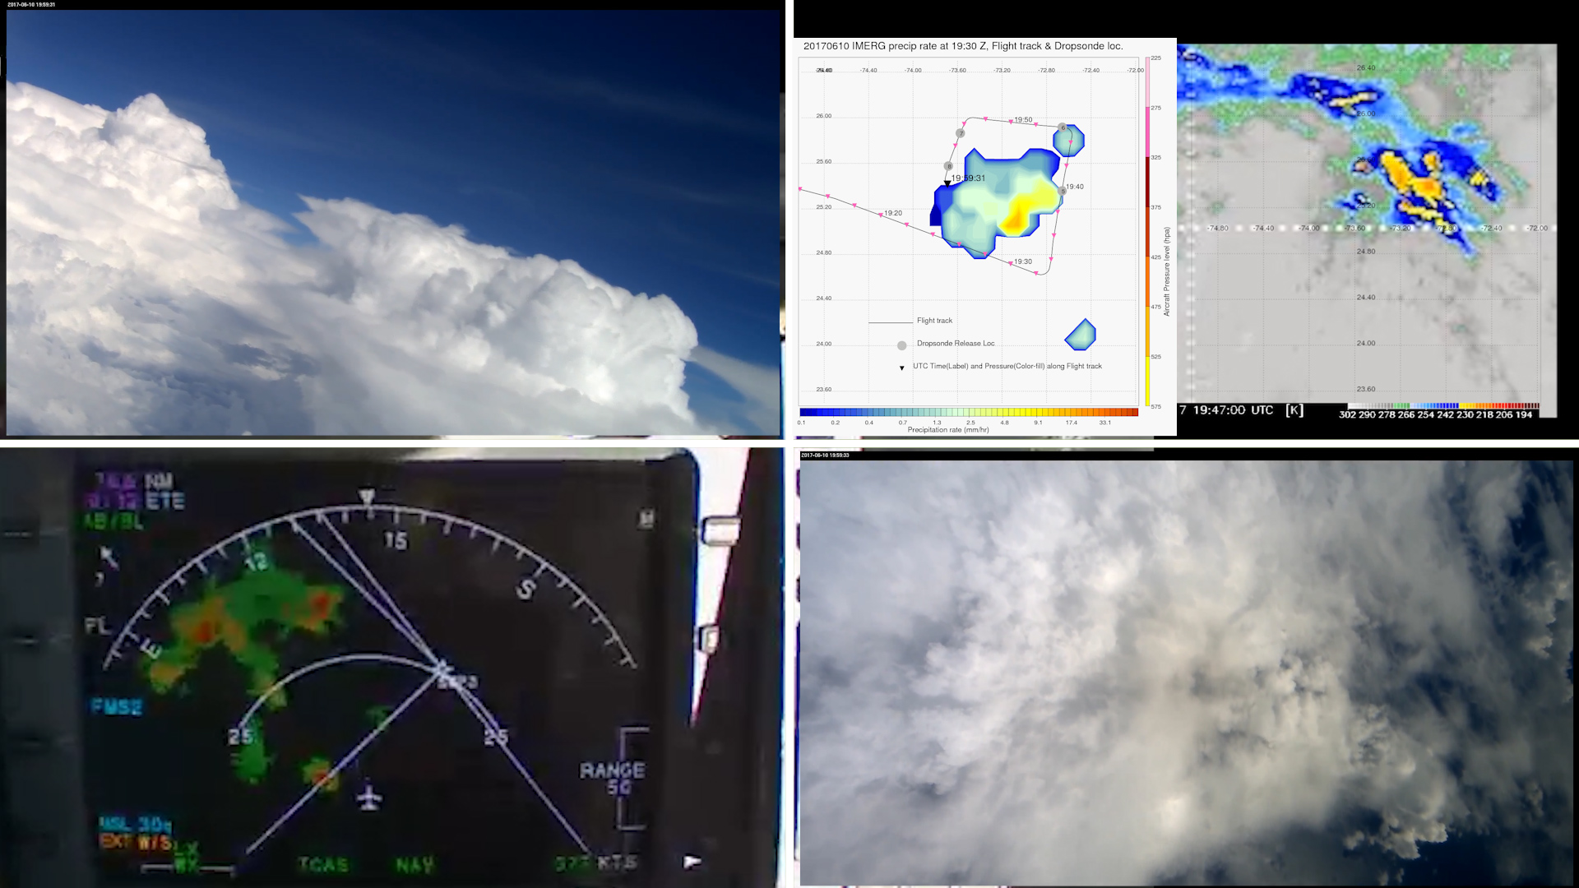
Time : 19:59:31 UTC - Beautiful cumulus towers
Navigating between the towers circled on the IR image

Slide 5
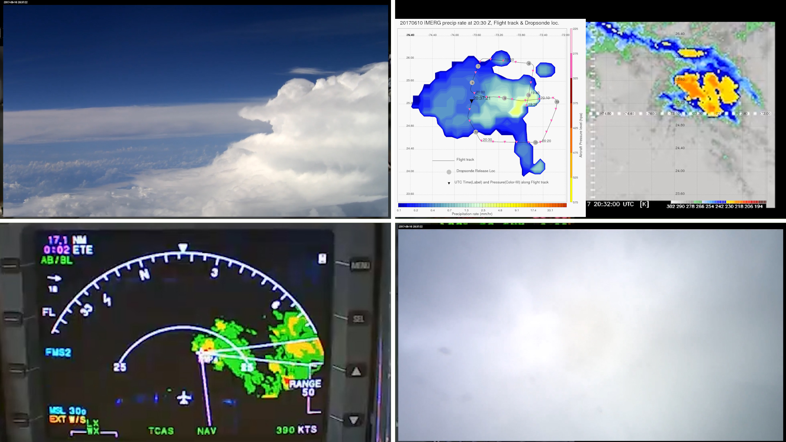
Time : 20:37:21 UTC - Beautiful cumulus towers
Radar, IR and IMERG matches very well. Tower circled on the IR image.

Slide 6
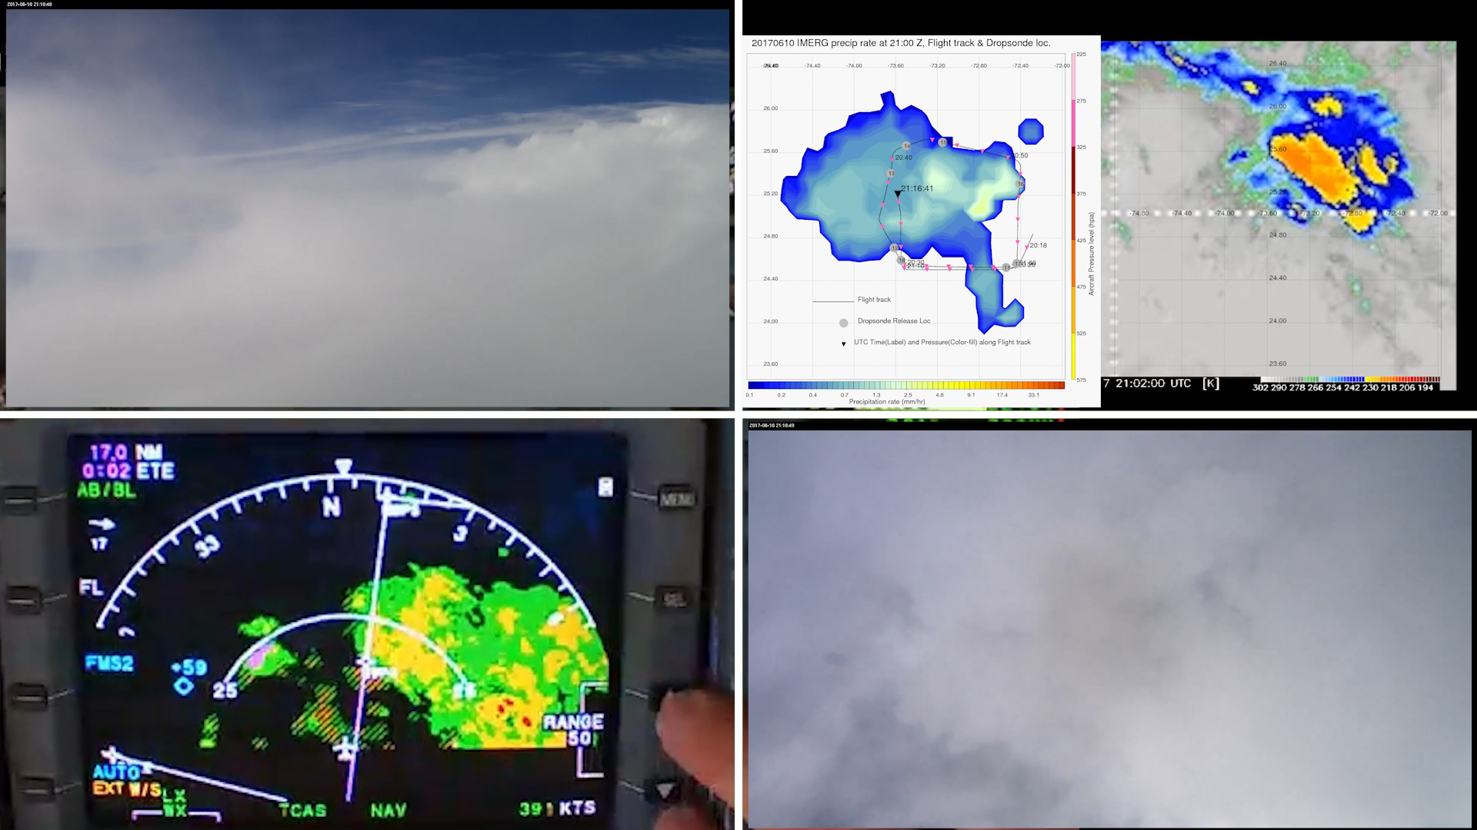
Time : 21:16:41 UTC - Wide spread Convection

Slide 7
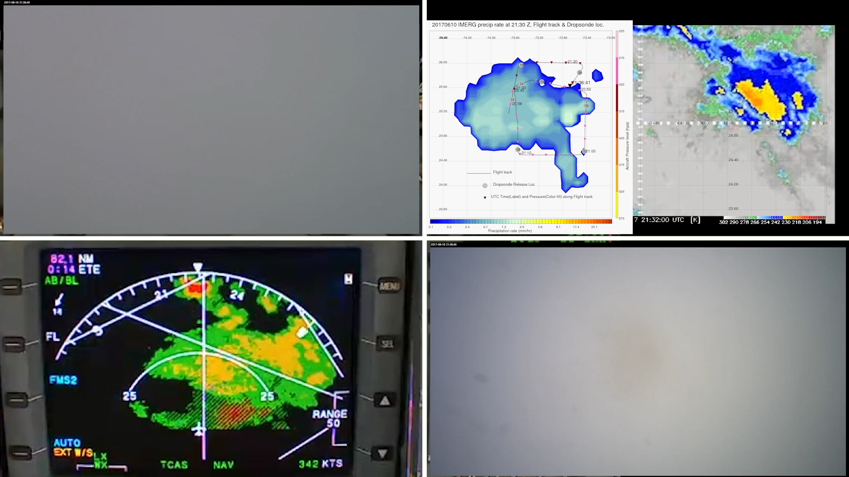
Time : 21:36:41 UTC - Wide spread Convection

Slide 8
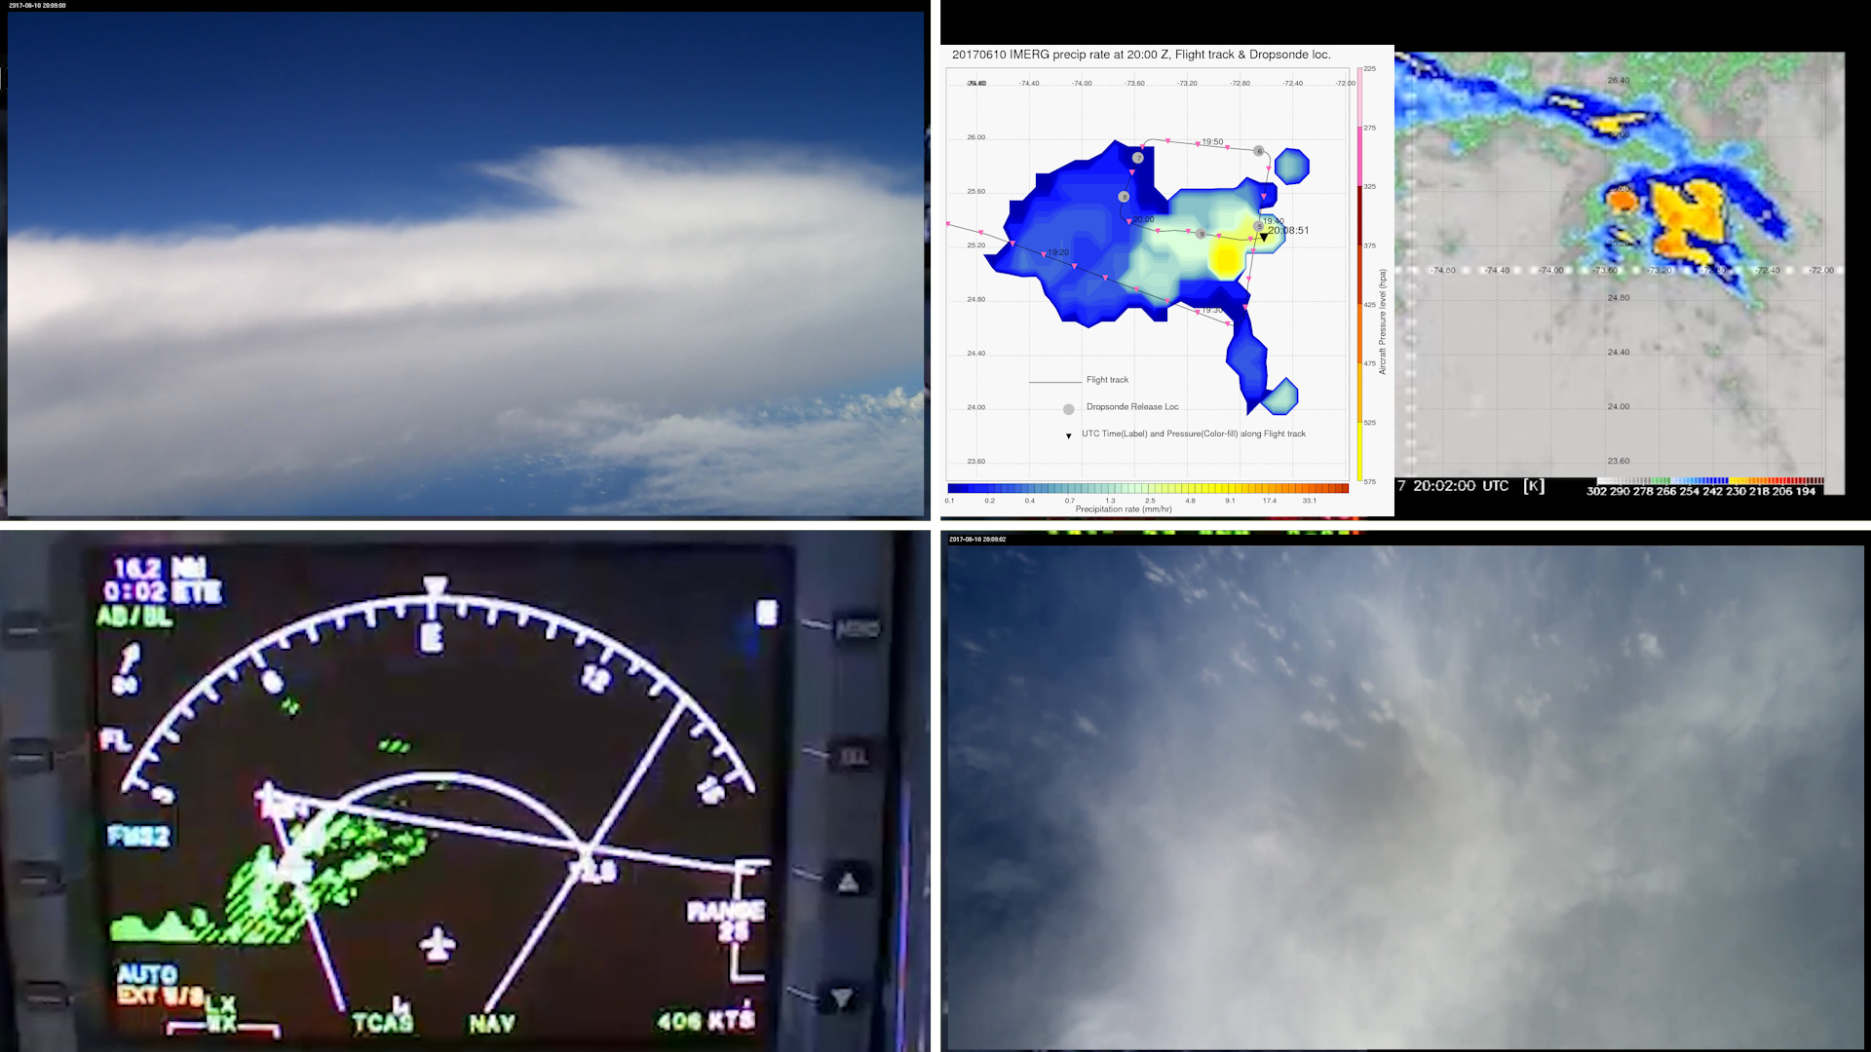
Time : 20:08:51 UTC - IMERG is a time integrated product
Not a Deep Convection at the current aircraft location seen from the camera and IR but IMERG shows a strong precipitation. It shows up later in time - see next slide (IMERG is time integrated product)

Slide 9
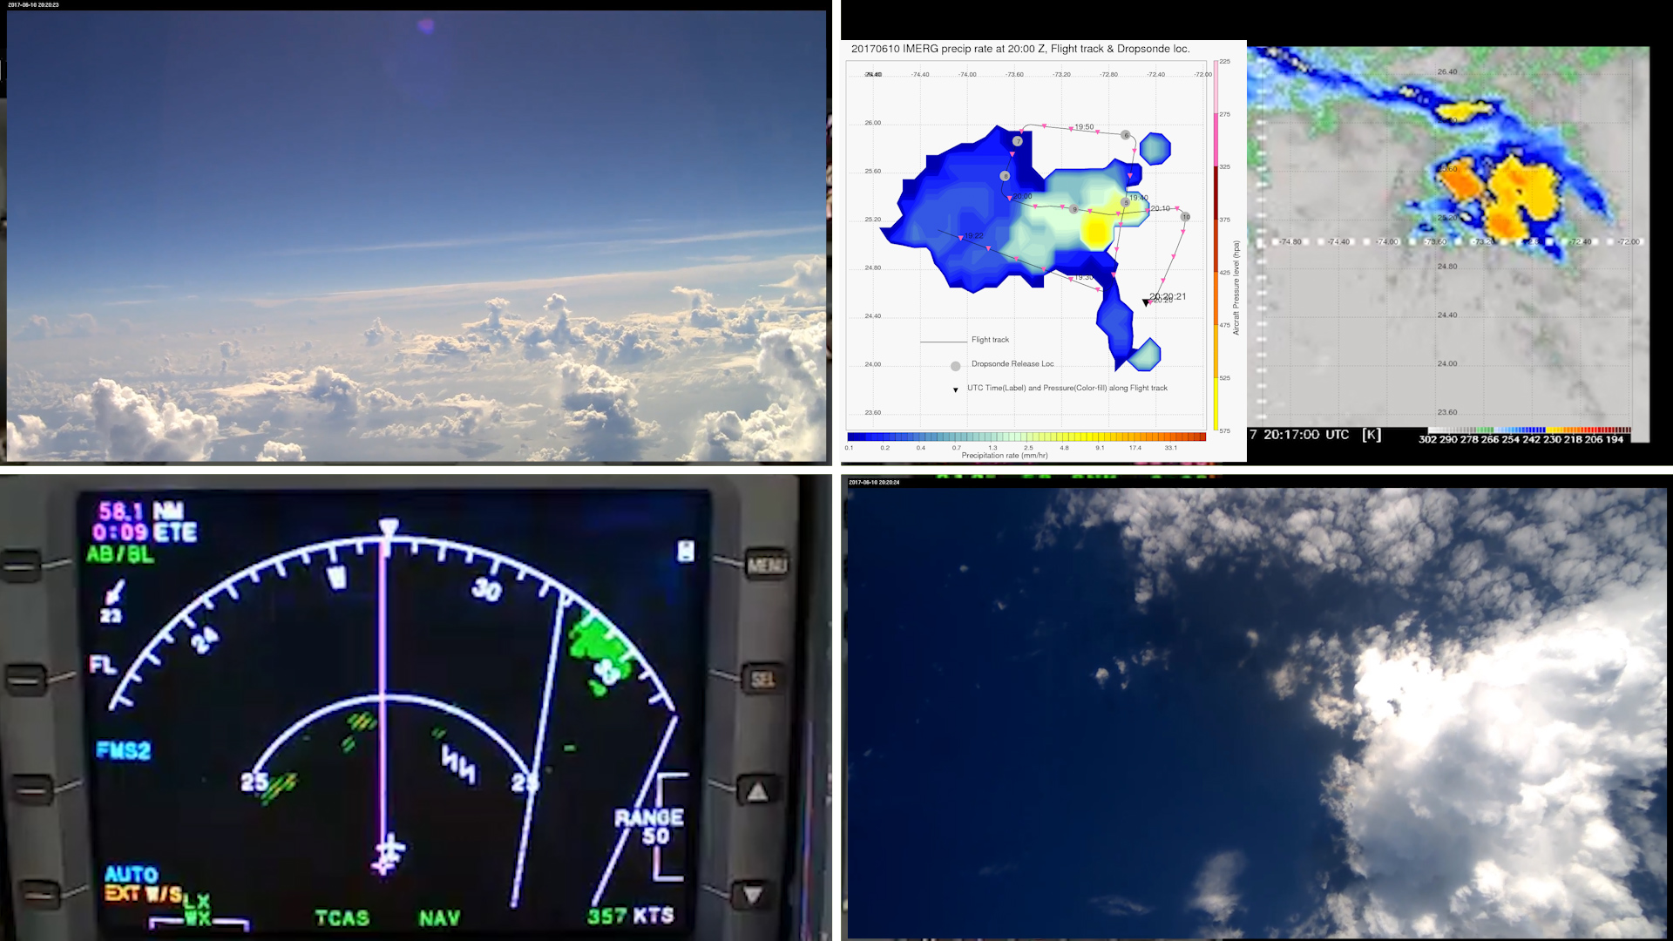
Time : 20:20:21 UTC - IMERG is a time integrated product

Slide 10
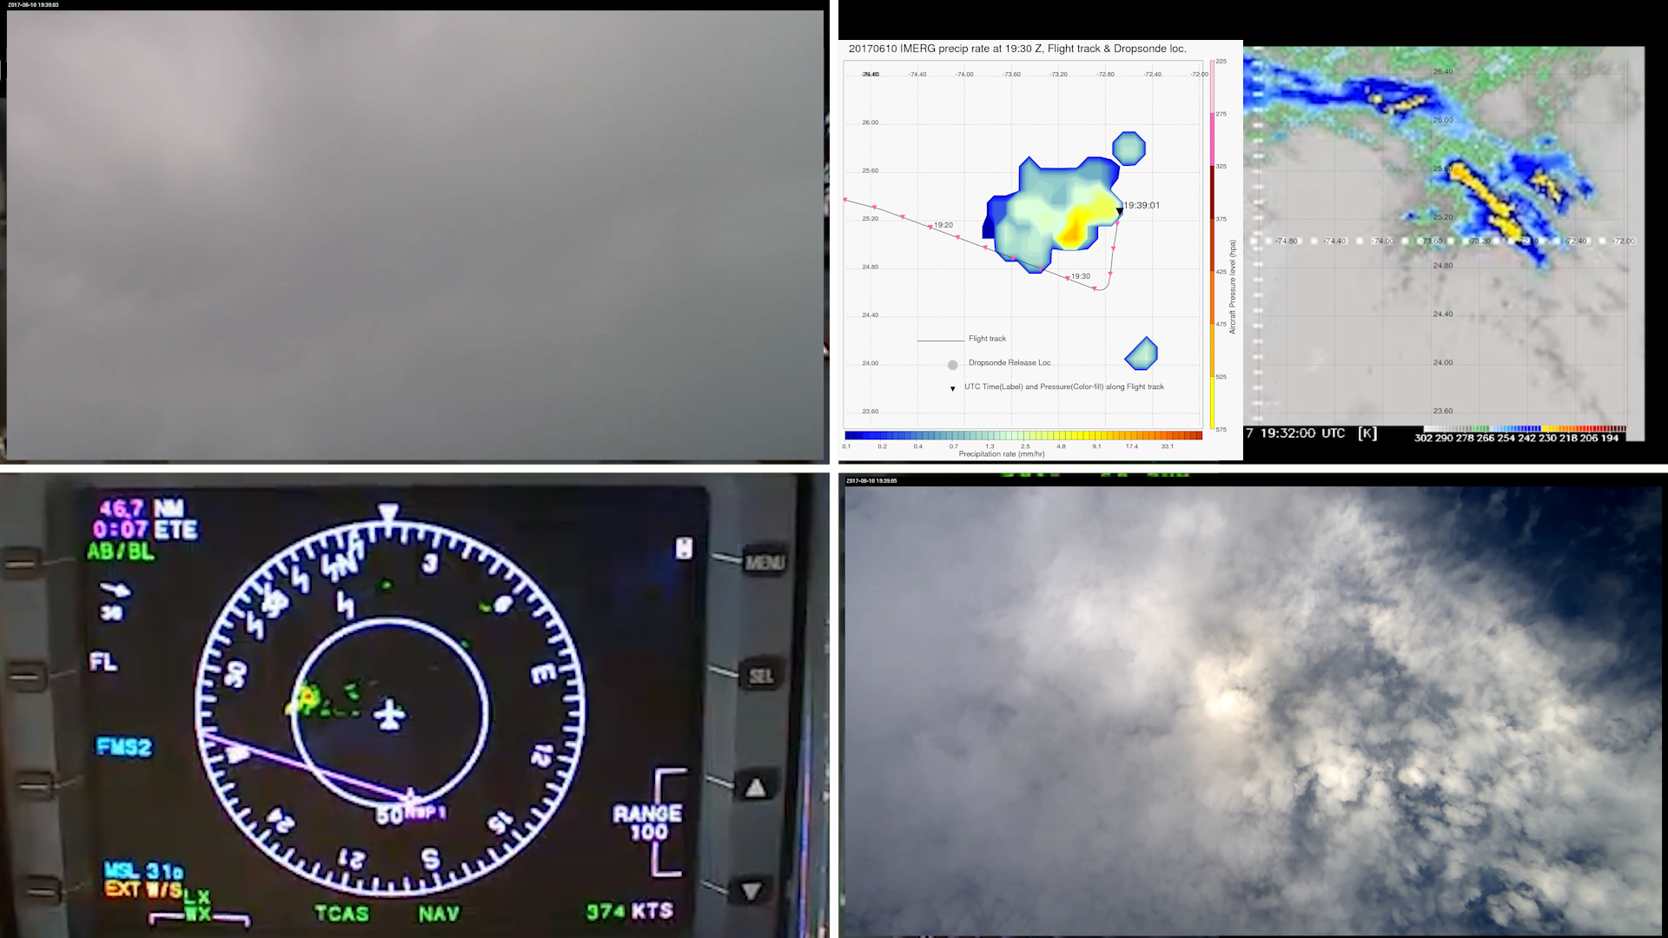
Time : 19:39:01 UTC - Another example of time integration of IMERG
IMERG shows anvil as precipitation.

Slide 11
Time : 19:59:31 UTC

Slide 12
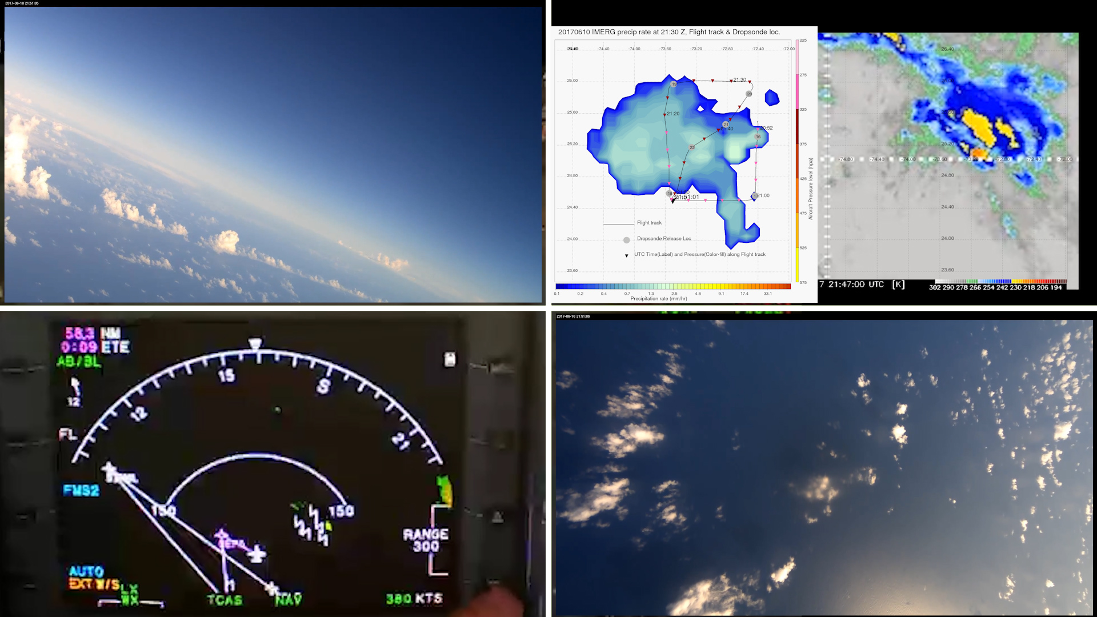
Time : 21:51:01 UTC - Is front camera seeing a cold pool boundary?

Slide 13
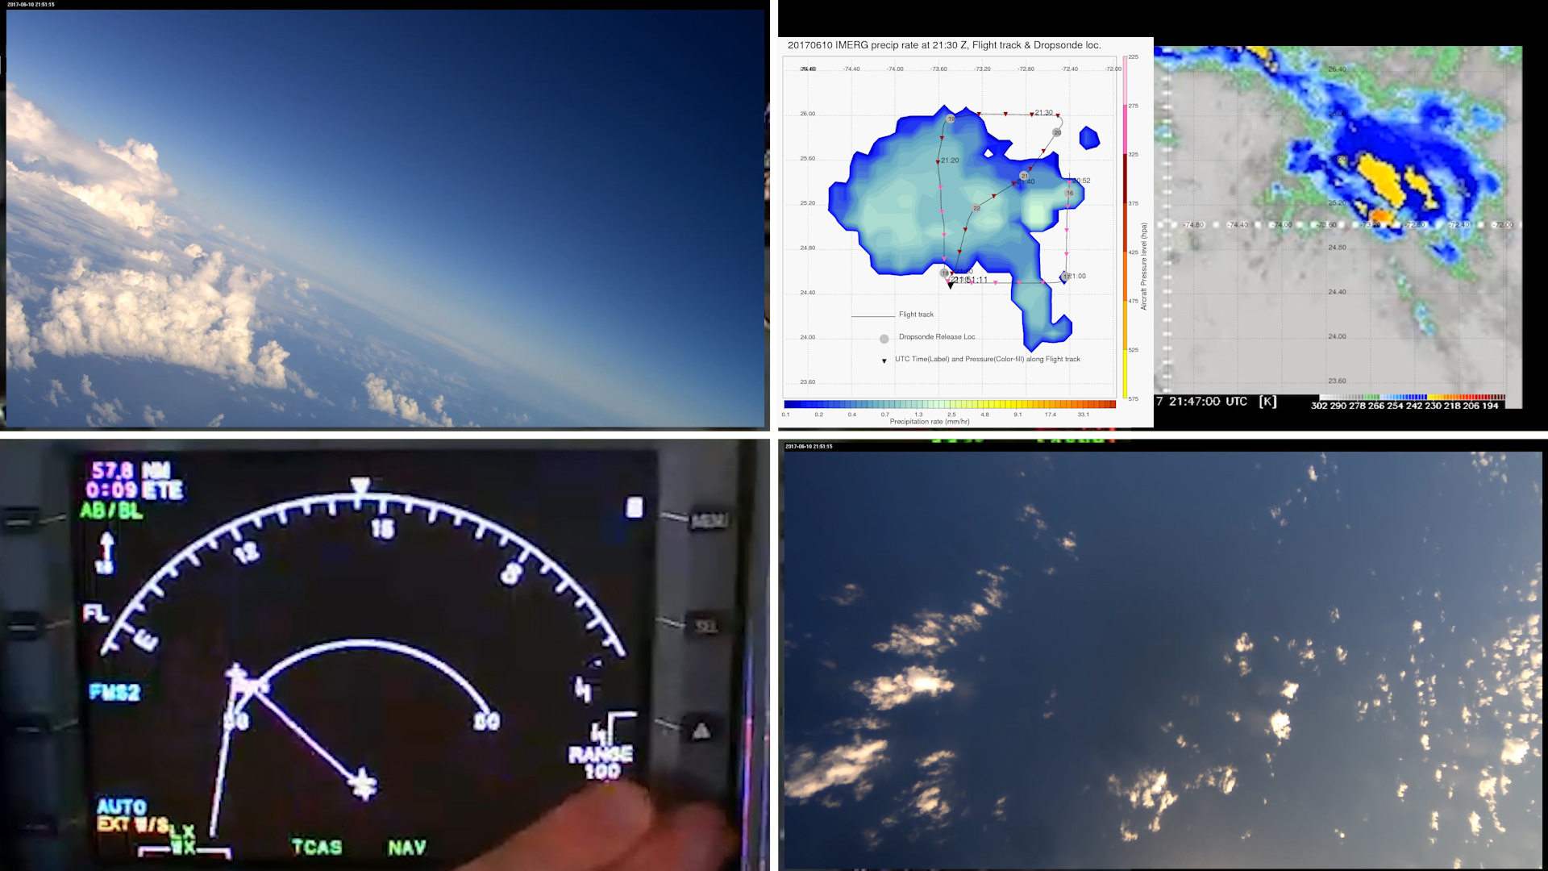
Time : 21:51:11 UTC - Is front camera seeing a cold pool boundary?

Slide 14
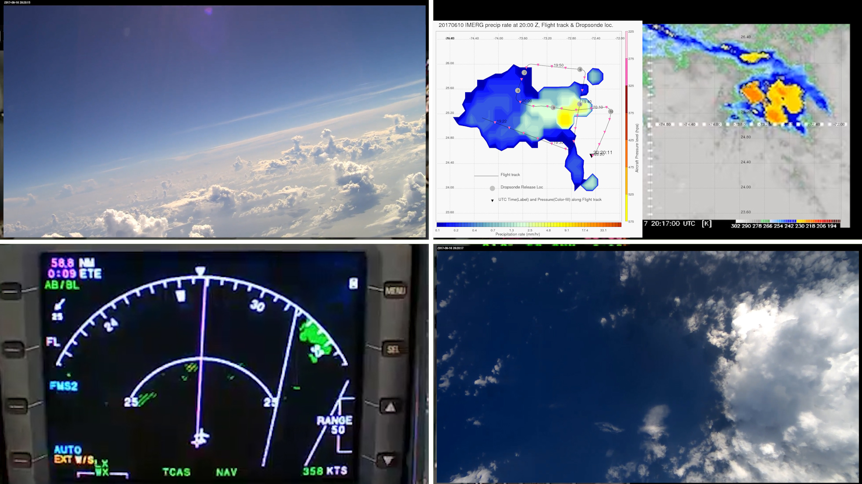
Time : 20:20:21 UTC - Narrow cumulus tower seen in Nadir Camera

Slide 15
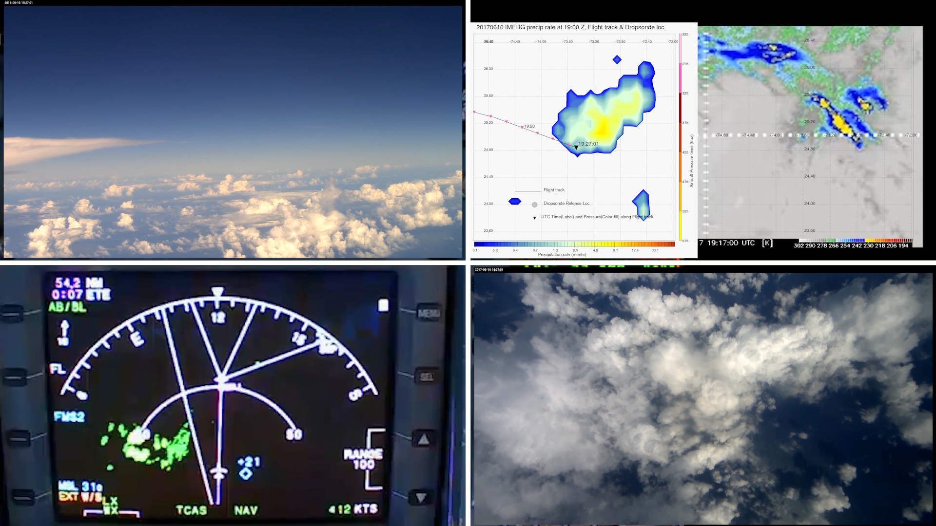
Time : 19:27:01 UTC - Moderately-Deep clouds & precipitation
These moderately deep clouds may be precipitating. IMERG shows it as precipitation

Slide 16
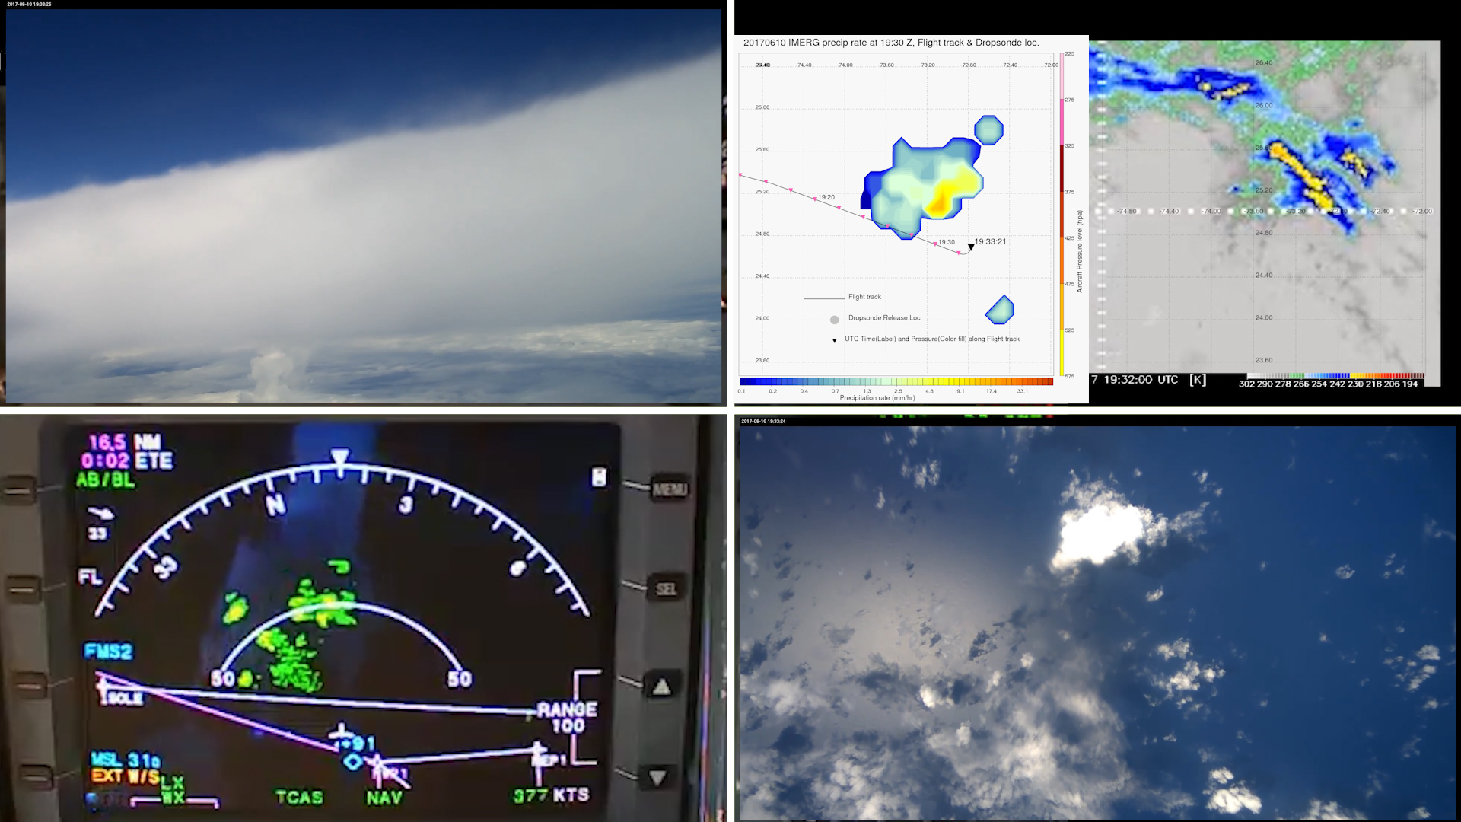
Time : 19:33:21 UTC - IMERG does not show anvil as precipitation
IR shows the anvil, but the IMERG did not represent it as precipitation (which is good).

Slide 17
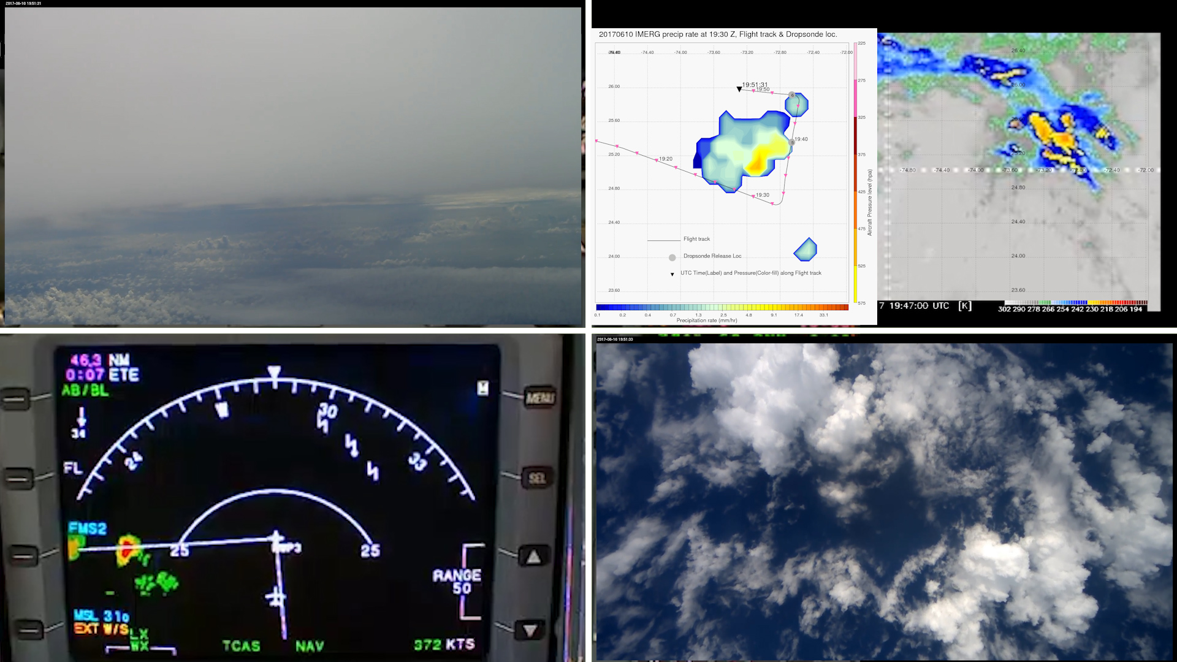
Time : 19:51:31 UTC - Another example

Slide 18
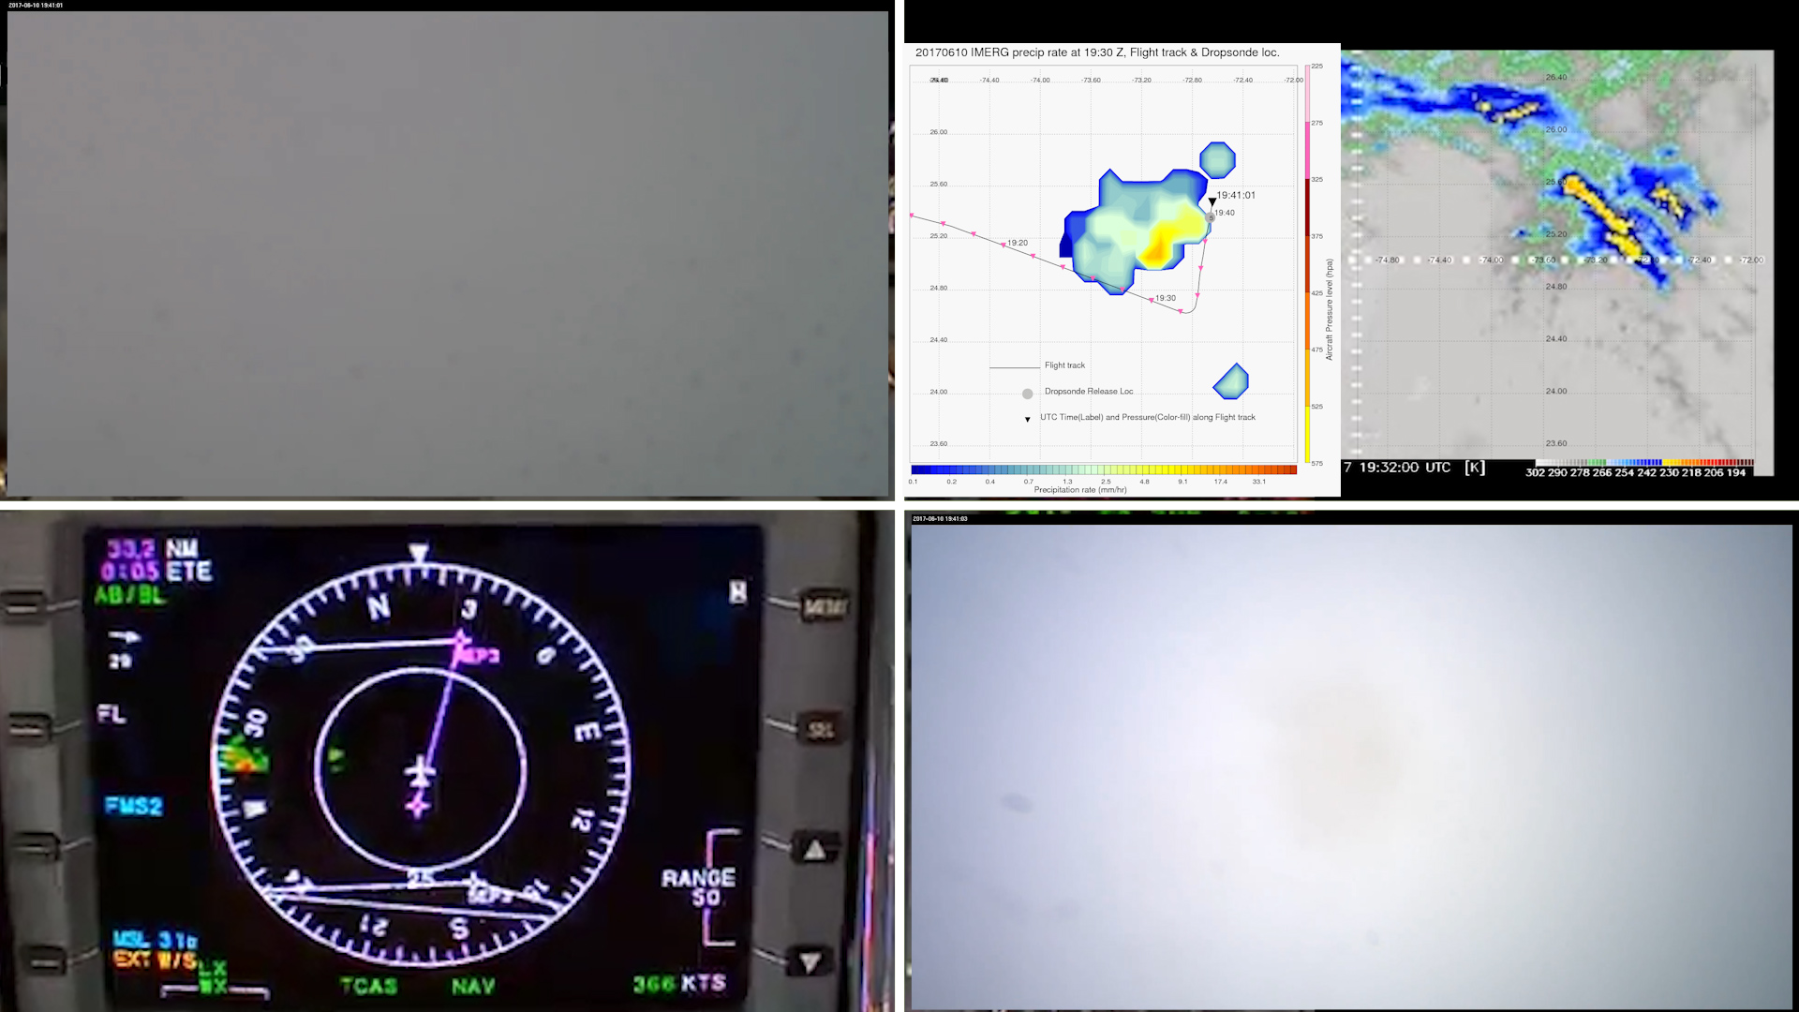
Time : 19:41:01 UTC - IMERG missing the deep convection
Hydrometeors hitting the forward camera. IMERG missing precipitation at the aircraft. IR shows deep convection (circled)

Slide 19
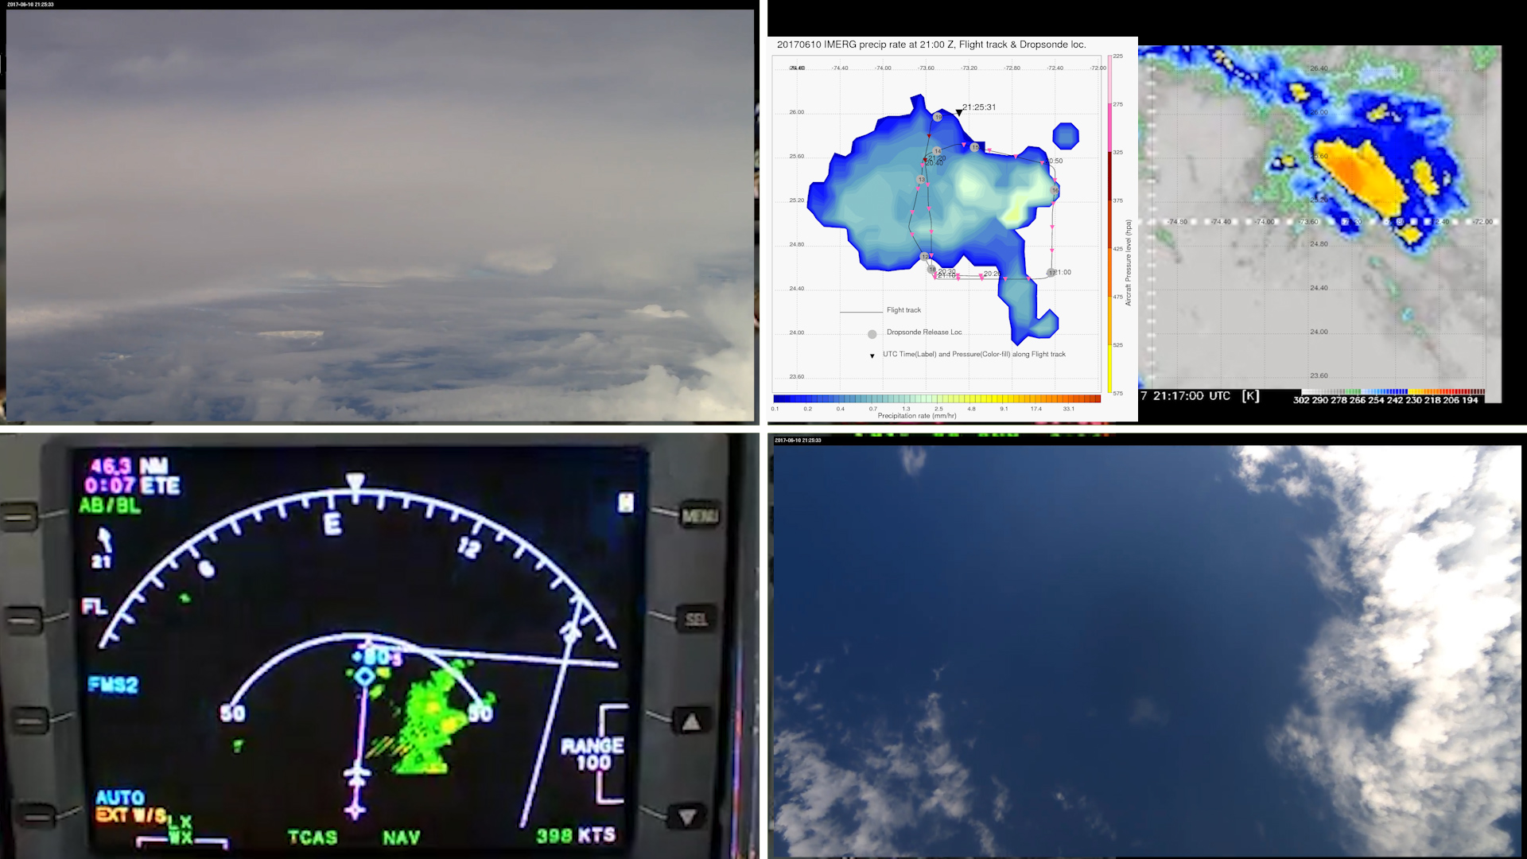
Time : 21:25:31 UTC - IMERG missing wide spread precipitation

Slide 20
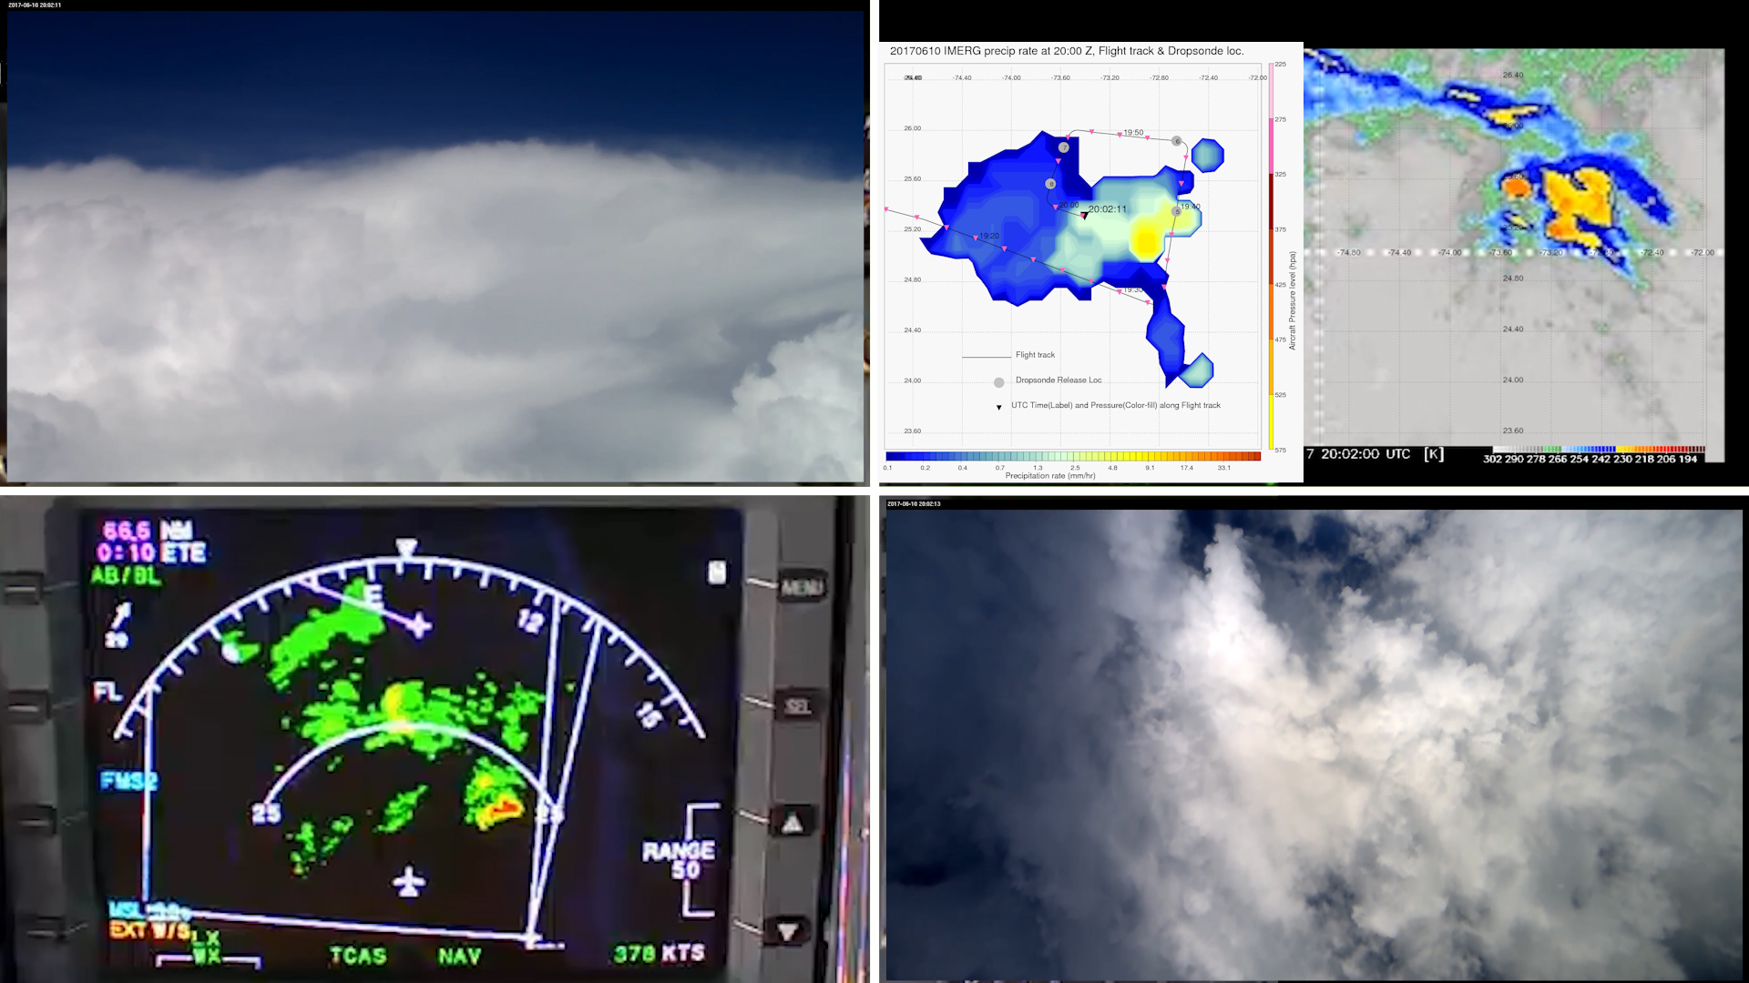
Time : 20:02:11 UTC - Path taken to avoid deep convection matches with IR than IMERG.

Slide 21
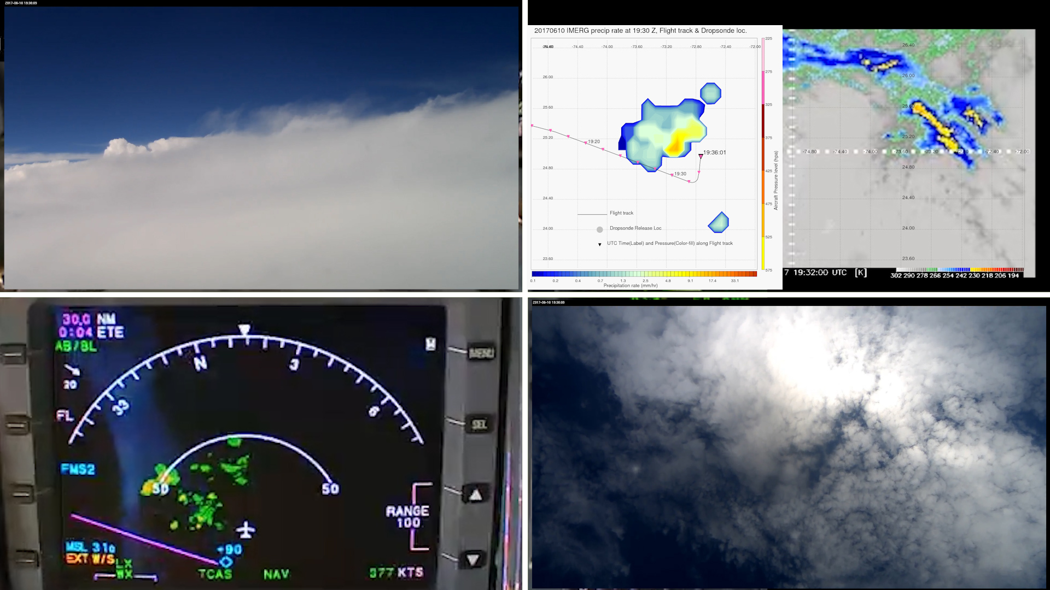
Time : 19:36:01 UTC - IMERG didn’t represent intensity, (shifted southwest)
IMERG and IR captures the deep convection that is immediately at 330 degrees. The deep convection at 50 nautical miles and 330 degree (circled), is not represented in terms of intensity.

Slide 22
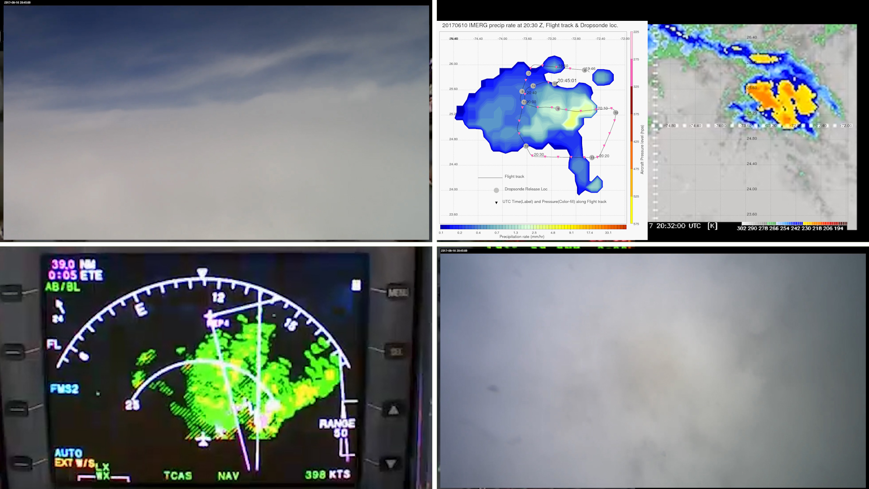
Time : 20:45:01 UTC - Intensity mismatch between IMERG and IR

