Slide 1
Rapid Growth of IMERG Precipitating Area as seen on
Camera, Radar, IR, and IMERG

Slide 2
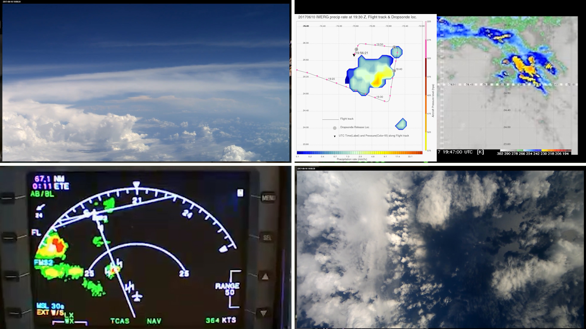
Time : 19:30:00 UTC - What caused the rapid growth in IMERG Precipitating Area?

Slide 3
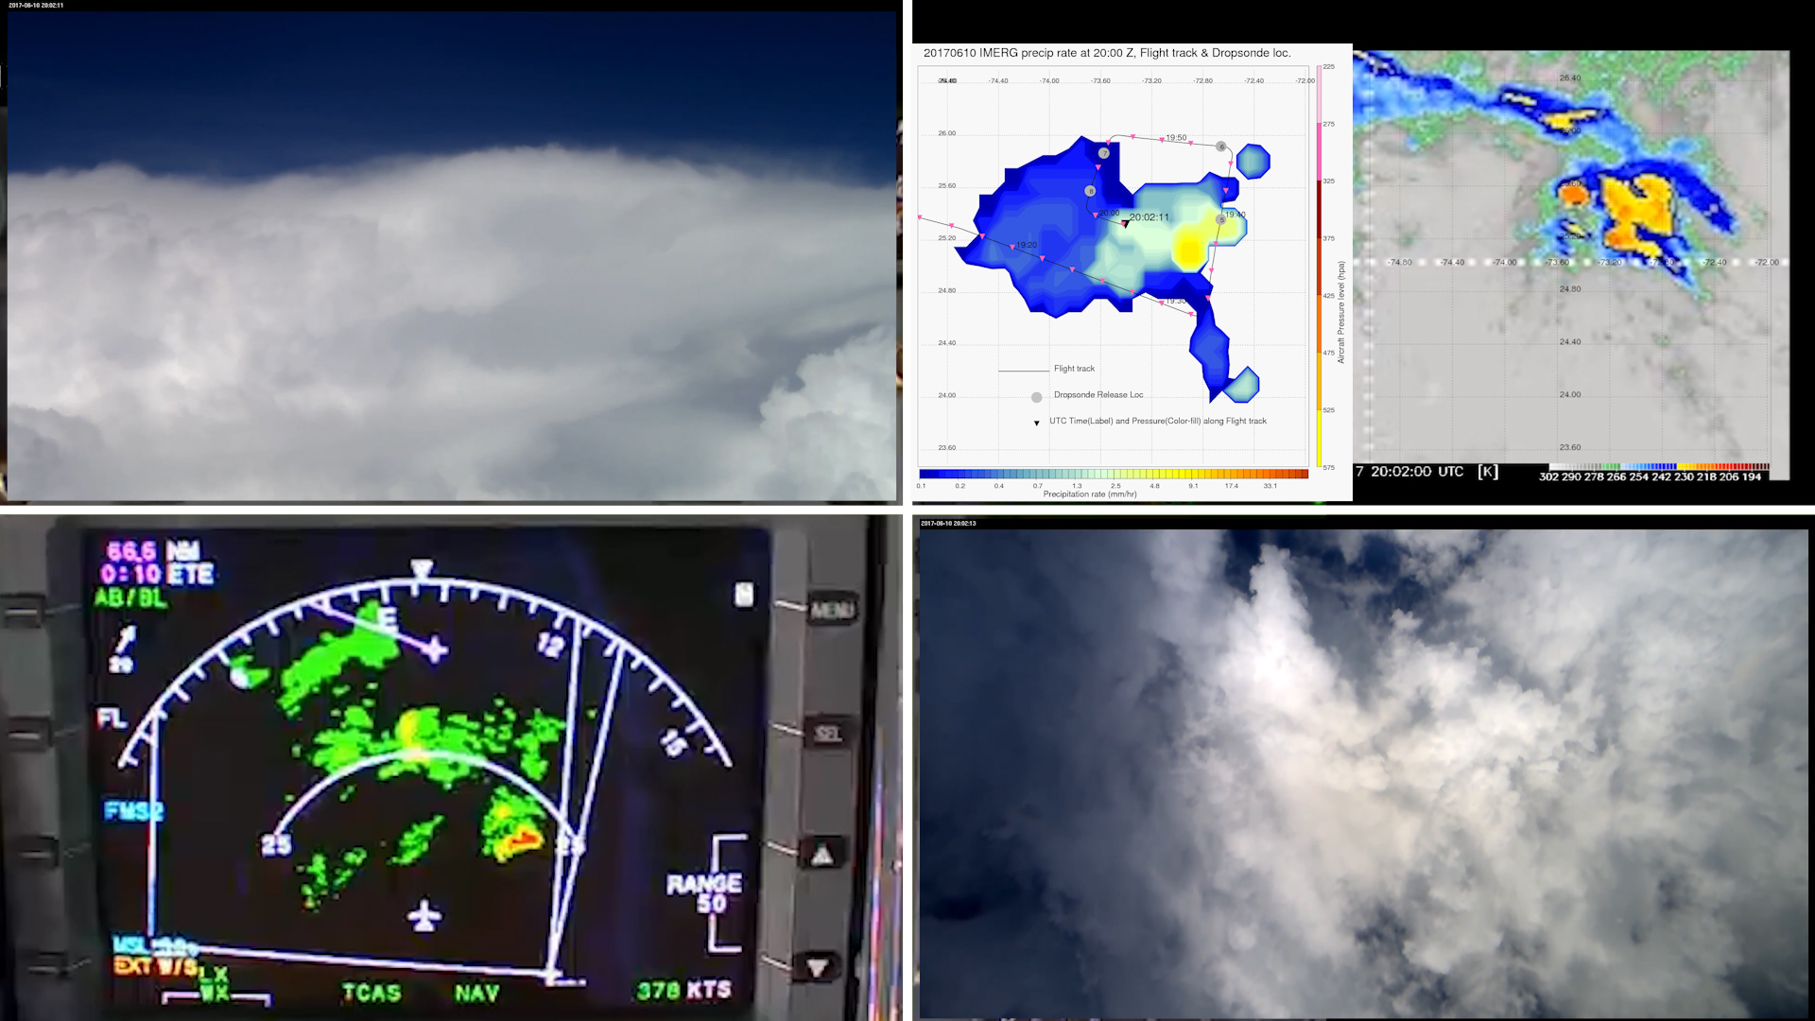
Time : 20:00:00 UTC - What caused the rapid growth in IMERG Precipitating Area?

Slide 4
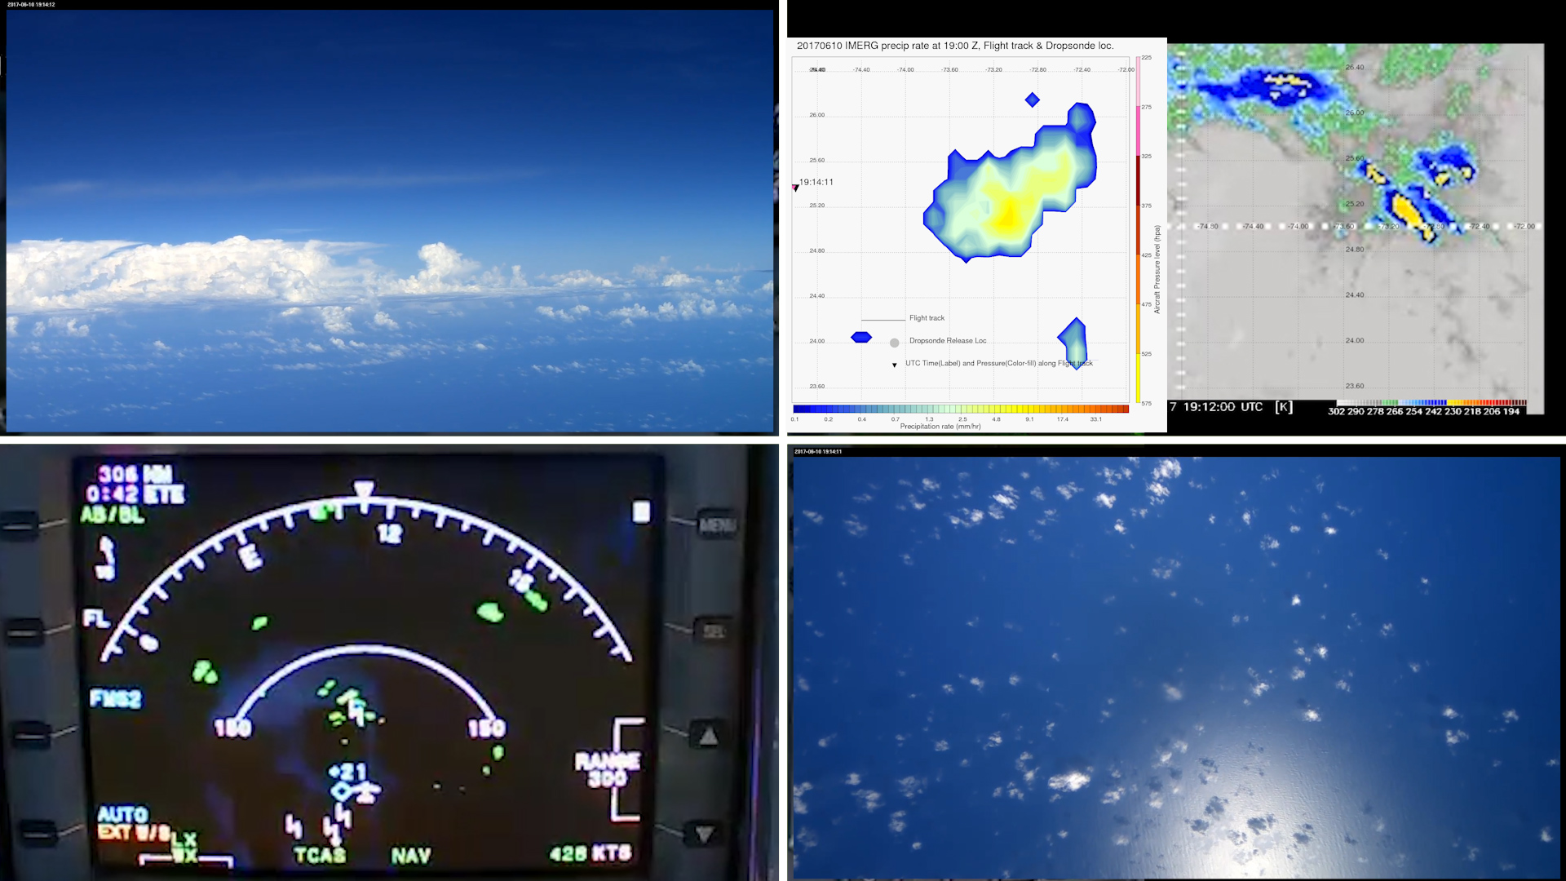
Time : 19:14:11 UTC - Area has Fair weather cumulus

Slide 5
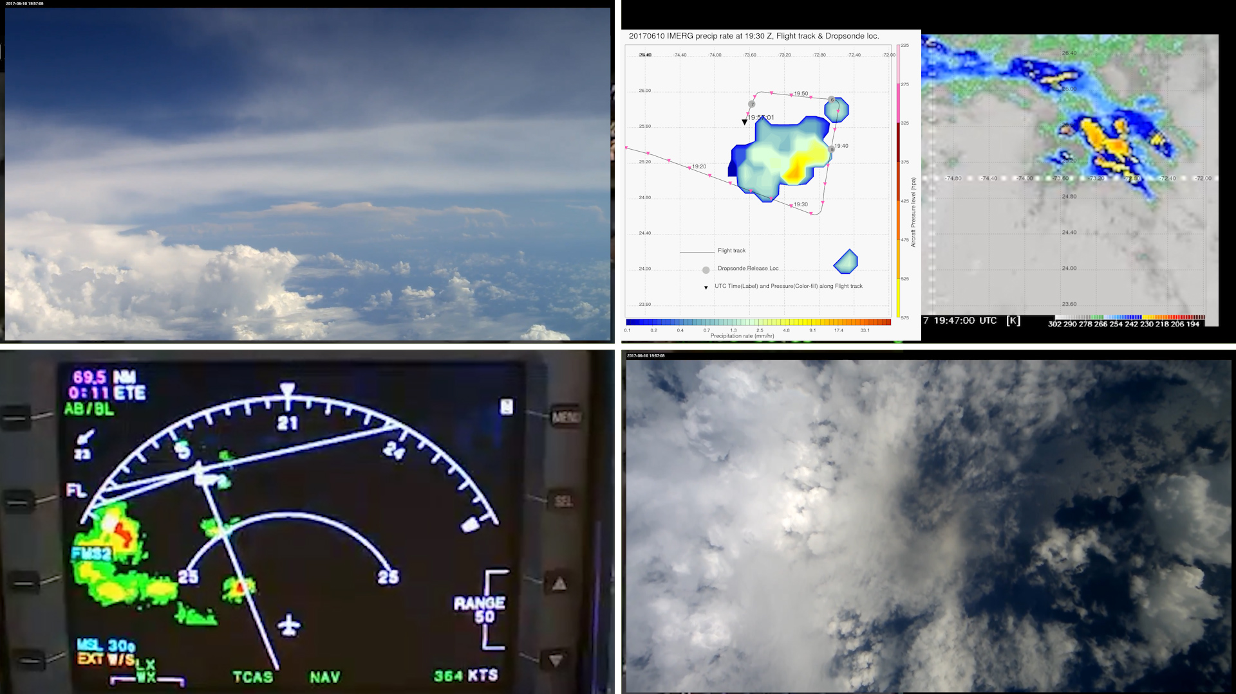
Time : 19:57:01 UTC - Looking from North

Slide 6
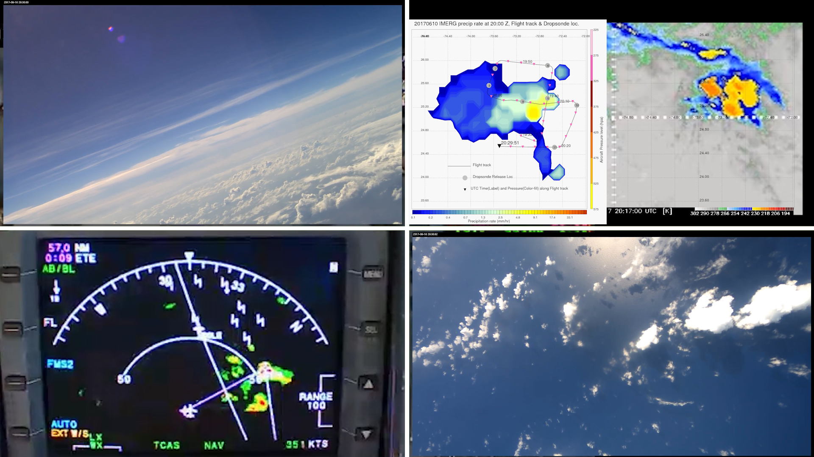
Time : 20:29:51 UTC - Looking from south at 310 degrees - Scattered cumulus

Slide 7
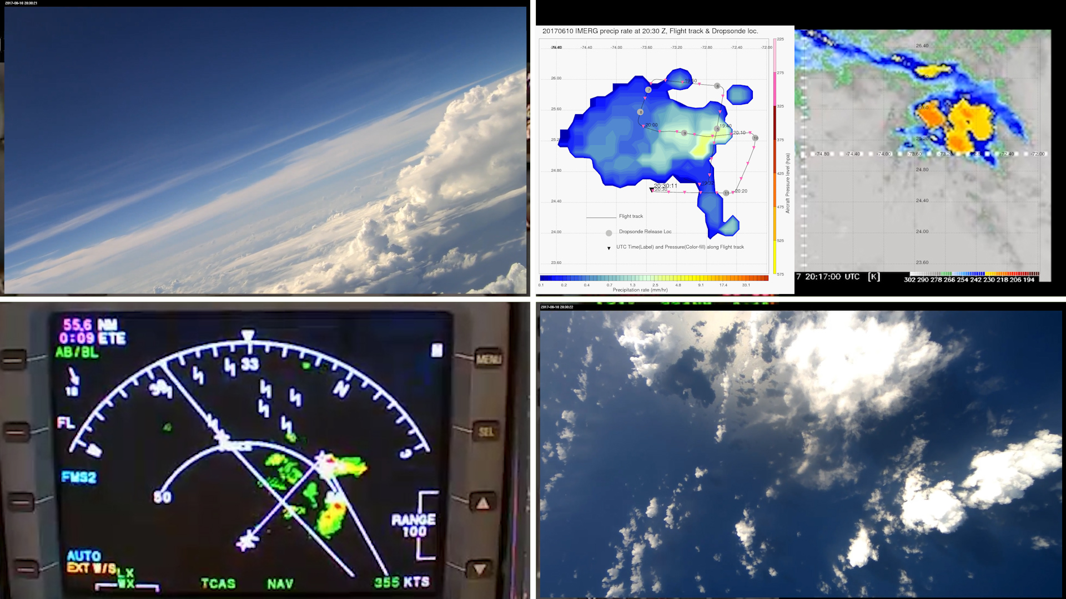
Time : 20:30:11 UTC - Looking from south at 330 degrees - Scattered cumulus (Left of forward camera)

Slide 8
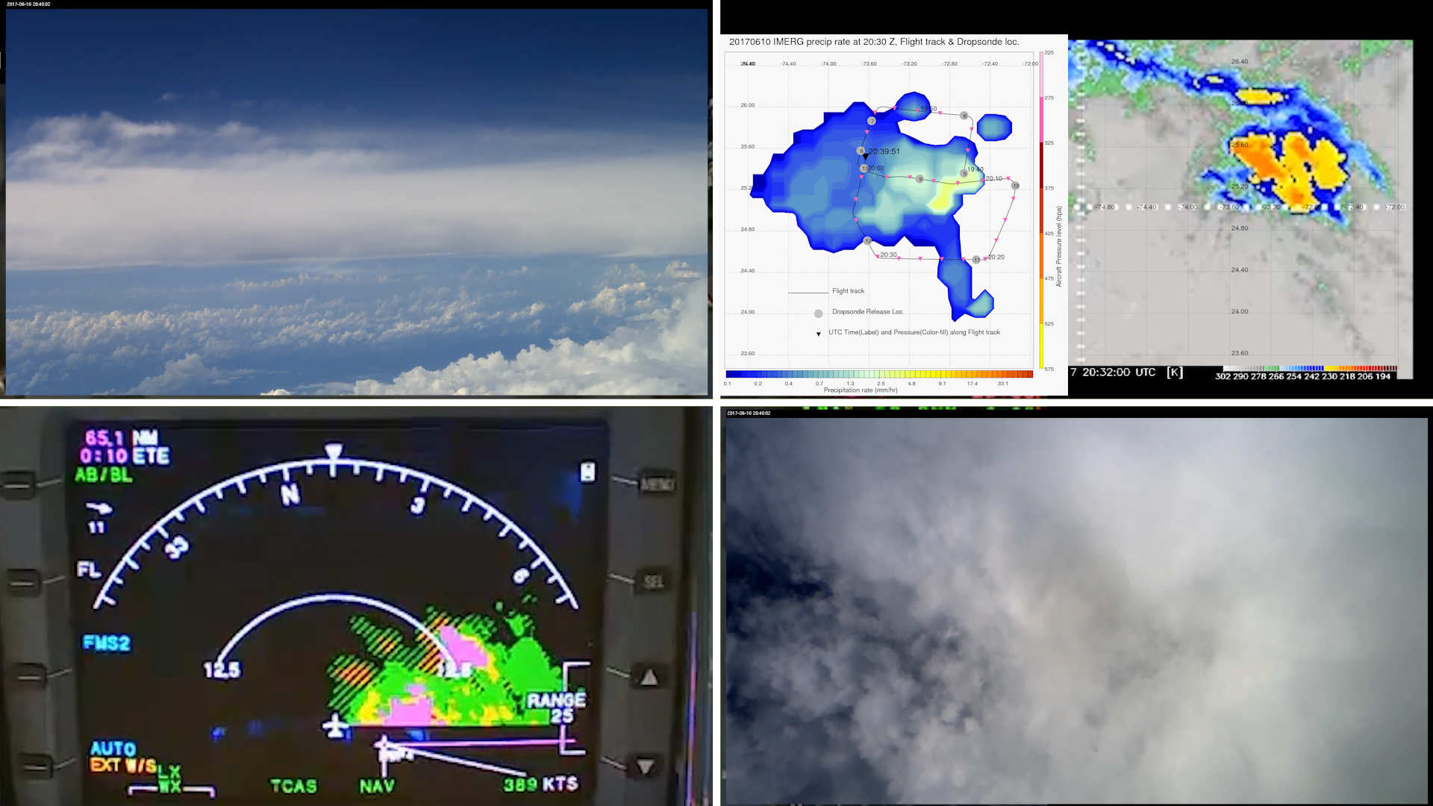
Time : 20:39:51 UTC - Northern region of rapid growth (scattered cumulus)

Slide 9
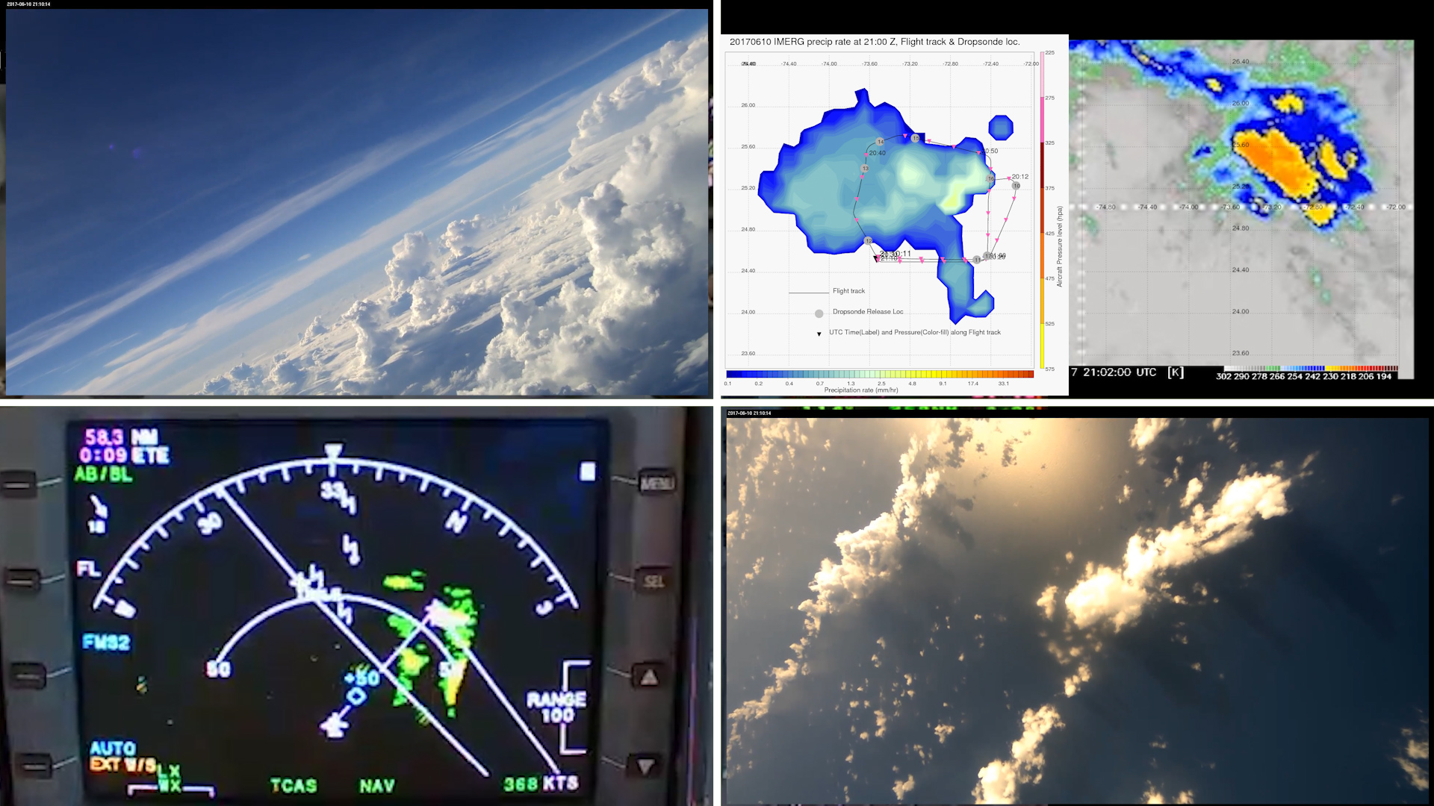
Time : 21:10:11 UTC - Looking from south at 310 degrees - Scattered but growing cumulus

Slide 10
Time : 21:10:11 UTC - Looking from south at 330 degrees - Scattered but growing cumulus.

Slide 11
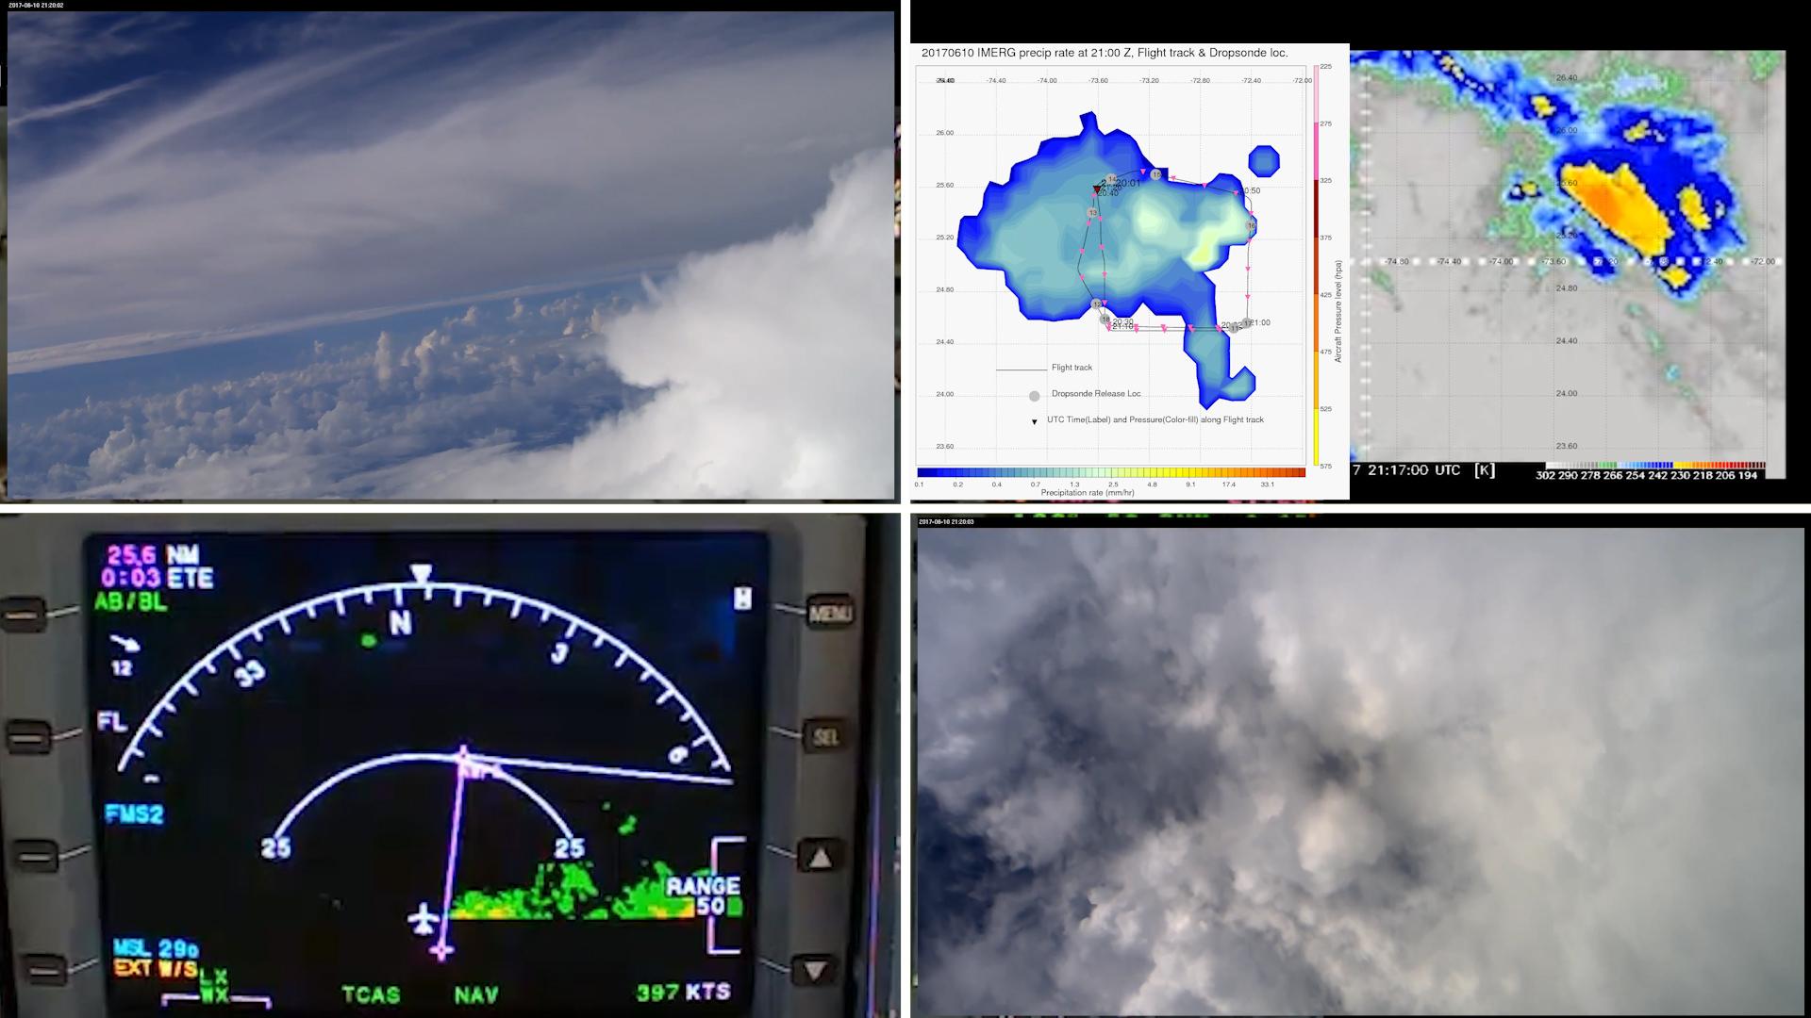
Time : 21:20:01 UTC - Northern region of rapid growth ( scattered but growing cumulus)

Slide 12
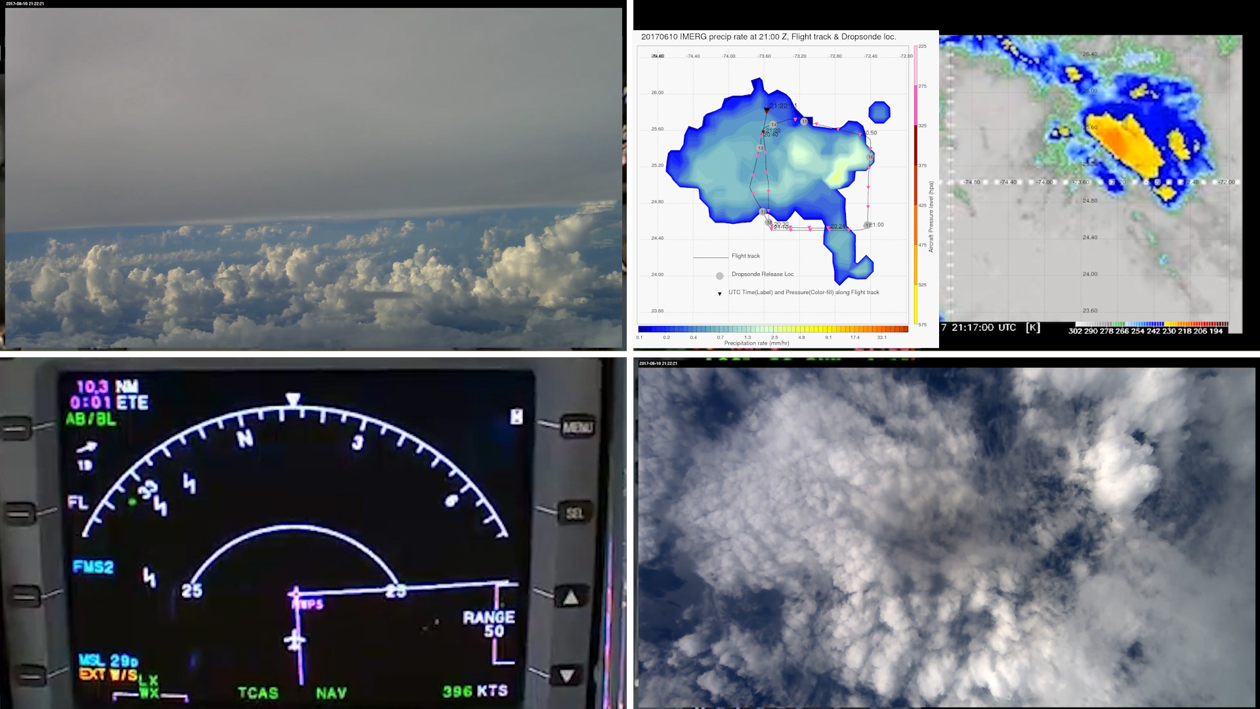
Time : 21:22:11 UTC - Northern region of rapid growth ( scattered but growing cumulus)

