Slide 1
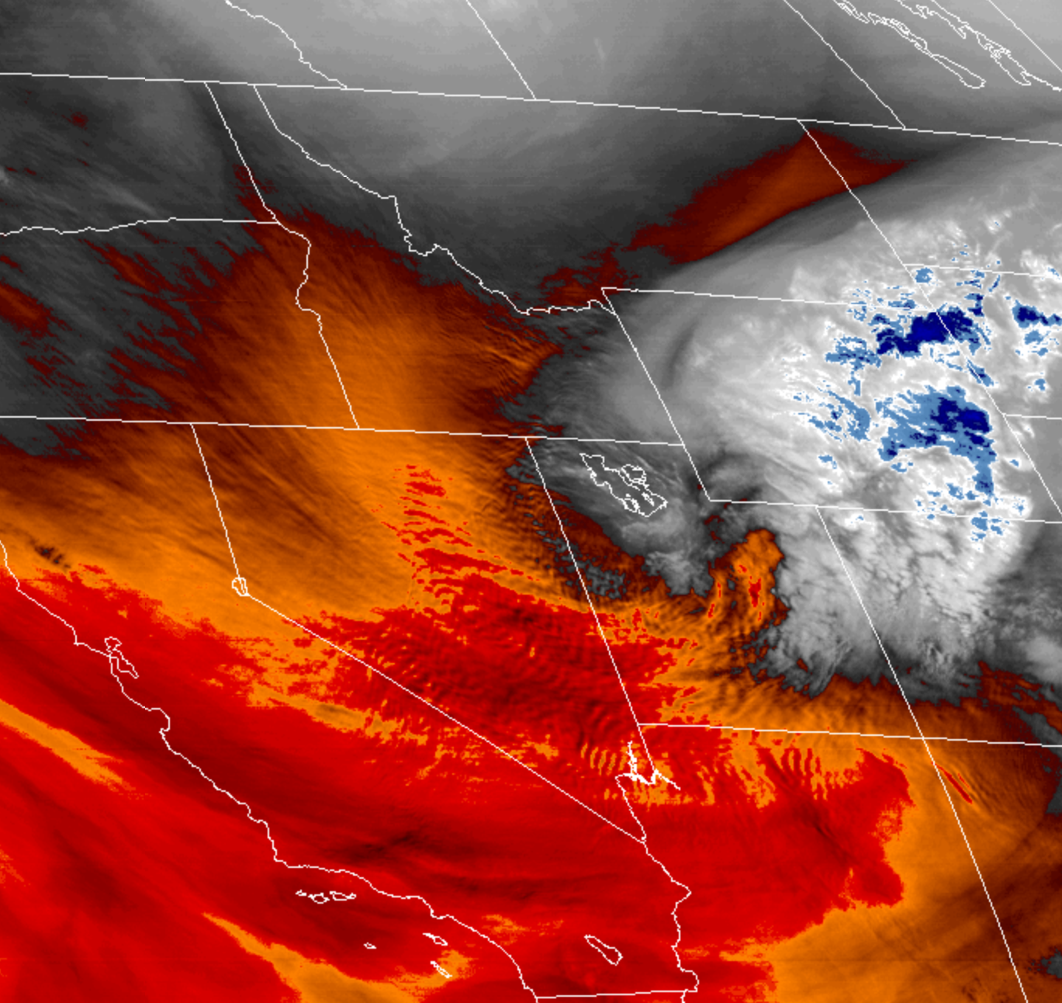
ATMOS 6010
September 10, 2020
When the weather trumps lecture plans… you adapt

Slide 2
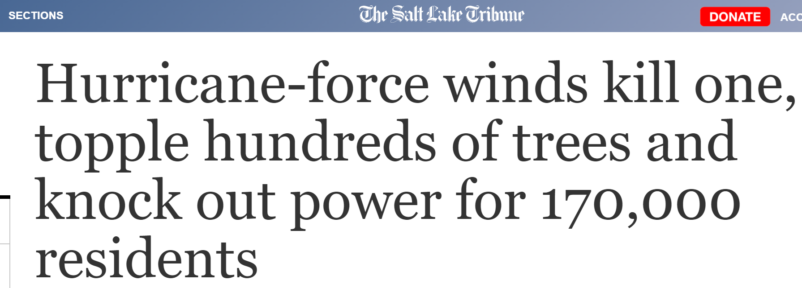
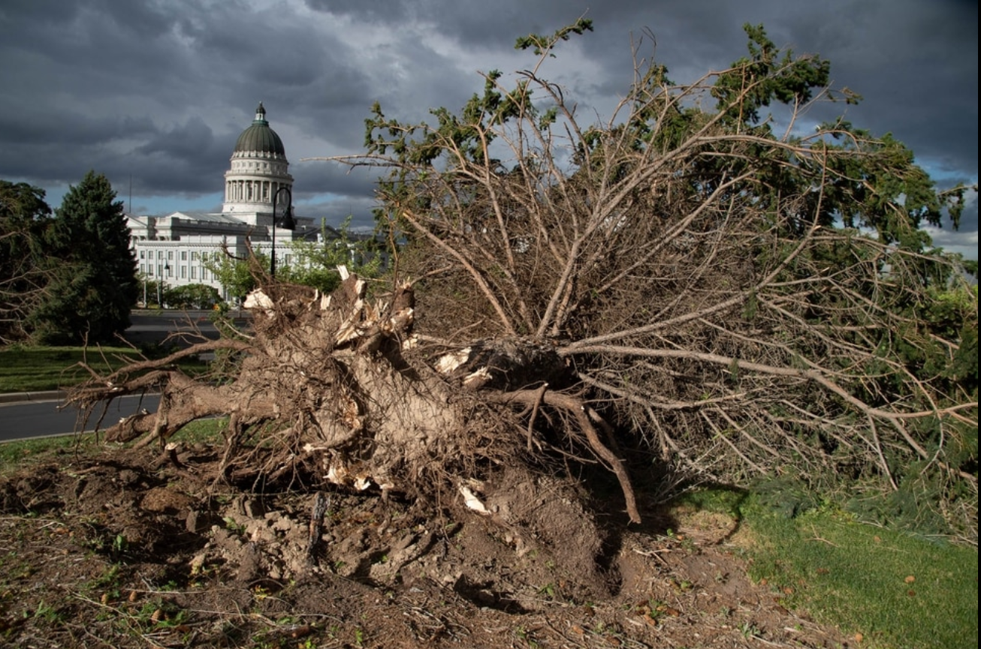

Slide 3
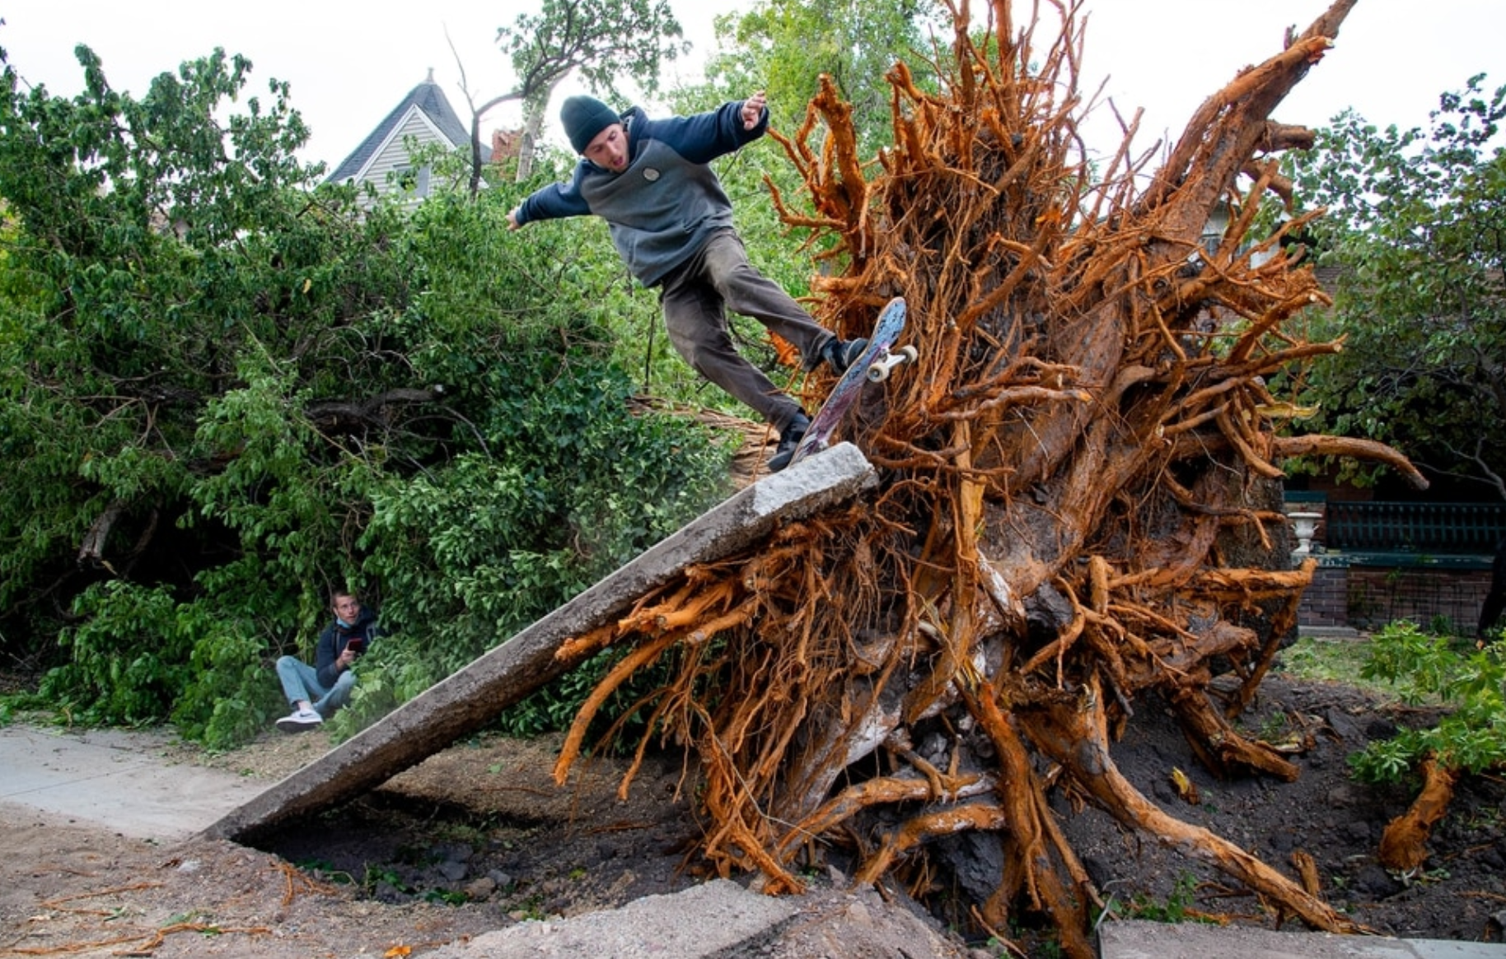

Slide 4
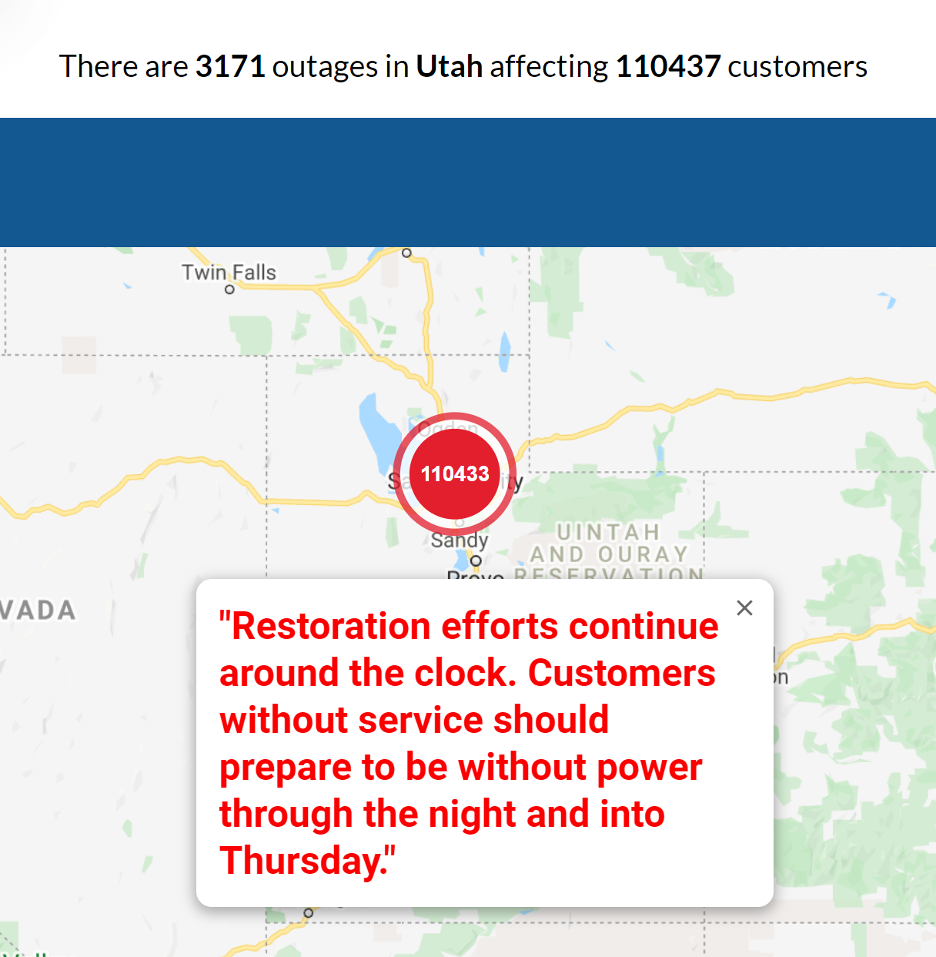
After power restored to 70,000 on Day 1

Slide 5
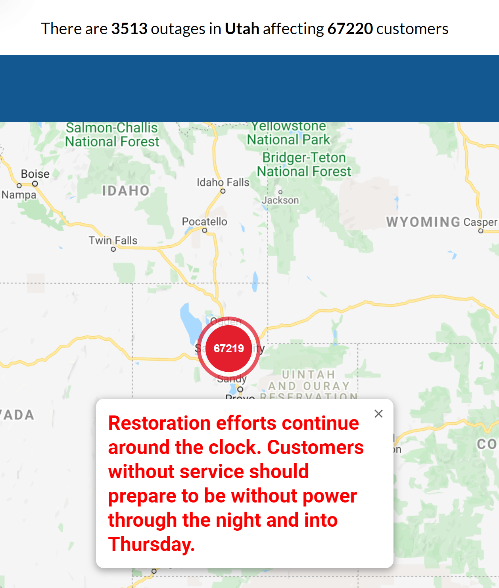

Slide 6
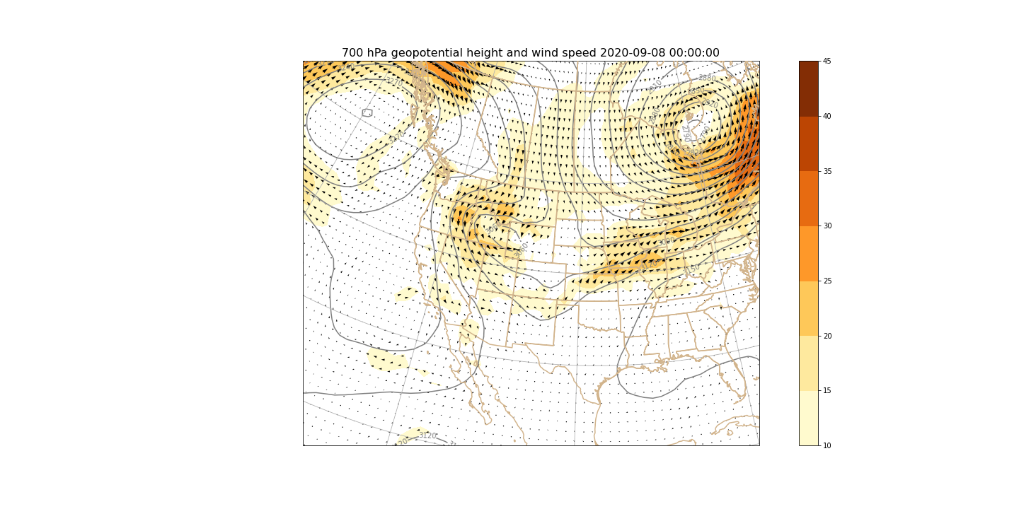

Slide 7
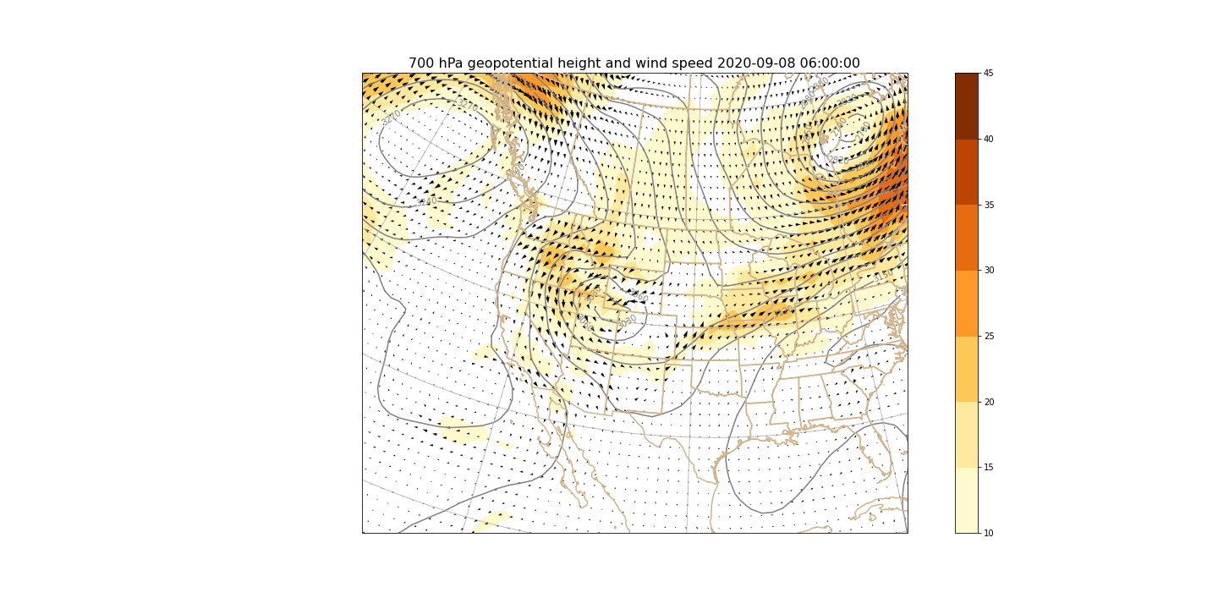

Slide 8
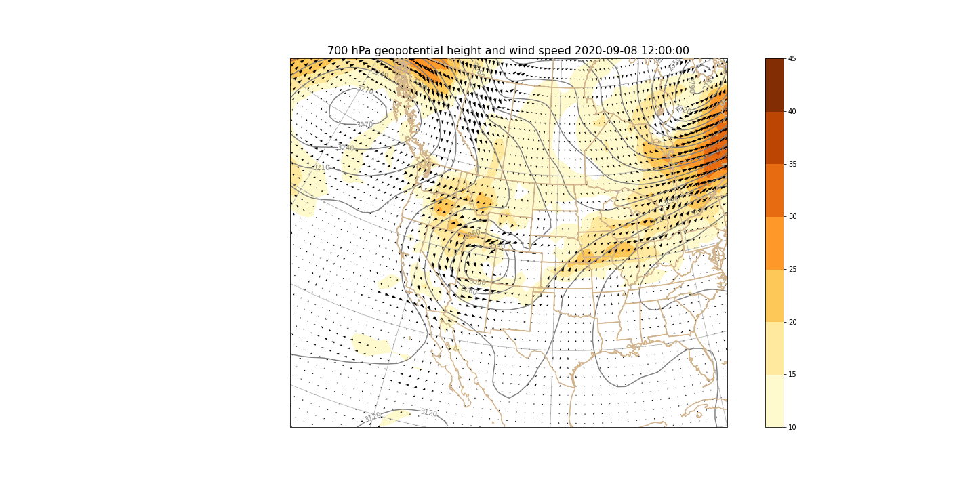

Slide 9
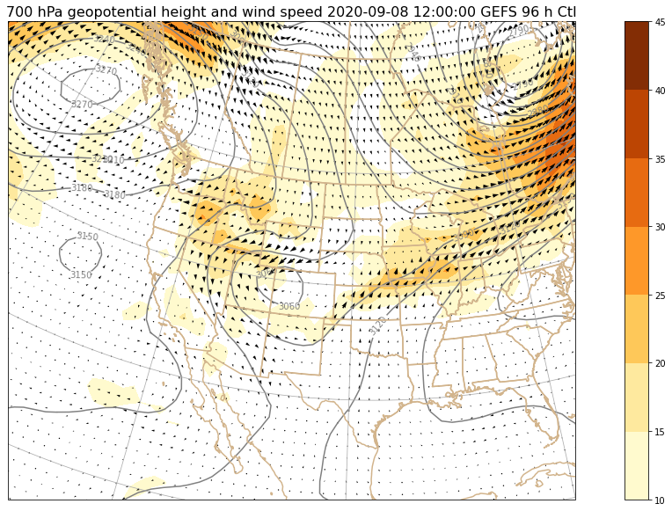

Slide 10


Slide 11
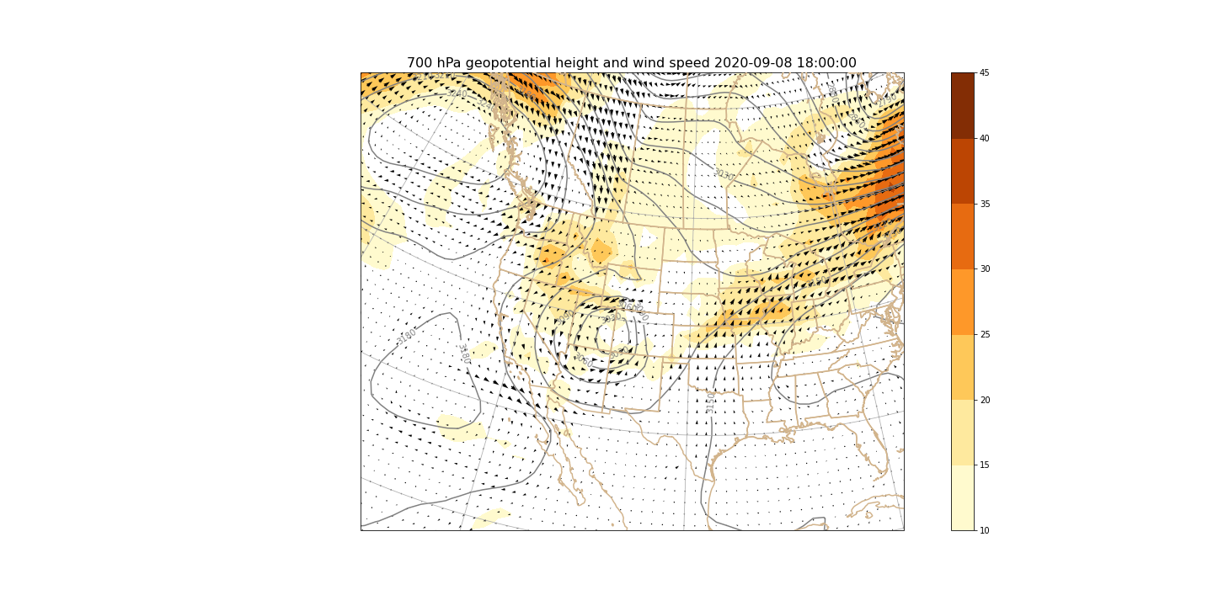

Slide 12
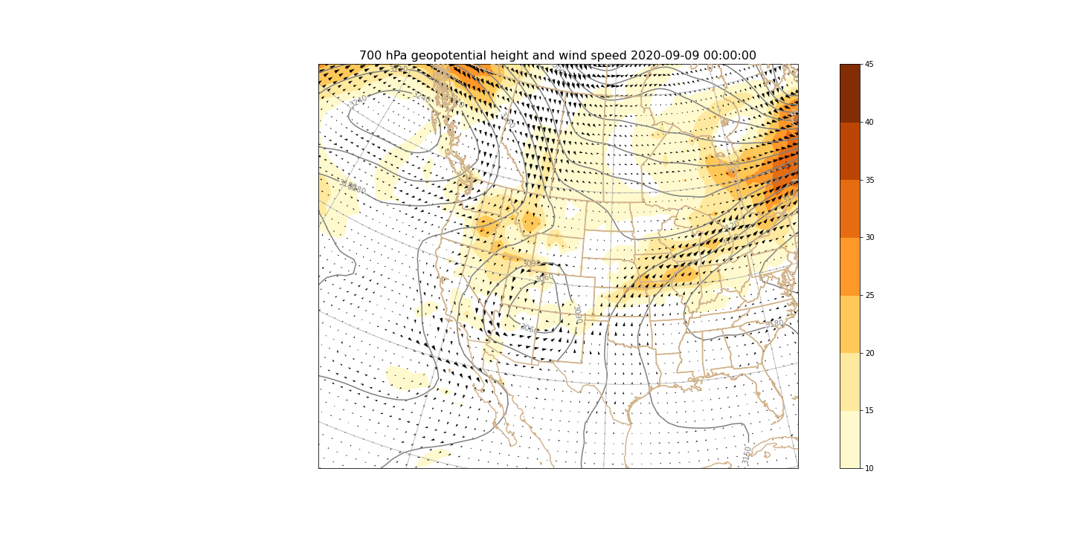

Slide 13


Slide 15

Launching Rawinsondes

Slide 16
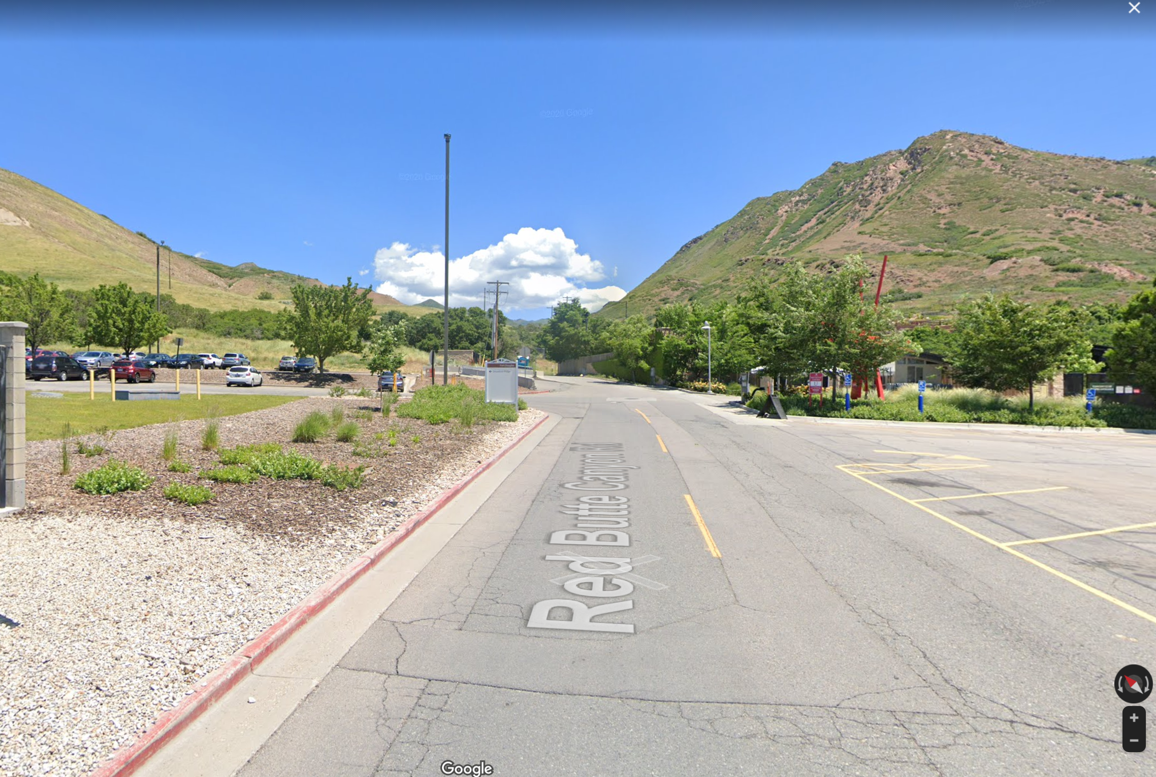
MTMET site

Slide 17
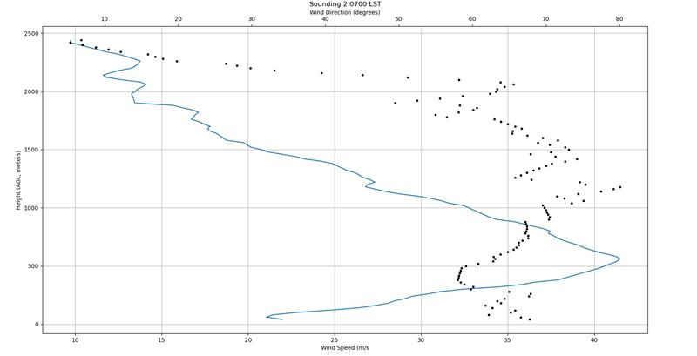
Tuesday’s launch

Slide 18
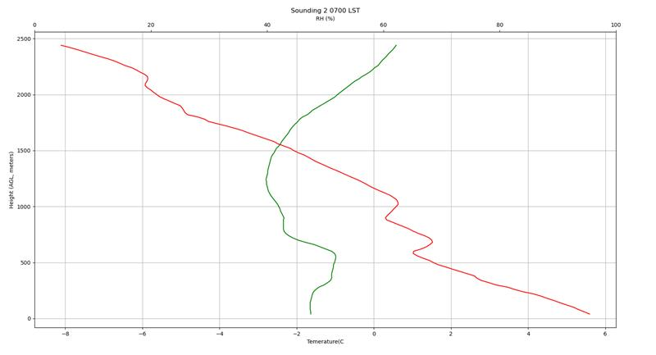
Tuesday’s launch

Slide 20
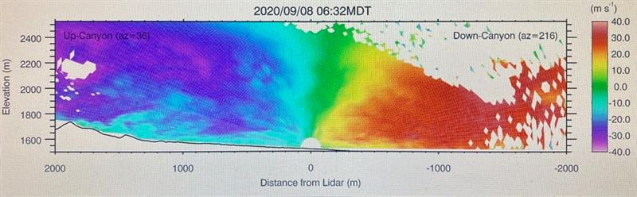
Sebastian’s lidar

Slide 21
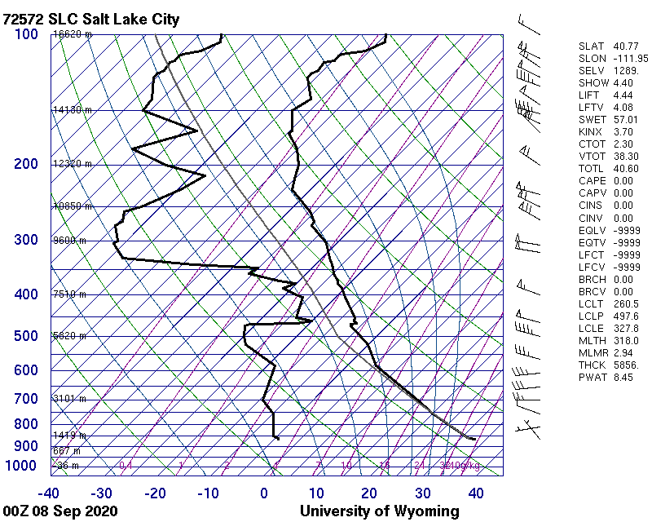

Slide 22
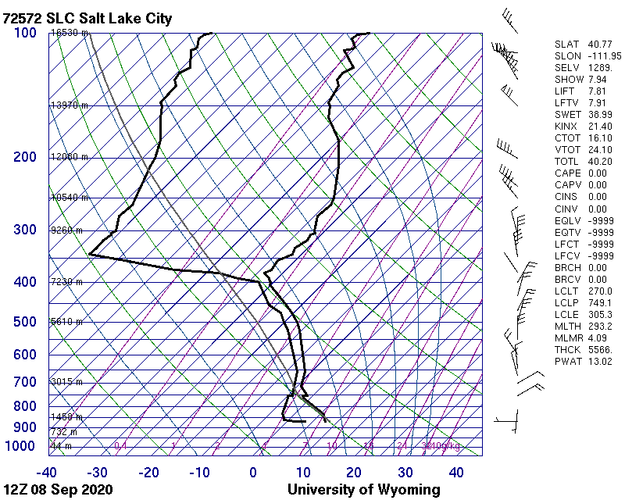

Slide 23
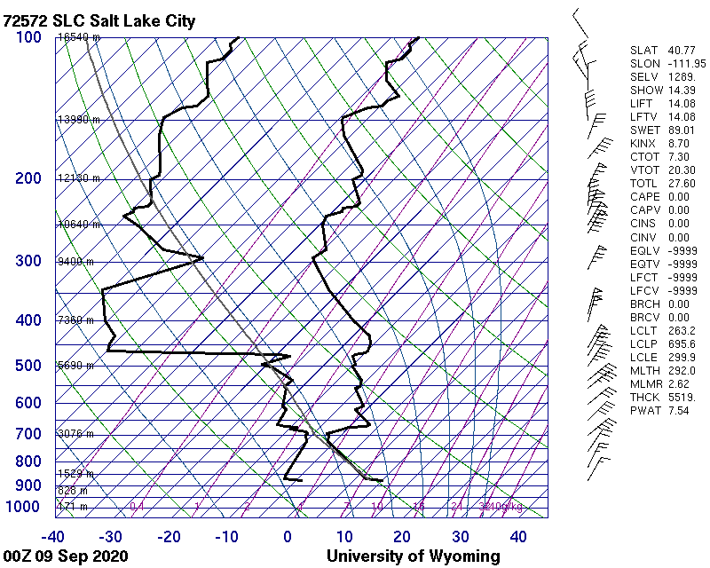

Slide 24
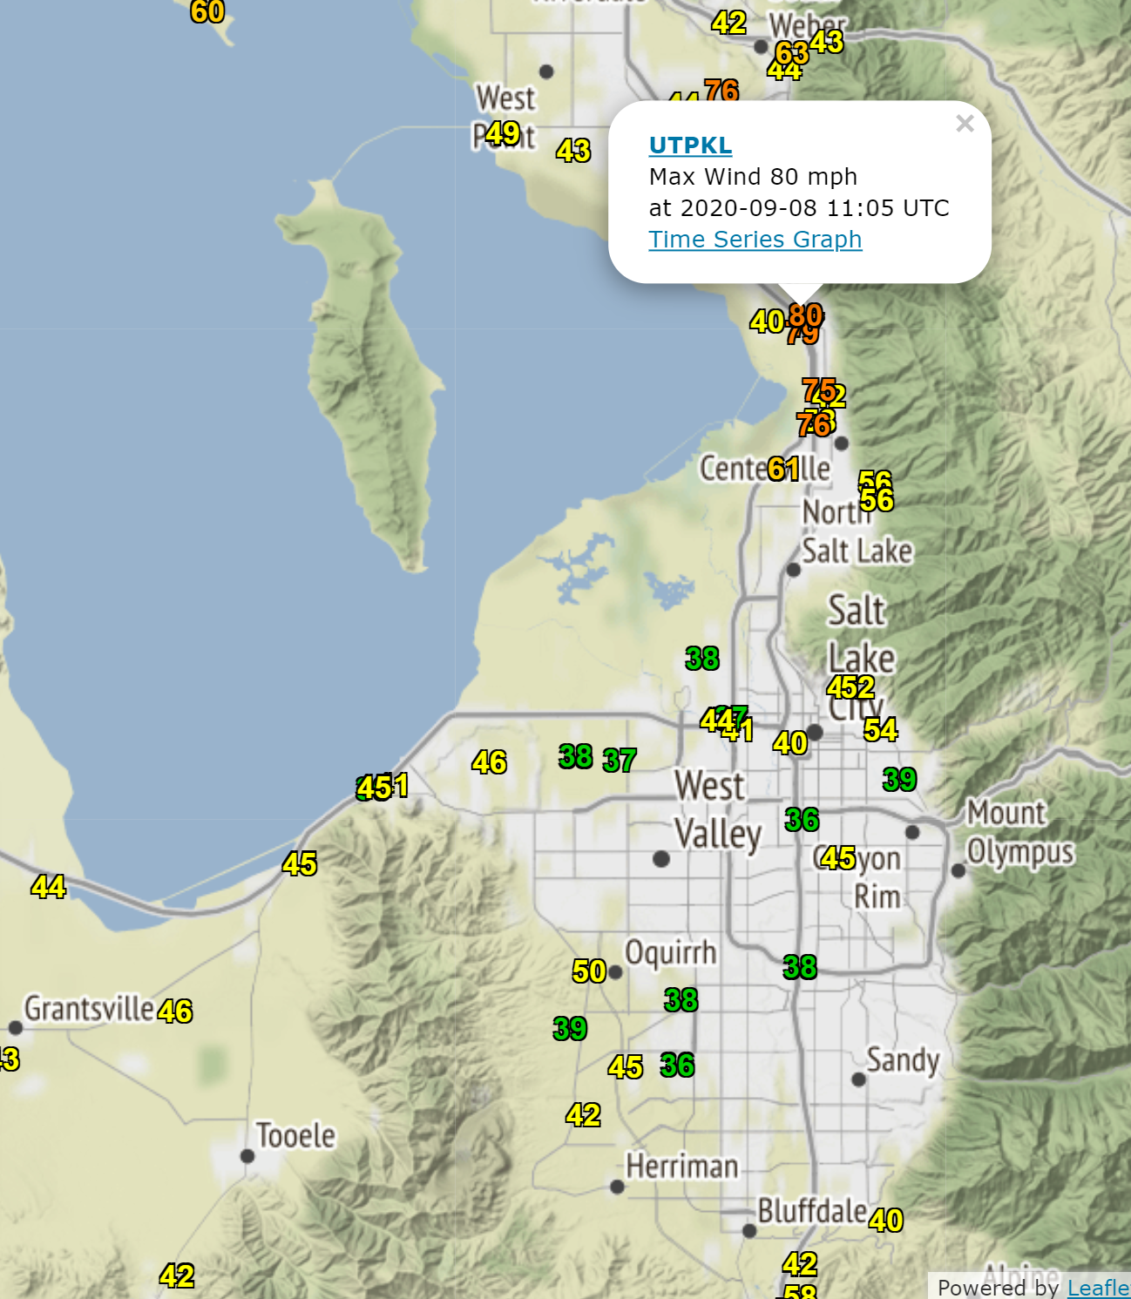

Slide 25
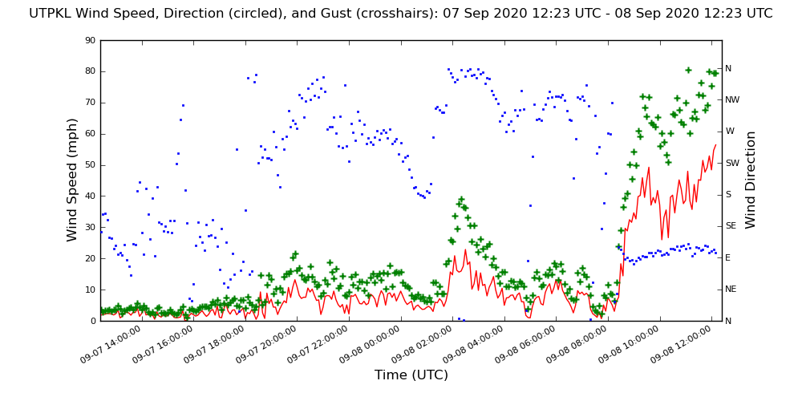

Slide 26
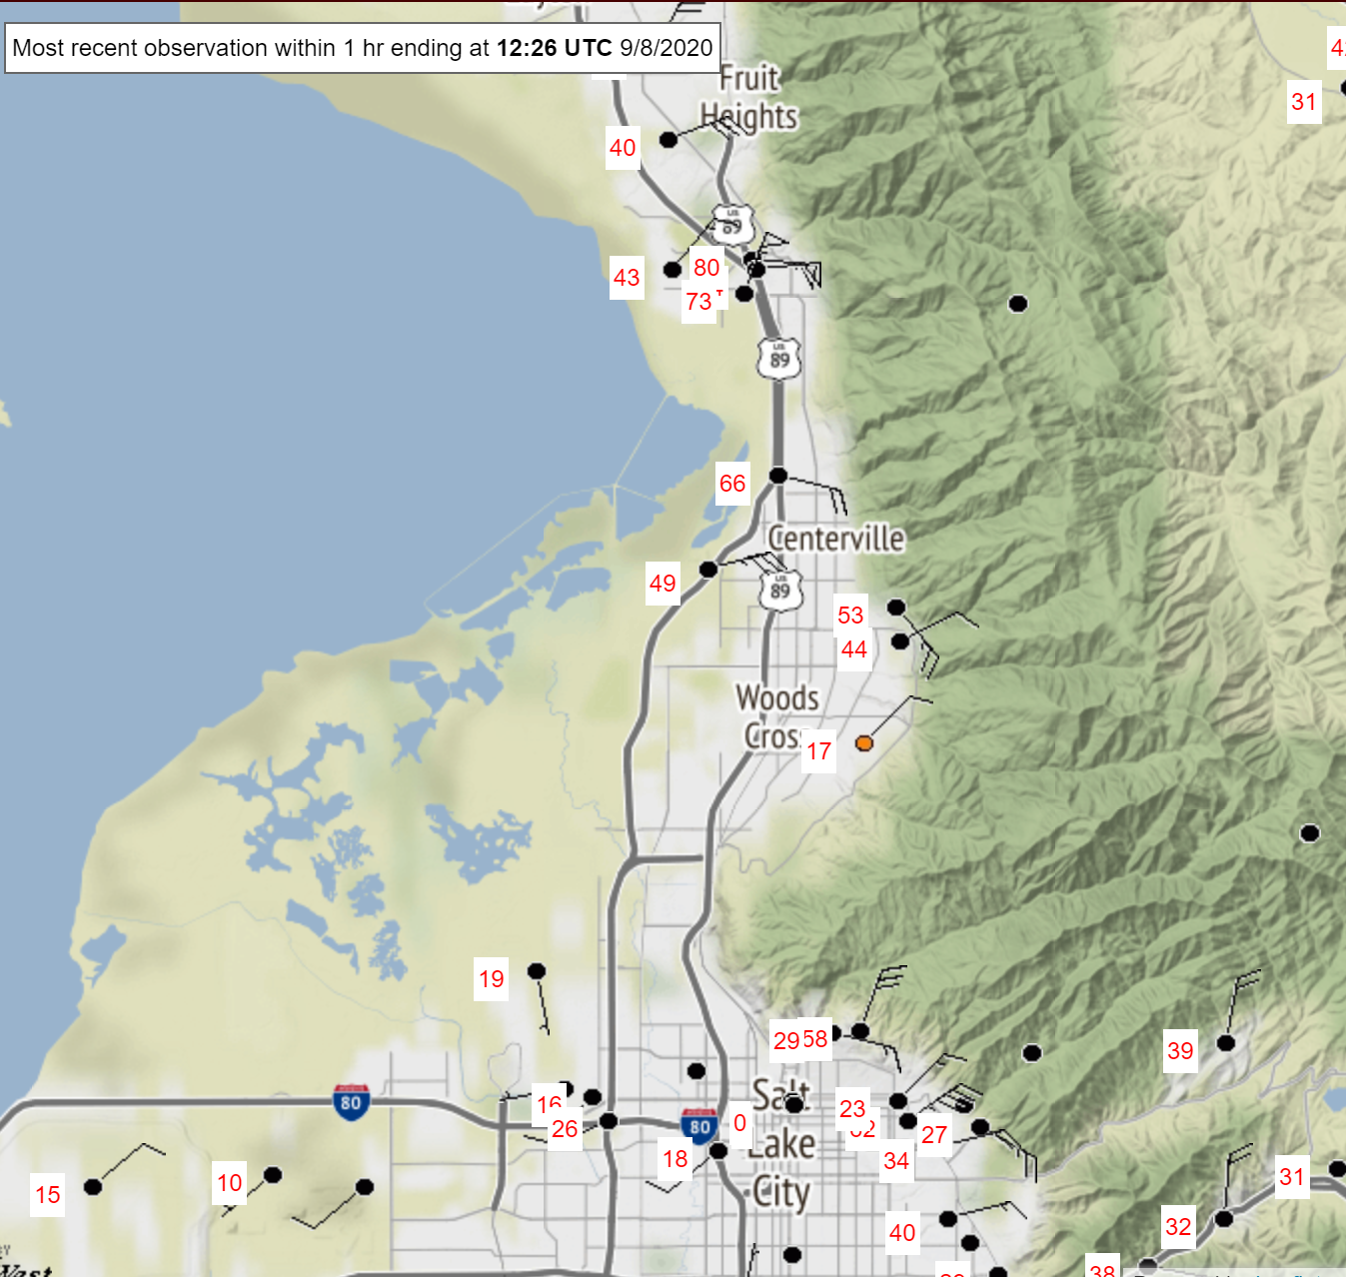

Slide 27
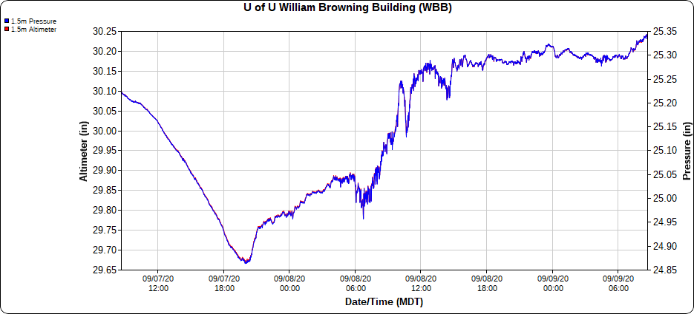

Slide 28
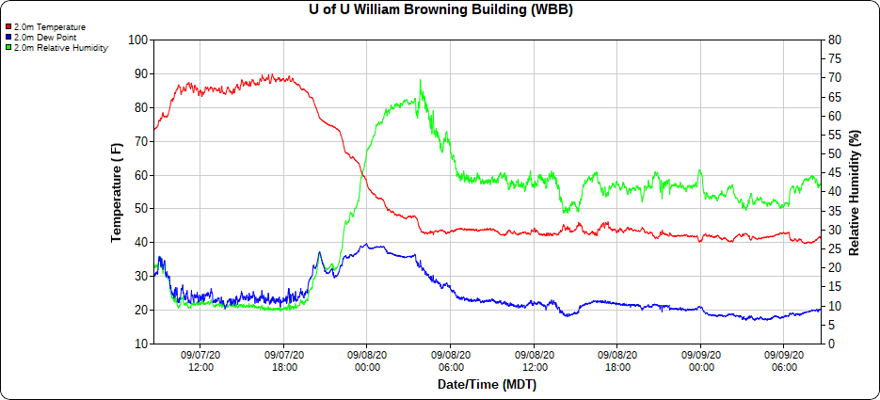

Slide 29
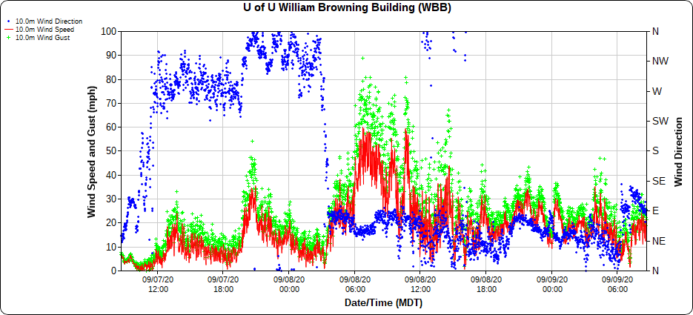

Slide 30
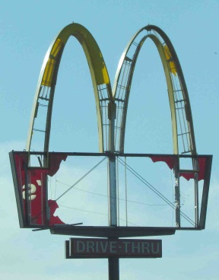
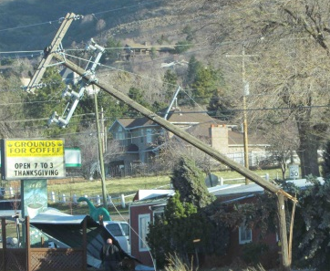
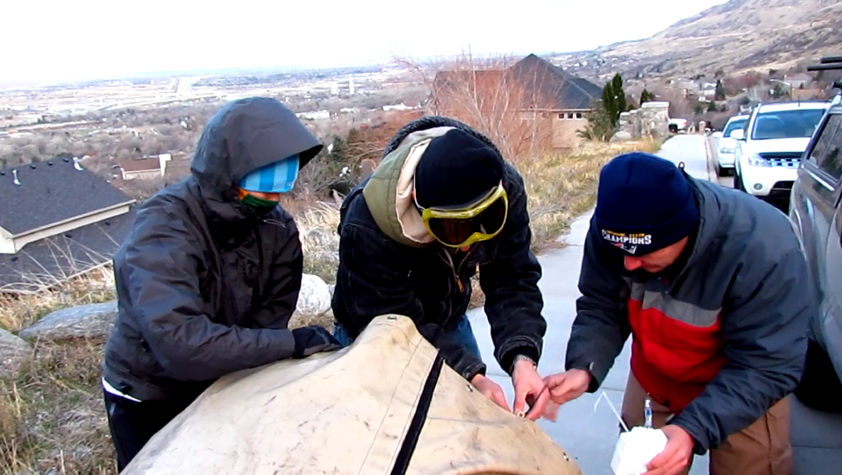

Chasing the Wind:
The December 1, 2011 Downslope Windstorm
John Horel, John Lawson, Roger Akers, Trevor Alcott, Chris Ander, Erik Crosman, Alex Jacques, Matt Lammers, Nola Lucke, Wil Mace

Slide 31
Outline
Hydraulic jump theory for downslope windstorms
December 1, 2011 downslope windstorm
  Lawson, J., and J. Horel 2015: Analysis of the 1 December 2011 Wasatch downslope windstorm. Wea. Forecasting, 30, 115-135. doi: http://dx.doi.org/10.1175/WAF-D-13-00120.1
  Lawson, J., and J. Horel 2016: Predictability of the 1 December 2011 Wasatch. Wea. Forecasting. https://journals.ametsoc.org/doi/full/10.1175/WAF-D-15-0034.1
COMET module: Mountain Waves and Downslope Winds. http://www.meted.ucar.edu/mesoprim/mtnwave/

Slide 32
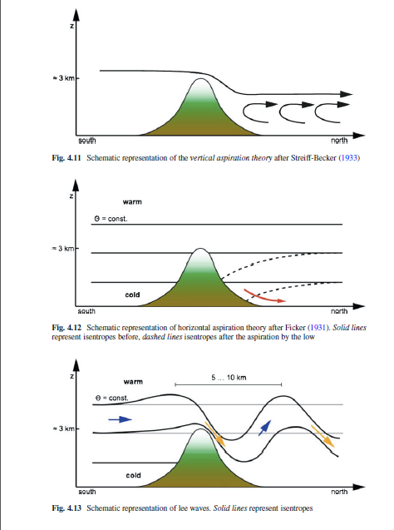
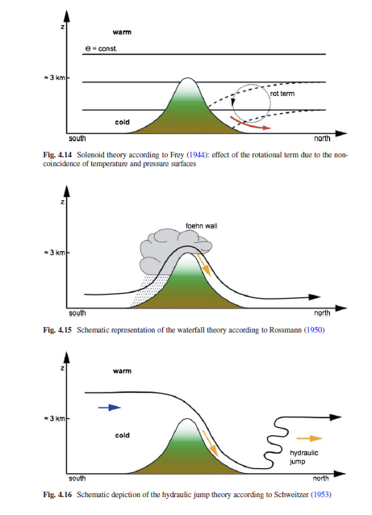
Complementary and Competing Theories

Slide 33
AMS Glossary
foehn—(Or föhn.) A warm, dry, downslope wind descending the lee side of the Alps as a result of synoptic-scale, cross-barrier flow over the mountain range.
bora—A fall wind with a source so cold that, when the air reaches the lowlands or coast, the dynamic warming is insufficient to raise the air temperature to the normal level for the region; hence it appears as a cold wind
downslope windstorm—A very strong, usually gusty, and occasionally violent wind that blows down the lee slope of a mountain range, often reaching its peak strength near the foot of the mountains and weakening rapidly farther away from the mountains

Slide 34
Two complementary theories for downslope wind storms
focus on
  presence of inversion/strong stable layer in flow over and upstream of crest
    hydraulic jump falls in this camp
  Presence of critical layer (reversal in direction of cross-barrier flow above crest)
    Vertical propagation of internal gravity waves in continuously stratified atmosphere
    In some cases, gravity wave breaking may “induce” critical layer
Most strong cases are a mix of both (Mobbs et al. 2005)

Slide 35
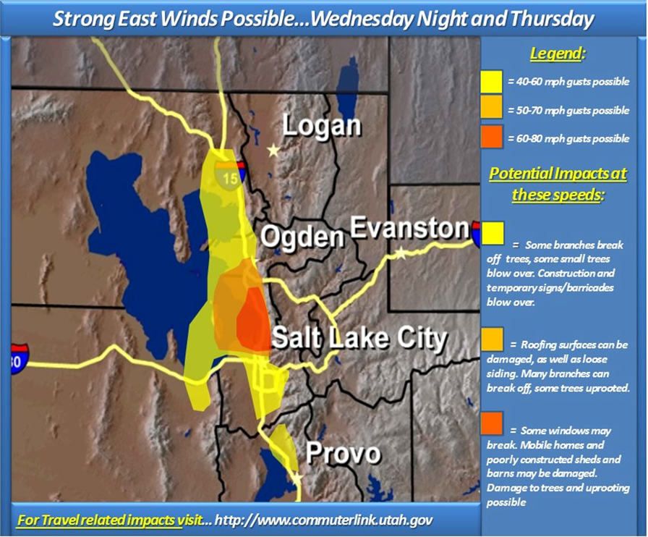
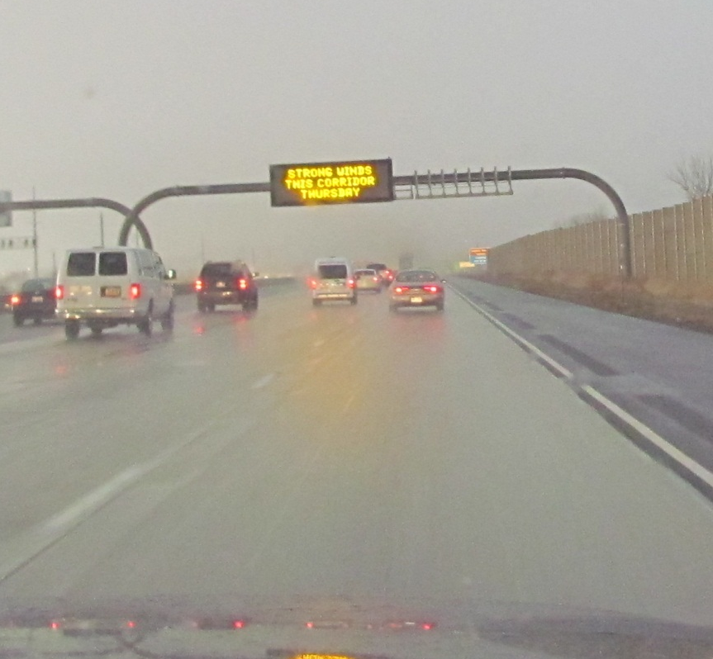
December 1, 2011 Windstorm
Event well forecast and info provided to the public through many sources in advance

Slide 36
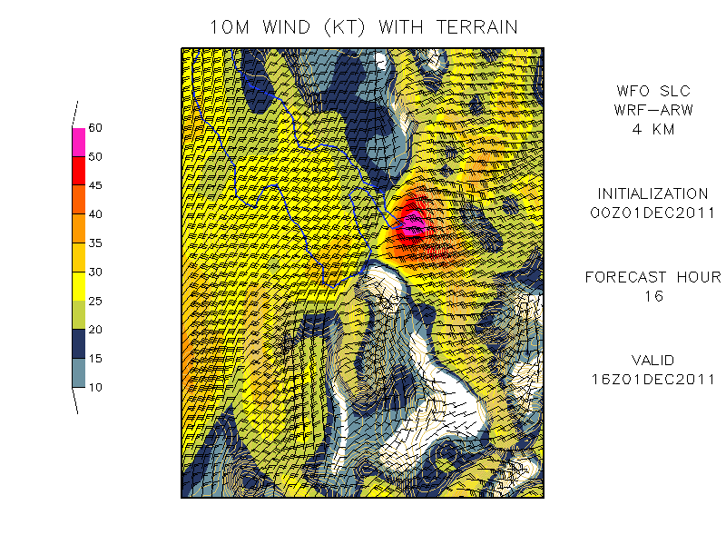
WFO SLC WRF Forecast

Slide 37
Reinecke and Durran (2009)
“The sensitivity of downslope wind forecasts to small changes in initial conditions is explored by using 70-member ensemble simulations of two prototypical windstorms observed during the Terrain-Induced Rotor Experiment (T-REX)… neither case suggests that much confidence should be placed in the intensity of downslope winds forecast 12 or more hours in advance.”

Slide 38
Predictability of 1 December 2011 Windstorm?
Predictability low for downslope windstorms past 12 h (Reinecke & Durran 2009)
Small errors in large-scale circulation may limit forecast skill of embedded mesoscale systems more so than large errors on small scales (Durran & Gingrich 2014)
24–48-h deterministic WRF forecasts from SLC WFO
Timing
Intensity
Location
Westward extent
Up to 90 h (AFD):
Strong winds possible
Confidence from model guidance

Slide 39
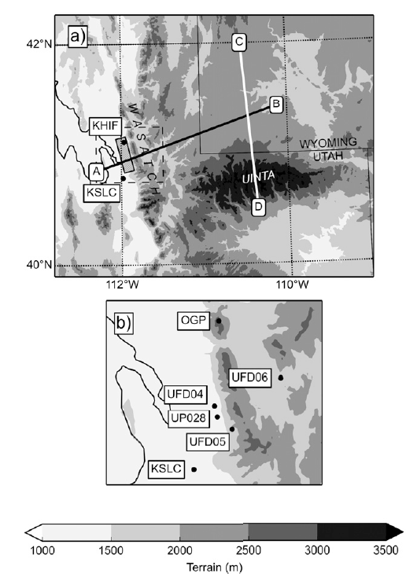

Slide 40
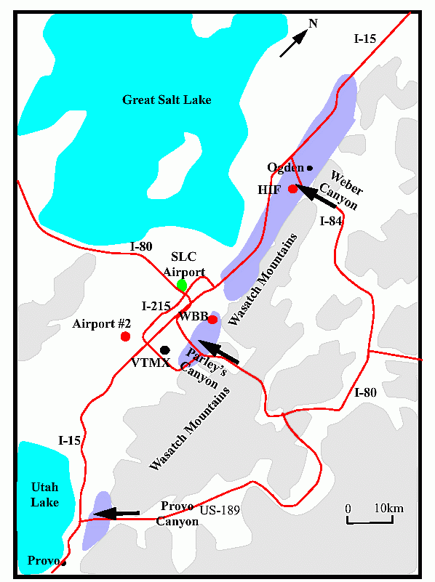
Areas affected by Wasatch downslope windstorms
(Horel et al. 2002, BAMS)

Slide 41
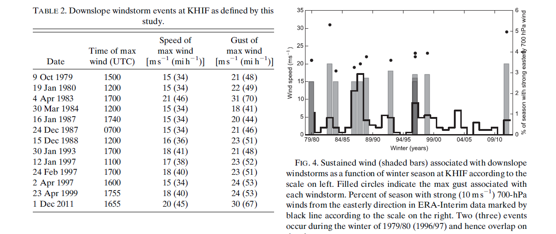
Downslope Climatology

Slide 42
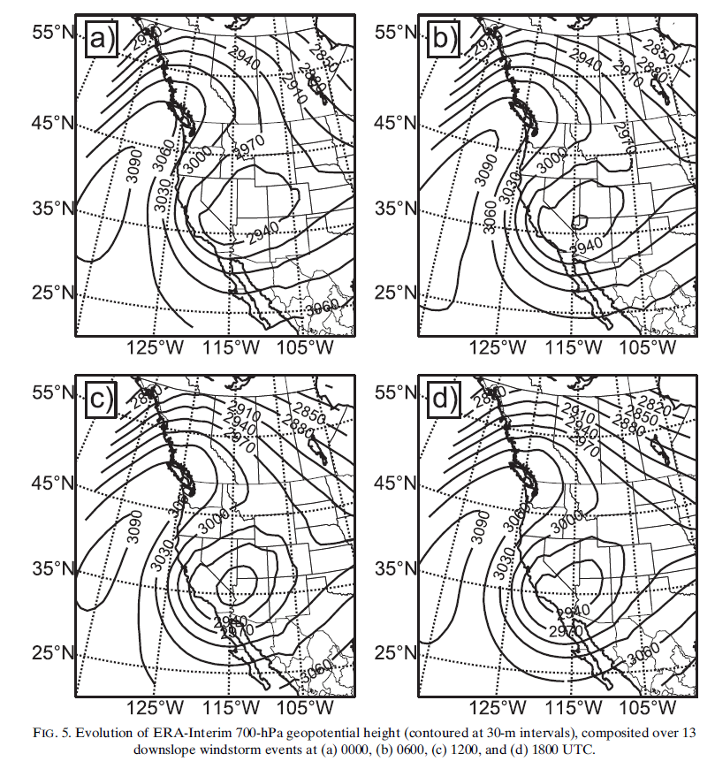

Slide 43
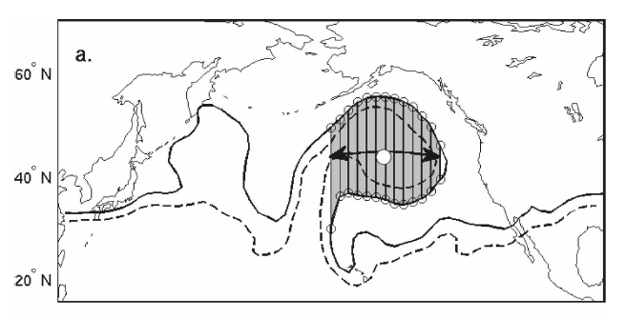
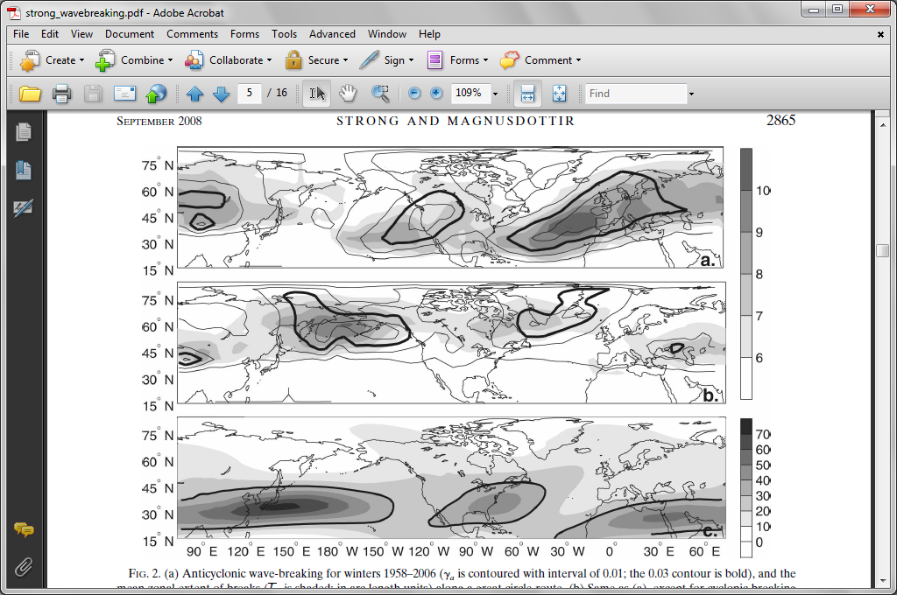
Anticyclonic Rossby wave breaking events

Slide 44
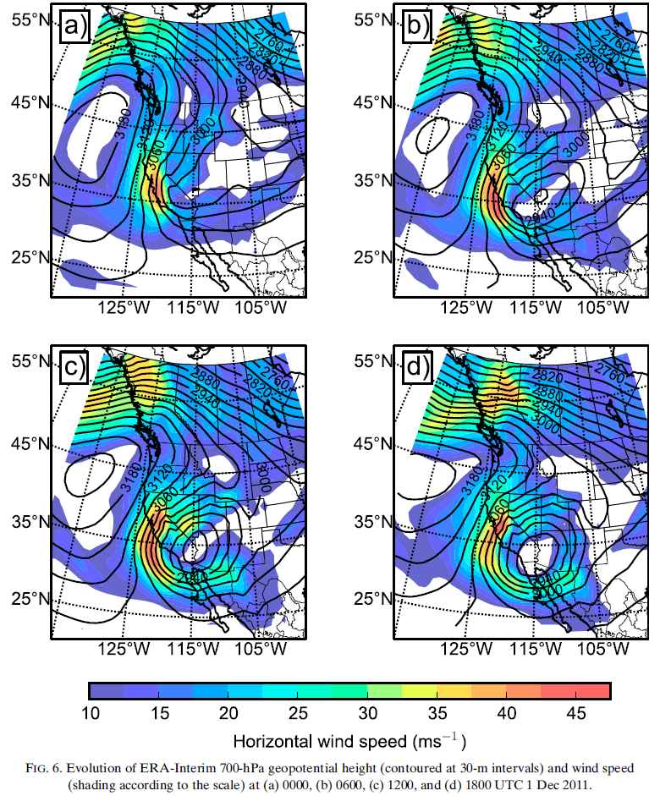
1 December 2011

Slide 45
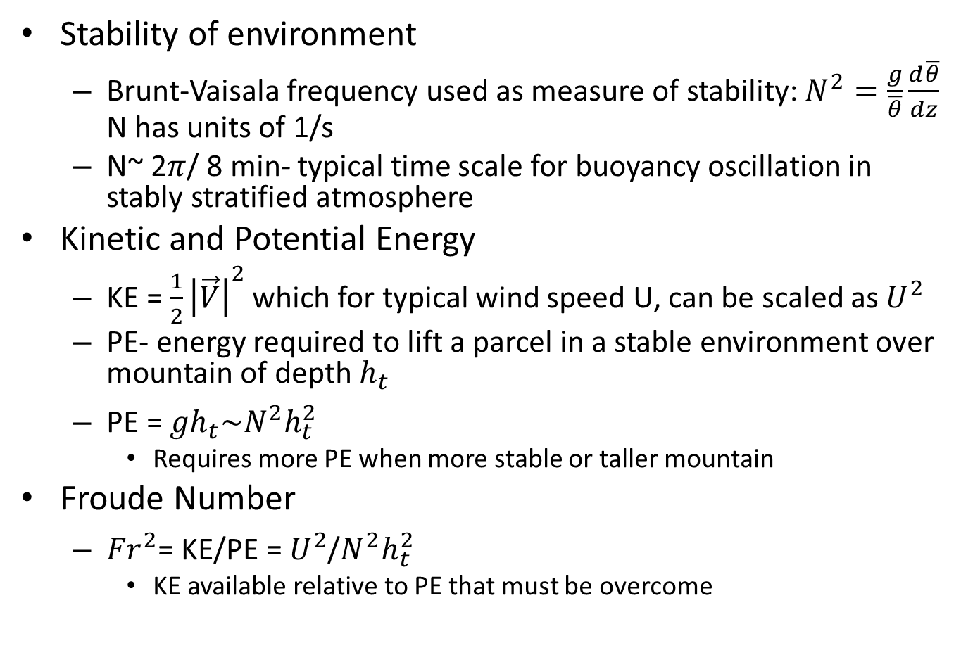
What is Important?
Stability of environment
  Brunt-Vaisala frequency used as measure of stability: $N^{2}=\frac{g}{\overline{θ}}\frac{d\overline{θ}}{dz}$ N has units of 1/s
  N~ 2$π$/ 8 min- typical time scale for buoyancy oscillation in stably stratified atmosphere
Kinetic and Potential Energy
  KE = ${\frac{1}{2}\left|\vec{V}\right|}^{2}$ which for typical wind speed U, can be scaled as $U^{2}$
  PE- energy required to lift a parcel in a stable environment over mountain of depth $h_{t}$
  PE = ${gh}_{t}\sim N^{2}{h_{t}^{2}}^{}$
    Requires more PE when more stable or taller mountain
Froude Number
  ${Fr}^{2}$= KE/PE = $U^{2}$/$N^{2}{h_{t}^{2}}^{}$
    KE available relative to PE that must be overcome

Slide 46
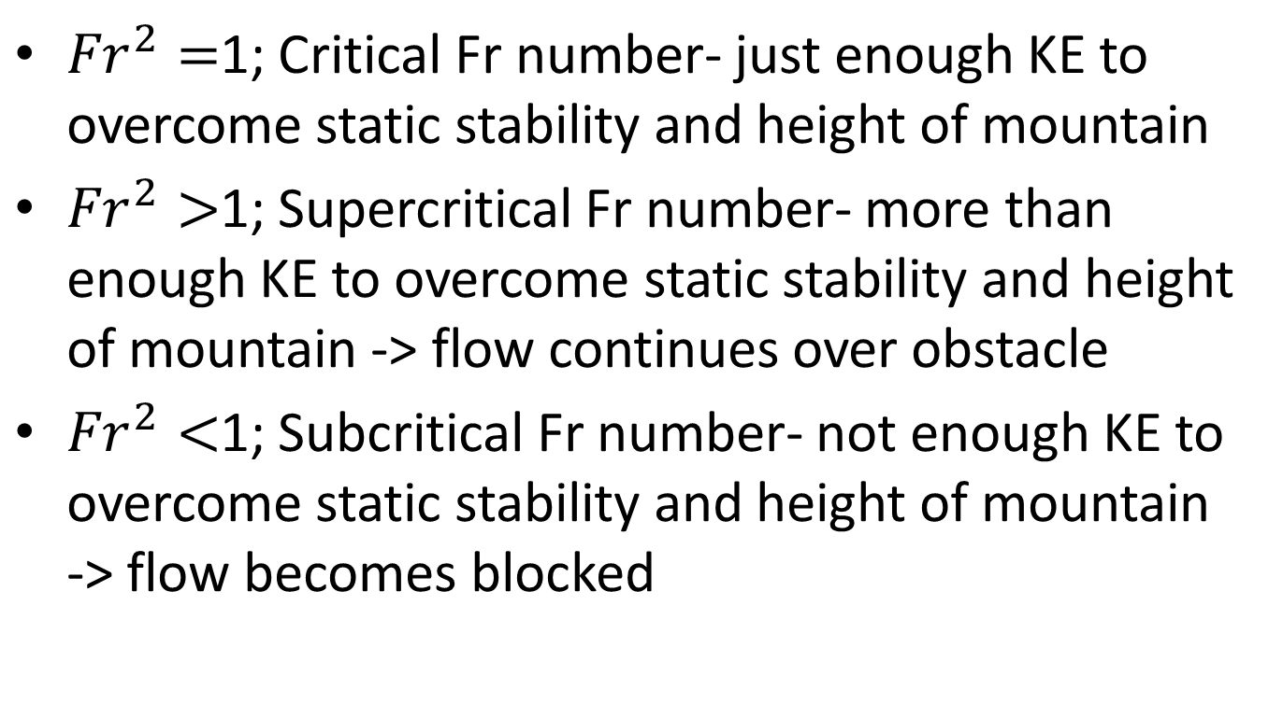

${Fr}^{2}$= KE/PE = $U^{2}$/$N^{2}{h_{t}^{}}^{2}$
${Fr}^{2}=$1; Critical Fr number- just enough KE to overcome static stability and height of mountain
${Fr}^{2}>$1; Supercritical Fr number- more than enough KE to overcome static stability and height of mountain -> flow continues over obstacle
${Fr}^{2}<$1; Subcritical Fr number- not enough KE to overcome static stability and height of mountain -> flow becomes blocked

Slide 47
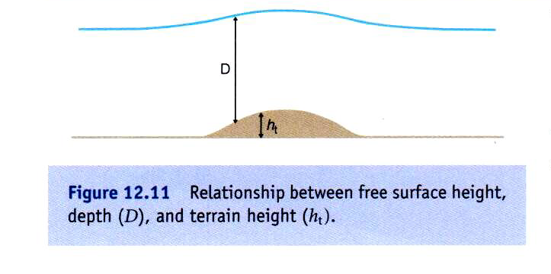
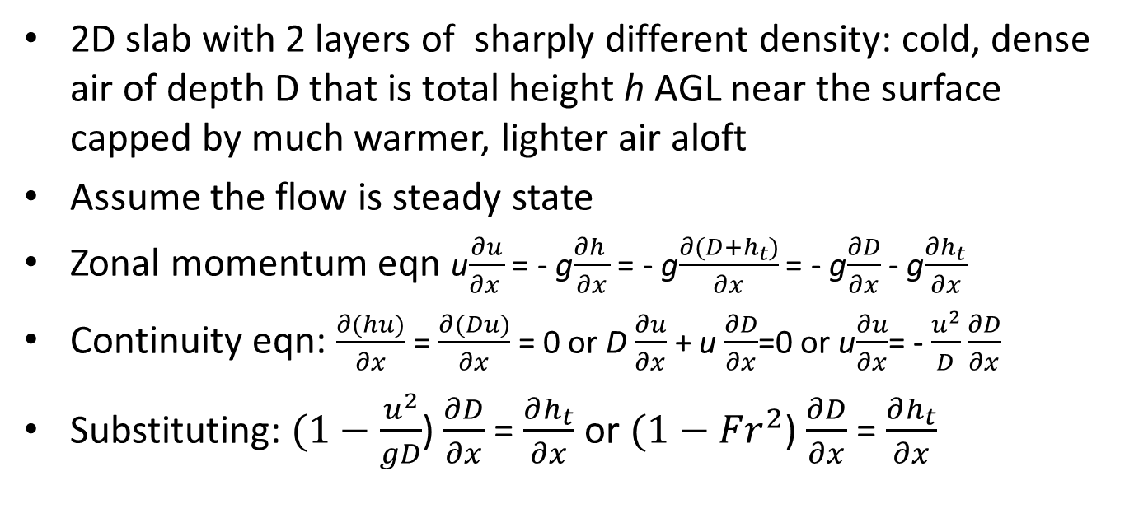
Shallow water approximation
2D slab with 2 layers of sharply different density: cold, dense air of depth D that is total height h AGL near the surface capped by much warmer, lighter air aloft
Assume the flow is steady state
Zonal momentum eqn u$\frac{∂u}{∂x }$ = - g$\frac{∂h }{∂x}$ = - g$\frac{∂(D+h_{t})}{∂x}$ = - g$\frac{∂D}{∂x}$ - g$\frac{∂h_{t}}{∂x}$
Continuity eqn: $\frac{∂(hu)}{∂x}$ = $\frac{∂(Du)}{∂x}$ = 0 or D $\frac{∂u}{∂x}$ + u $\frac{∂D}{∂x}$=0 or u$\frac{∂u}{∂x}$= - $\frac{u^{2}}{D}\frac{∂D}{∂x}$
Substituting: $(1−\frac{u^{2}}{gD}$) $\frac{∂D}{∂x}$ = $\frac{∂h_{t}}{∂x}$ or $(1−{Fr}^{2}$) $\frac{∂D}{∂x}$ = $\frac{∂h_{t}}{∂x}$

Slide 48
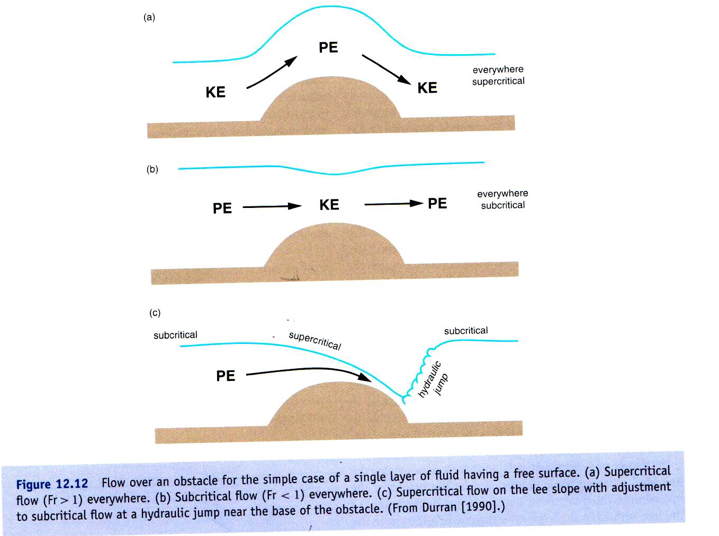

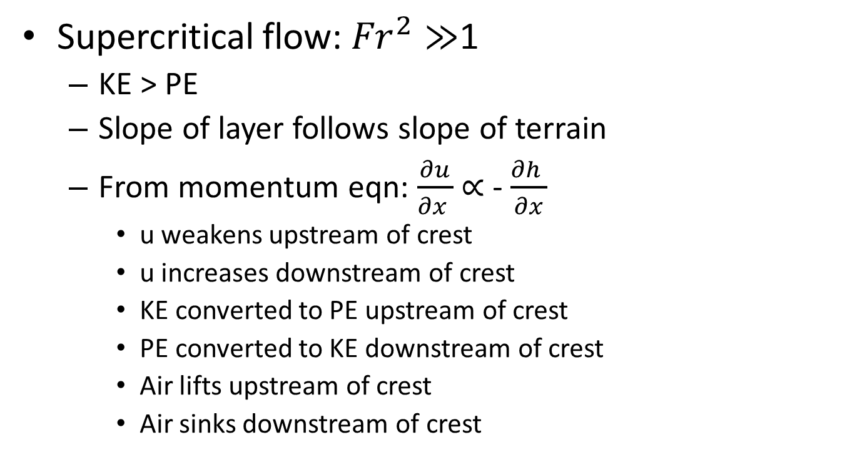
$(1−{Fr}^{2}$) $\frac{∂D}{∂x}$ = - $\frac{∂h_{t}}{∂x}$
Supercritical flow: ${Fr}^{2}≫$1
  KE > PE
  Slope of layer follows slope of terrain
  From momentum eqn: $\frac{∂u}{∂x }$ $∝$ - $\frac{∂h }{∂x}$
    u weakens upstream of crest
    u increases downstream of crest
    KE converted to PE upstream of crest
    PE converted to KE downstream of crest
    Air lifts upstream of crest
    Air sinks downstream of crest

Slide 49
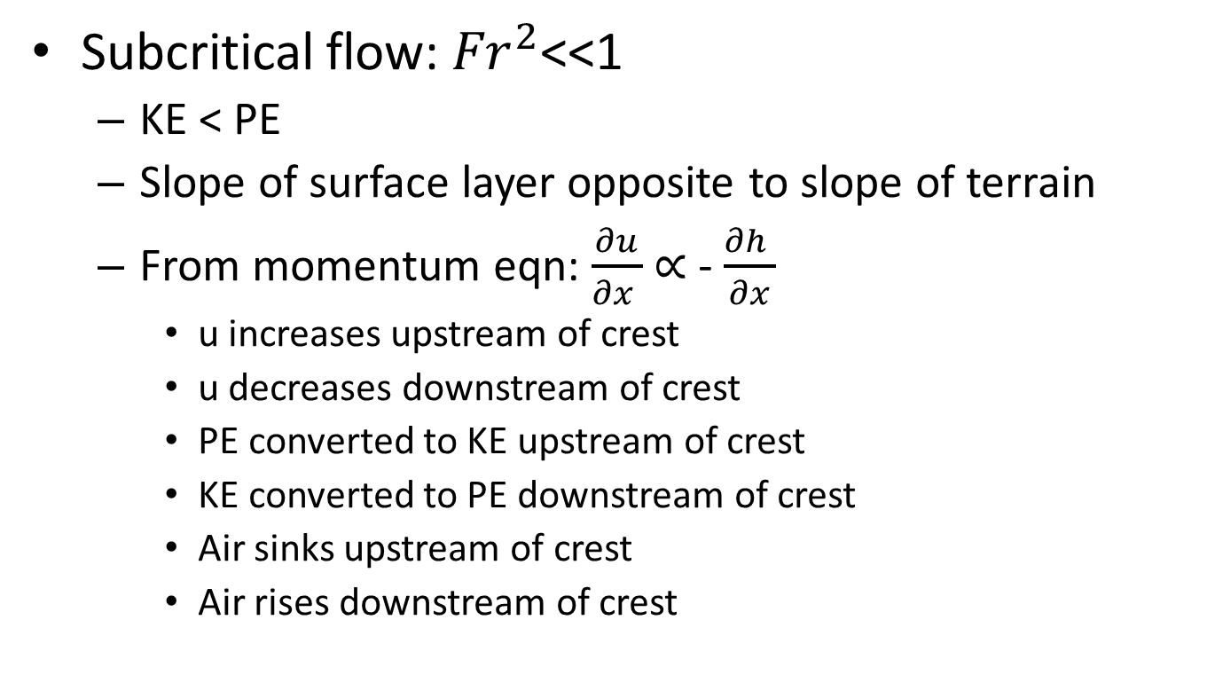
$(1−{Fr}^{2}$) $\frac{∂D}{∂x}$ = - $\frac{∂h_{t}}{∂x}$
Subcritical flow: ${Fr}^{2}$<<1
  KE < PE
  Slope of surface layer opposite to slope of terrain
  From momentum eqn: $\frac{∂u}{∂x }$ $∝$ - $\frac{∂h }{∂x}$
    u increases upstream of crest
    u decreases downstream of crest
    PE converted to KE upstream of crest
    KE converted to PE downstream of crest
    Air sinks upstream of crest
    Air rises downstream of crest

Slide 50
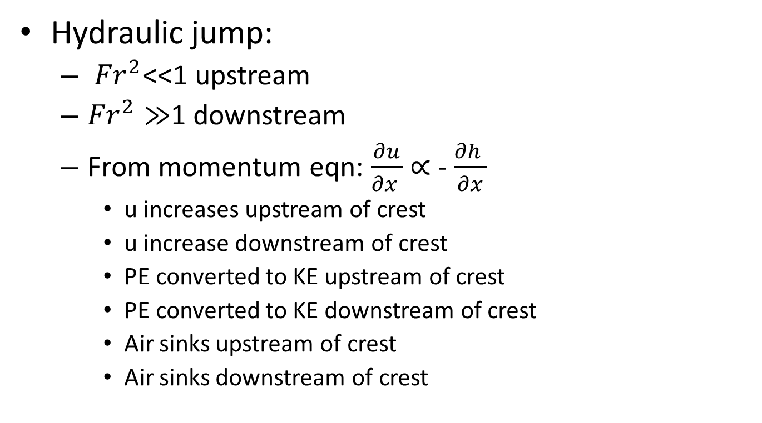
$(1−{Fr}^{2}$) $\frac{∂D}{∂x}$ = - $\frac{∂h_{t}}{∂x}$
Hydraulic jump:
  ${Fr}^{2}$<<1 upstream
  ${Fr}^{2}≫$1 downstream
  From momentum eqn: $\frac{∂u}{∂x }$ $∝$ - $\frac{∂h }{∂x}$
    u increases upstream of crest
    u increase downstream of crest
    PE converted to KE upstream of crest
    PE converted to KE downstream of crest
    Air sinks upstream of crest
    Air sinks downstream of crest

Slide 51
Other factors
Analogy to shallow water theory is most appropriate when there is a well-defined stable layer above crest level
Linear wave theory suggests vertically propagating gravity waves become trapped if cross-barrier flow becomes very weak in layer above crest level
Froude number is a notoriously poor metric for evaluating actual cases (Reinecke and Durran 2008)

Slide 52
Hydraulic Jump Conceptual Model for Wasatch
1.3 km
5.8 km

Slide 53
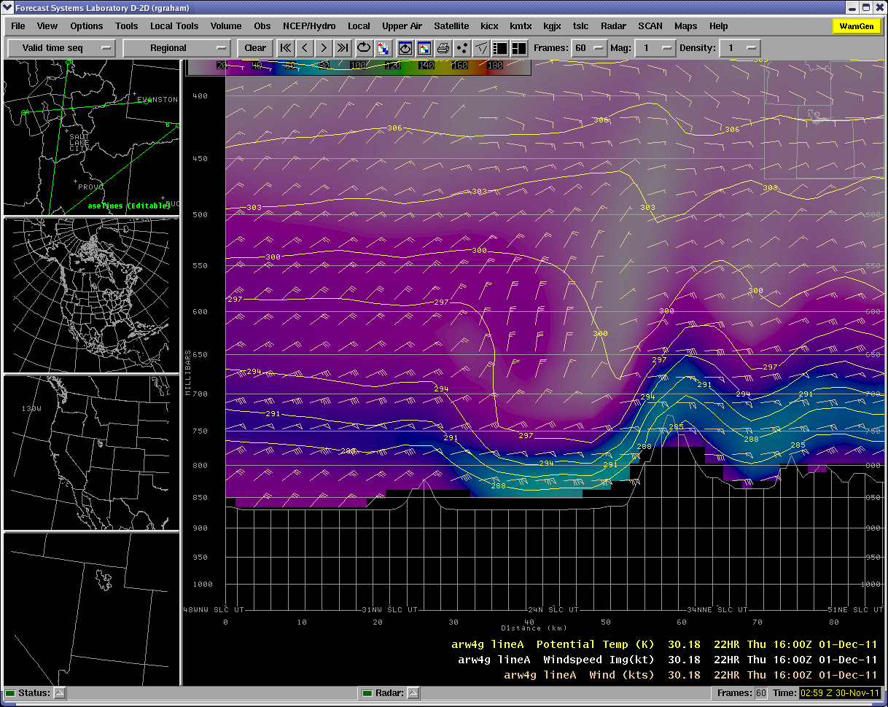
WFO SLC WRF Forecast

Slide 54
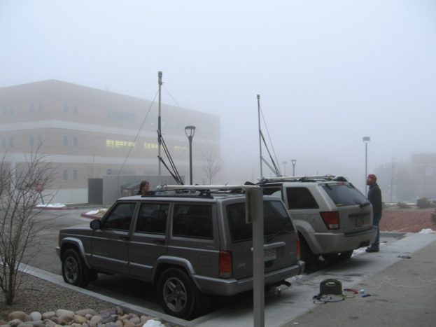



Go Decision
Wed Nov. 30
mobile UDOT station in Fruit Heights added to MesoWest
Prepping mobile units & sondes
deploying 3 surface stations

Slide 55
Defining Science Questions Before the Event
What is spatial and temporal variability of winds in Davis County?
To what extent do wind speeds increase from crest to benches/valley floor?
What is the predictability of mesoscale timing and location of damaging winds?

Slide 56




Slide 57
NWS SLC Storm Summary
Significant winter storm with damaging downslope winds in northern Utah and heavy snow and strong winds across area of central & southern Utah
Areas hit the hardest by the winds were Davis & Weber Counties
Gusts over 100 mph in Centerville and over 90 mph gusts occurred in West Bountiful
Three injuries reported at Weber State University
Thousands of trees (pines predominantly) uprooted along the Wasatch Front, including 400 at Kaysville golf course
Overturned 11 semi-tractor trailers, damaged fences, removed shingles and siding, blew windows out of parked cars, tossed around large trampolines, bent or destroyed large road signs and light poles, and downed power lines
Downed power lines led to road closures, 3 homes catching fire, and 50,000 homes without power for up to 3 days
Damage estimates in Centerville alone ~8 million dollars
Overall damage estimated at over 20 million dollars

Slide 58
Interesting Characteristics of Event
“Upstream” sounding was “downstream” of upstream ranges
Northward shift in timing and location of damaging surface winds
Damage- impact of sound walls
Sonde ascent through downstream rotor

Slide 59


Slide 60

Vector 30 m/s
MesoWest
Mobile 1
Mobile 2

Slide 61

Vector 30 m/s
MesoWest
Mobile 1
Mobile 2

Slide 62

Vector 30 m/s
MesoWest
Mobile 1
Mobile 2

Slide 63


Centerville: 102 mph gust

Slide 64



Slide 65



Slide 66


Slide 67


Slide 68


Slide 69


Slide 70




Slide 71

Mouth of Weber Canyon
Utah Wind Energy Tall Tower

Slide 72

Wind Speed: Mouth of Weber Tall Tower
Red/Purple- 50 m
Blue- 30m
Black- 10m
Green- 3m
Solid- 10 min ave
Dashed- Peak
m/s
Brandon Malman. SLCC
Dec 1: UTC

Slide 73


Slide 74

“upstream”
“downstream”

Slide 75


Slide 76

Rotor Clouds

Slide 77

Rotor clouds

Slide 78


Rotor clouds
Doyle and Durran 2007 (JAS)
Wndstrm_12012011_long.mov (Dave Whiteman)
307
308
Hertenstein 2010 (JAS)

Slide 79

Stab at what was happening
1.3 km
5.8 km

Slide 80
Summary
Rarity of strong downslope wind events tied to infrequent “correct” alignment of large-scale AC Rossby wave breaking events?
Small flow acceleration downstream of crest
Rare sonde ascent through strong rotor
Engineering standards for signs should be enforced

Slide 81
Final Points
Deterministic WRF mesoscale forecasts tend to have high false alarm rate for Wasatch windstorms
WRF ensembles generated from GEFS/R2 hindcasts captured synoptic-scale circulation and tendency for downslope windstorms at lead times up to ~100 h
WRF ensembles exhibit low uncertainty upstream and high uncertainty downstream of Wasatch Front
Even if GEFS/R2 10 member ensembles are underdispersive, tendency for higher certainty in breaking Rossby waves may limit error growth in Wasatch region

